Slide 1
NOTE FOR FACILITATORS
This is set of sample slides for Mental Health and Psychosocial Support in Emergencies training. Facilitators will need to review and modify these slides in line with their training needs.
The training manual and training materials can be found at pscentre.org

Slide 2
Mental health and psychosocial support in emergencies

Slide 3
Training modules
Module 1: Mental health and psychosocial impacts of emergencies
Module 2: Responding to MHPSS needs
Module 3: MHPSS assessment and coordination in emergencies
Module 4: MHPSS approaches and interventions in emergencies
Module 5: Preparedness for MHPSS responses

Slide 4
Buddy systems
Before: Are you ready?
During: Check in
After: Cool down

Slide 5
Buddy check in: Before
The focus for your first check in is on getting ready for the day, task, shift or mission.
Check in questions
Making an inventory of how things are here and now | How are you today? Did you sleep well? How was your trip here? Etc…
Worries or concerns that should be handled or parked | Is there anything that prevents you from being fully mentally present today? Do you have any worries, reservations or resistance against the day, task, shift or mission? Is there anything at home or outside what you are to do, that you are thinking about, need to do or maybe mentally park aside before we begin today?
Preparing for the task | What do you think will be the tasks today? Is there anything you can do to prepare? What can you do to get the most out of the work today?
Needs for support and when to check in | Do you need any support from me for today? When should we check in with one another?

Slide 6
Buddy check in: During
The questions focus on how the buddy is doing, how the buddy is dealing with the situation.
Check in questions
How are you doing? Are you hydrated, did you eat, and have you had breaks? What has happened until now? Should anything have happened: Do you want to tell me what happened now or maybe later?

Slide 7
Buddy check in: After
The question focus on how the buddy has been doing, which challenges arose and how to change to an after work mode.
Check in questions
How was the day? Are you ready to move on and finish the shift/session? What would you like to do now? Anything else you should or can do to cool down? Any self-care plans for the rest of the day?

Slide 8
+ & -
On post it notes write your plusses and minuses for the day.
You can write as many as you like.
  Plus: What went well? What did you like about the training today?
  Minus: What could be changed? What could we improve?

Slide 9
Module 1:
Mental health and psychosocial impacts of emergencies

Slide 10
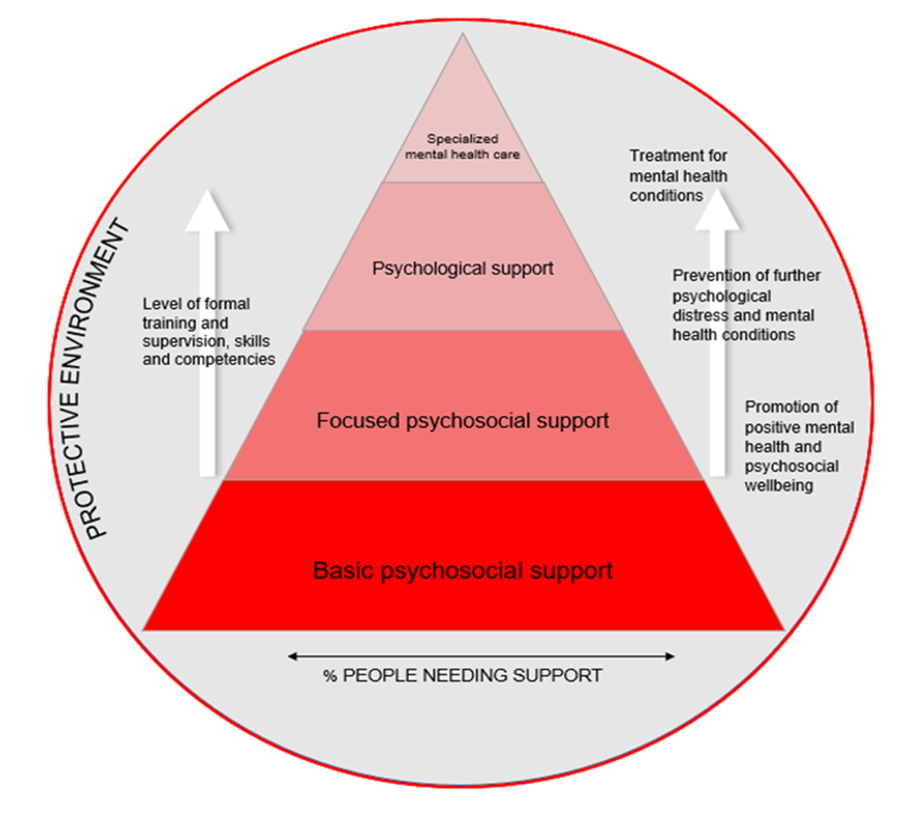

Slide 11
Quiz
“On average, 24% of people affected by disasters will develop clinically significant post-traumatic stress syndrome (PTSS) in the first six months following exposure, 28% will develop depressive symptoms, and 23% will develop anxiety.”
Newnham, E. A., Mergelsberg, E. L. P., Chen, Y., Kim, Y., Gibbs, L., Dzidic, P. L., DaSilva, M. I., Chan, E. Y. Y., Shimomura, K., Narita, Z., Huang, Z., & Leaning, J. (2022). Long term mental health trajectories after disasters and pandemics: A multilingual systematic review of prevalence, risk and protective factors. Clinical Psychology Review, vol.97.
Notes:
The first multilingual systematic review of its kind, it finds that mental health rates showed a gradual improvement over time, but trajectories varied by disorder. Prevalence of PTSS significantly improved in the years following exposure, and the trajectory of recovery did not differ by age.
However, prevalence of depression and anxiety symptoms remained elevated for years following disasters, and children and adolescents reported significantly higher rates compared to adults both right after the disaster as well as years afterwards.

Slide 12
Quiz
Human rights and equity
Participation
Do no harm
Building on available resources and capacities
Integrated support systems
Multi-layered supports

Slide 13
Quiz
Safety
Calm
Connectedness
Self/collective efficacy
Hope

Slide 14
Quiz
Core principle 5: Integrated support systems
Activities and programming should be integrated as far as possible. The proliferation of stand-alone services, such as those dealing only with rape survivors or only with people with a specific diagnosis, such as PTSD, can create a highly fragmented care system.
Inter-Agency Standing Committee (IASC) (2007). IASC Guidelines on Mental Health and Psychosocial Support in Emergency Settings. Geneva: IASC.

Slide 15
Quiz
“Among people who have experienced war or other conflict in the previous 10 years, one in five (22%) will have depression, anxiety, post-traumatic stress disorder, bipolar disorder or schizophrenia”1
“On average, 24% of people affected by disasters will develop clinically significant PTSS in the first six months following exposure, 28% will develop depressive symptoms, and 23% will develop anxiety. For adults, PTSS demonstrated a gradual improvement, and depression and anxiety symptoms remained stable in the months and years following exposure”2
1 Charlson, F., van Ommeren, M., Flaxman, A., Cornett, J., Whiteford, H., & Saxena, S. (2019). New WHO prevalence estimates of mental disorders in
conflict settings: a systematic review and meta-analysis. The Lancet, vol.394, pp240-248.
2 Newnham, E. A., Mergelsberg, E. L. P., Chen, Y., Kim, Y., Gibbs, L., Dzidic, P. L., DaSilva, M. I., Chan, E. Y. Y., Shimomura, K., Narita, Z., Huang, Z., & Leaning, J. (2022). Long term mental health trajectories after disasters and pandemics: A multilingual systematic review of prevalence, risk and protective factors. Clinical Psychology Review, vol.97.
Notes:
Long term mental health trajectories after disasters and pandemics: A multilingual systematic review of prevalence, risk and protective factors. Clinical Psychology Review, vol.97

Slide 16
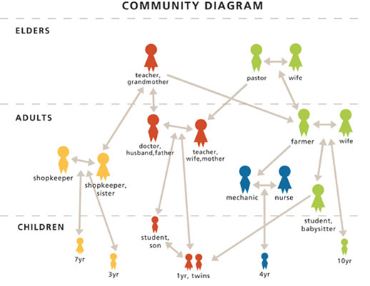

Slide 17
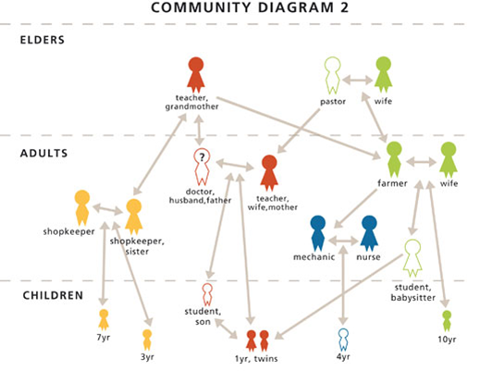

Slide 18
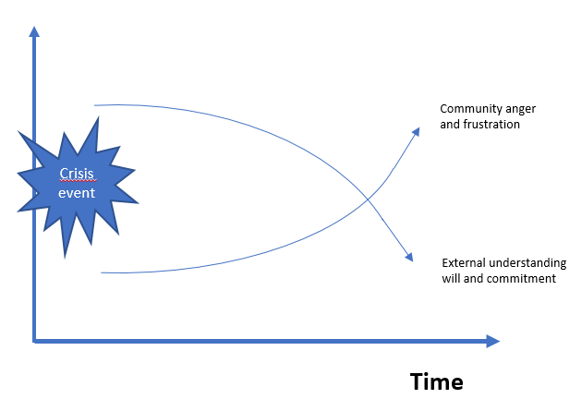

Slide 19
Discussion
How will the children be cared for?
Where will people get medical care?
What will the family do for income if the father is gone?
How will the community bury its dead if the elders and the religious leader are gone?
Who will teach the cultural traditions?
Who are the resource people in the community?

Slide 20
Reactions change
TIME
Days and weeks after
Weeks and months after
Years after the event

Slide 21
Reactions change
TIME
Bonnano at al. (2008, 2018) have described four prototypical patterns of psychological adjustment 2 years after an event:
Chronic disruption or chronicity
Delayed disruption,
Recovery
Resilience

Slide 22
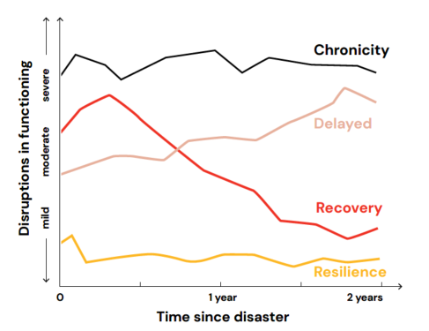
Common trajectories after distressful reactions

Slide 23
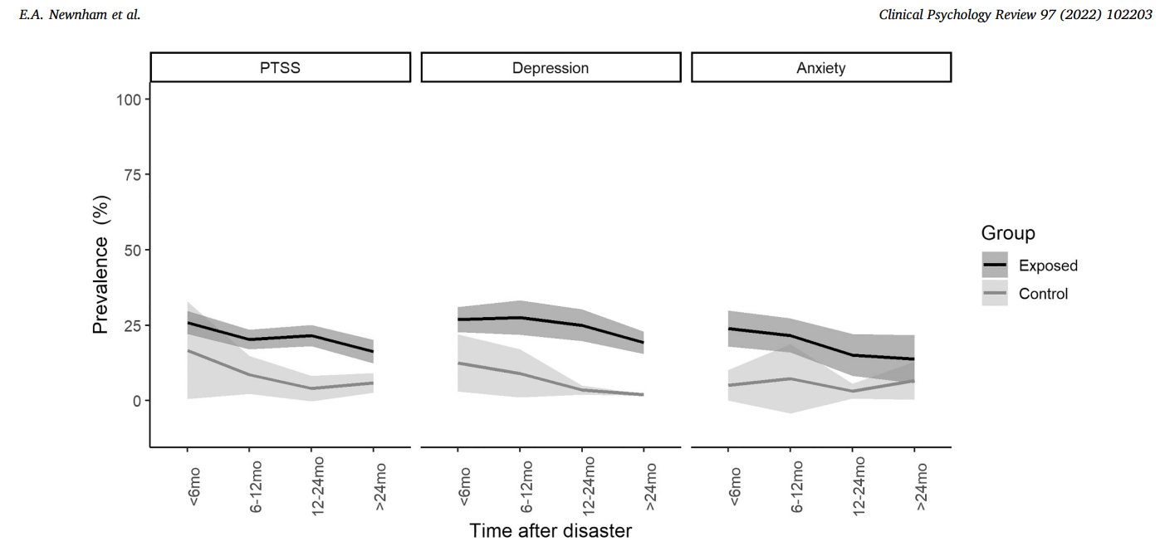
But what are the MH conditions?

Slide 24
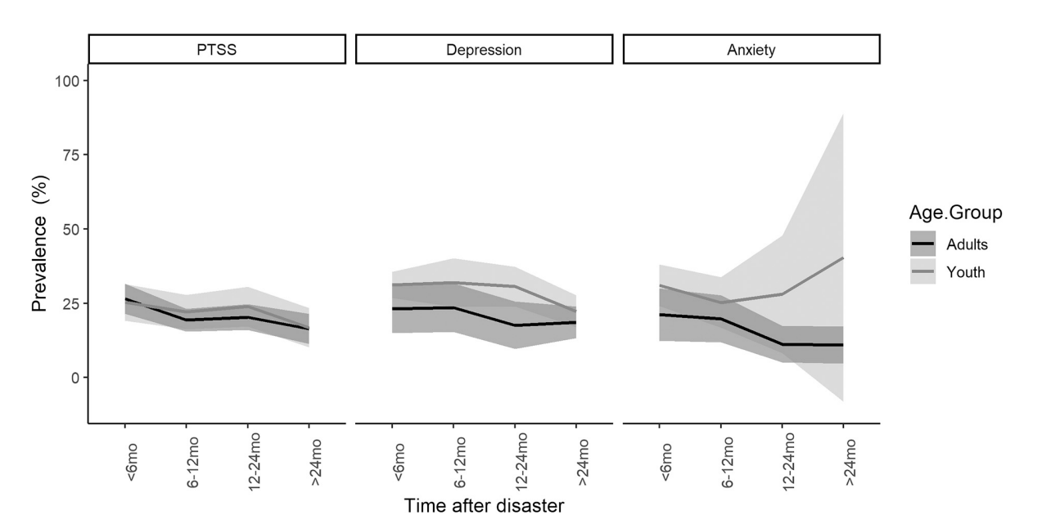
And is it the same for all?

Slide 25
So we are talking about the risk and protective factors in MHPSS
Degree of exposure to the event
The perceived severity of the event and the degree of suffering
If it is a single stressful event or multiple stressors during long time
Pre-existing vulnerabilities
Pre-existing mental conditions
Past experiences
Physical health
Financial resources
Access to resources
Social network such as family/friends as well as perceived social support
Personality and temper
Age

Slide 26
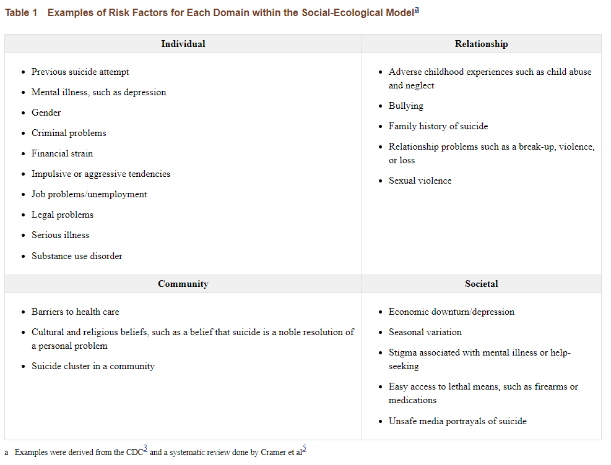
So we are talking about the risk and protective factors in MHPSS

Slide 27
Different losses
There are many types of losses
  destruction of property
  loss of livelihood
  loss of dignity
  loss of self-esteem
  loss of trust
  loss of hope
  the ending of an important relationship
  physical injury, loss of mobility
  loss of security
  loss of social networks.
  loss of honour
  the death of a significant other

Slide 28
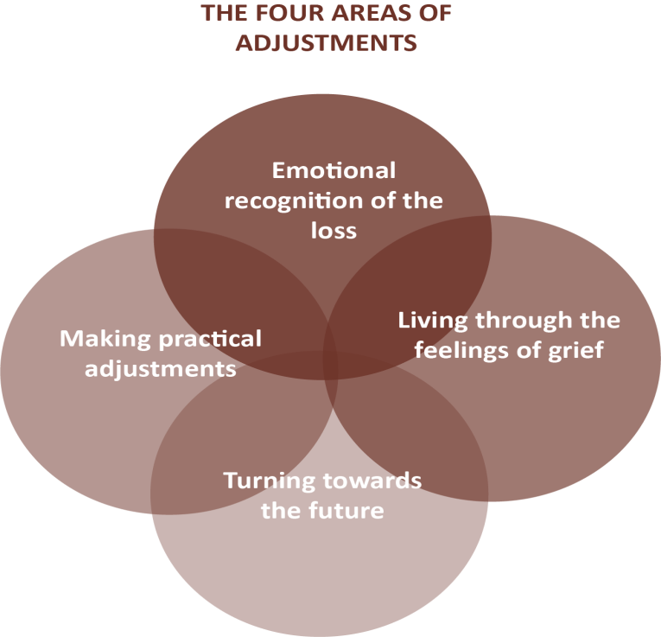
The grieving process

Slide 29
Different losses
The theory of ambiguous loss has been a watershed in the ICRC's efforts to develop its support for the families of missing persons.
It has helped us understand the uniqueness of their situation and cultivate a much broader perspective than that of the trauma-centred and grief theories that were previously predominant in our work.
The guidelines laid out by Pauline Boss in 2006: addressing the psychological and social problems that families are facing, even while they still lack answers.

Slide 30
Q&As
-

Slide 31
Caring for staff and volunteers
  Discuss in your groups:
  What are sources of stress / risks to volunteer wellbeing?
  How might you identify signs of stress in volunteers?

Slide 32
Self care in emergencies
With your buddy:
  What do you do to keep yourself healthy on a daily basis?
  What resources do you use, especially when times are tough?

Slide 33
Module 2:
Responding to MHPSS needs

Slide 34
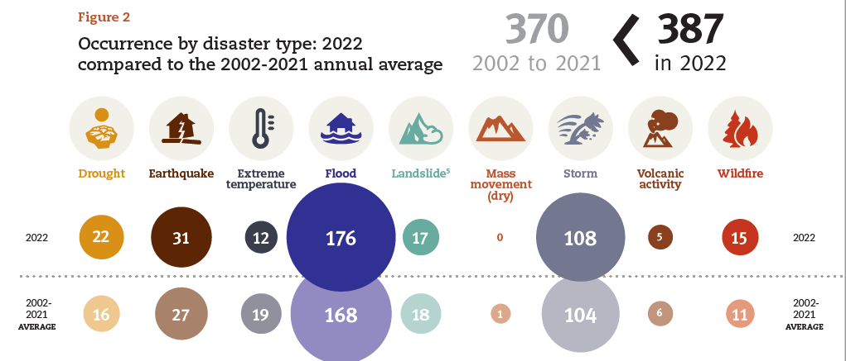
Source: Emergency Event Database, 2022 Disasters in numbers

Slide 35
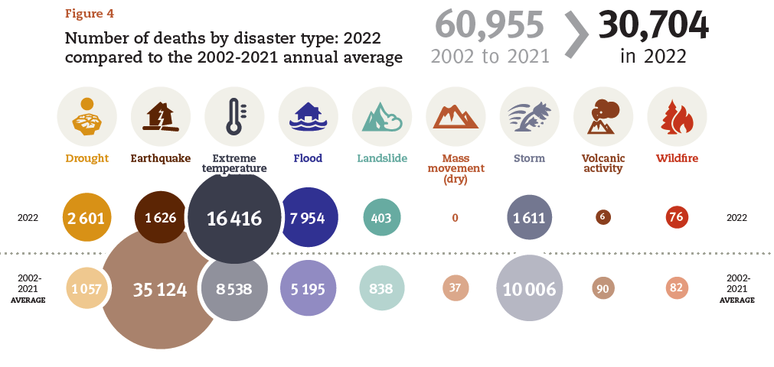
Source: Emergency Event Database, 2022 Disasters in numbers

Slide 36
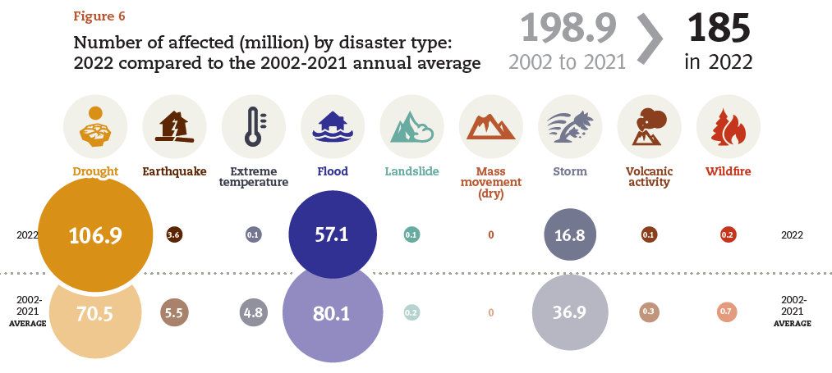
Source: Emergency Event Database, 2022 Disasters in numbers

Slide 37
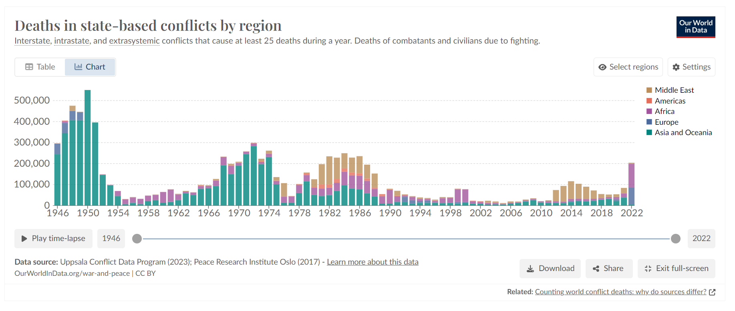

Slide 38
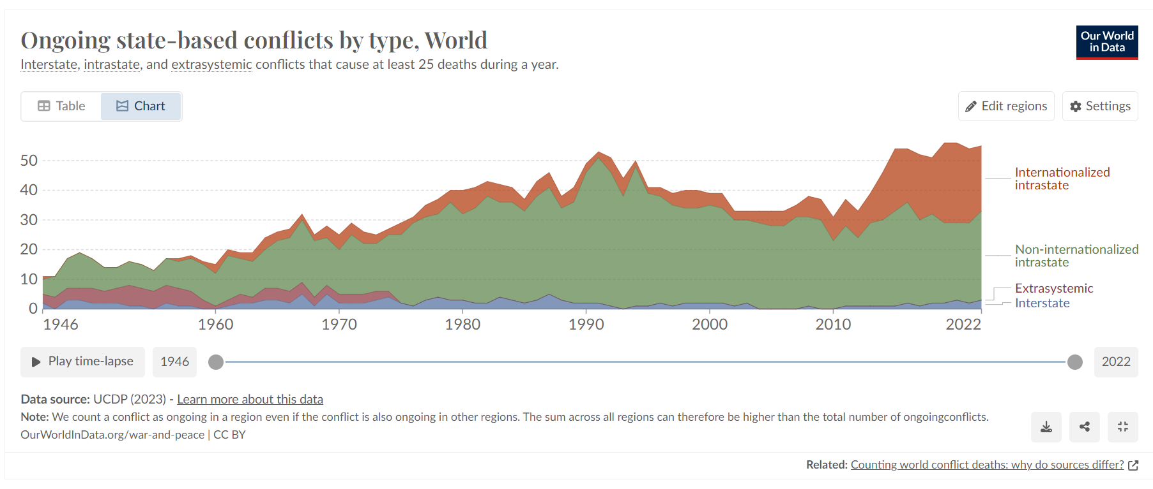

Slide 39
What is protection?
Protection is a broad term as the the IASC definition of Protection also illustrates:
  “all activities aimed at ensuring full respect for the rights of the individual in accordance with human rights law, international humanitarian law (which applies in situations of armed conflict) and refugee law”

Slide 40
Variables that increase protection risks in emergencies
the collapse of protective systems; (explain what they are as police, rescue services, local authorities and local protection services and institutions, army, and armed forces)
crowded and insecure environments
a stress-filled context
separation of family members
gender and age-based inequalities and discrimination
social isolation and exclusion
harmful use of alcohol and other substances
income inequality.
pre-existing vulnerabilities such as domestic violence, child abuse
misuse of power

Slide 41
Protection in relation to gender based violence
Providing lighting around shared sanitation blocks in a temporary shelter for displaced persons to reduce opportunity for attacks;
Establishing safe spaces for individuals at risk of GBV;
Conducting behaviour-change programming to reduce stigma for survivors of GBV and/or combat public apathy or acceptance of behaviours such as intimate-partner violence;
Advocating for stronger laws in relation to GBV;
Establishing referral systems to medical, legal and psychosocial support for survivors of GBV
Providing psychosocial training to non-specialist personnel likely to come into contact with survivors of GBV

Slide 42
Minimum standards for protection, gender and inclusion in emergencies
Dignity
Access
Participation
Safety

Slide 43
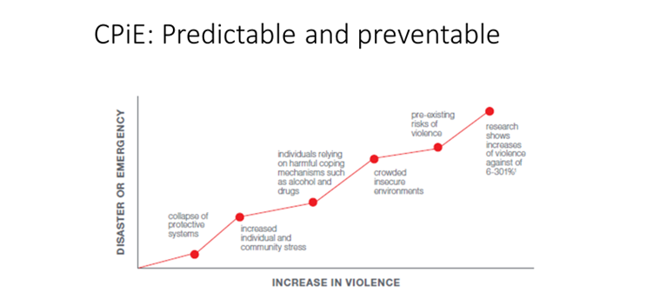
Child protection in emergencies

Slide 44
RCRC Movement MHPSS policy statements
Ensure impartial access to mental health and psychosocial support and prioritize prevention and early response
Ensure comprehensive and integrated support and care for people with mental health and psychosocial needs
Recognize the resilience, participation and diversity of people in all mental health and psychosocial activities
Ensure protection of safety, dignity and rights
Address stigma, exclusion and discrimination
Implement and contribute to the development of interventions based on mental health and psychosocial support standards and practices that are internationally recognized and informed by evidence
Protect the mental health and psychosocial wellbeing of staff and volunteers
Develop mental health and psychosocial support capacity

Slide 45
RCRC Movement MHPSS policy
In your groups discuss:
  “How, in practice, might you ensure your emergency response activities are in line with the policy? How will you work with partners and other stakeholders?”

Slide 46

Introductory module to the
IASC MHPSS Guidelines
The Reference Group and the MHPSS Humanitarian Response

Slide 47


A timeline of humanitarian coordination
2016 World Humanitarian Summit & The Grand Bargain
2011
Transformative Agenda
2006
Central Emergency response Fund (CERF)
2005
Humanitarian reform
Cluster Approach
1991 UNGA
Inter-Agency Standing Committee (IASC)
Emergency Relief Coordinator (ERC)
Consolidated Appeals Process (CAP)
Notes:
IASC consists of 18 orgs and agencies
Formulate policy, set strategic priorities, and mobilize resources in response to humanitarian crises
Emergency Relief Coordinator chairs the IASC
Central Emergency Response Fund (CERF) managed by ERC. Rapidly releases funds for humanitarian crises. UN member states contribute to the fund. Humanitarian Coordinator requests use of CERF together with the Humanitarian Country Team, identifying critical priorities. Released funds should be spent and activities completed within 6 months of disbursement.
Transformative agenda: A set of actions agreed by the IASC Principals to improve humanitarian response and collective action, including further refining of the cluster approach. This includes a Common Framework for Preparedness, Emergency Response Preparedness, Multi-Sector Initial Rapid Assessment Guidance, protocols for system-wide emergency activation or Sale Up activation (level 3 response), etc.
2016 World Humanitarian Summit and Grand Bargain: Launched during WHS in Istanbul. Agreement between some of the largest donors and humanitarian organizations to "get more means into the hands of people in need and to improve the effectiveness and efficiency of the humanitarian action." Launched as part of efforts to address humanitarian funding gap, ensure more localization and participation of affected communities, efficiency of funding (e.g. increased multi-year funding) etc. Includes 66 signatories (25 member states, 25 NGOs, 12 UN agencies, RCRC movement, two inter governmental orgs). Grand Bargain separate from IASC. https://interagencystandingcommittee.org/node/40190

Slide 48
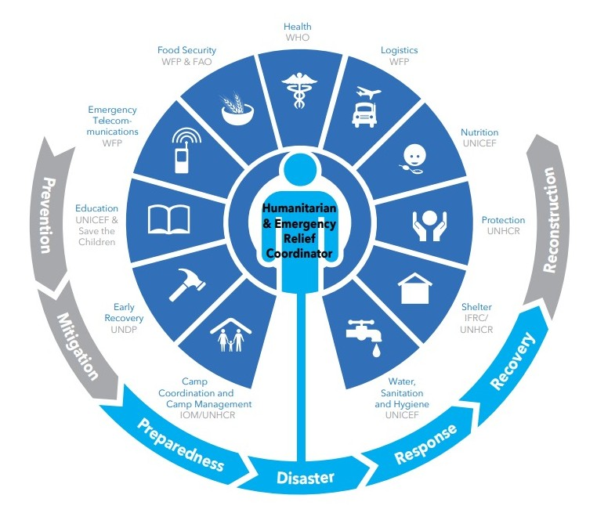



Background MHPSS in Emergencies
2005
Humanitarian Reform
2007
MHPSS Guidelines
2007
IASC MHPSS RG
  Support country-level MHPSS
Country
Global
  MHPSS in global humanitarian structures
Co-Chairs WHO & IFRC
  MHPSS resources and tools
63 members + 31Observers
  MHPSS surge capacity
Notes:
After the tsunami in South-East Asia-reflection
Humanitarian Coordinators to ensure effective leadership, coordination and partnerships
Humanitarian Financing: adequate, timely and flexible In support of local government
Cluster approach: Clusters are groups of humanitarian organizations (UN and non-UN) working in the main sectors of humanitarian action e.g. protection, shelter, health, logistics

Slide 49
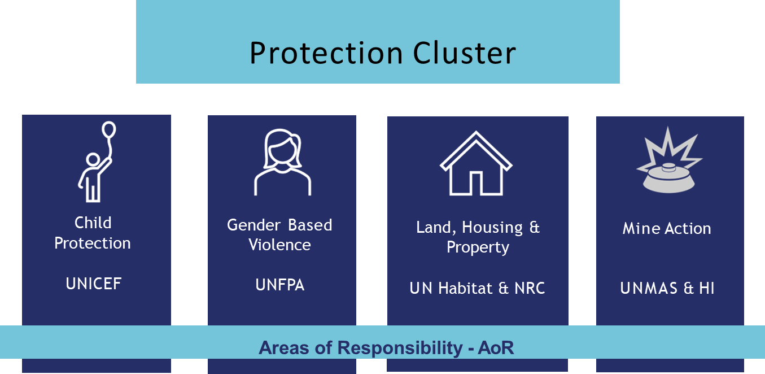
Notes:
Increased transparency and accountability (resource allocation, co- leadership)
Enhanced predictability: clearer responsibilities – provider of last resort.
Engagement with national and local authorities by one or two contact persons
More effective advocacy
Joint strategic and operational planning

Slide 50

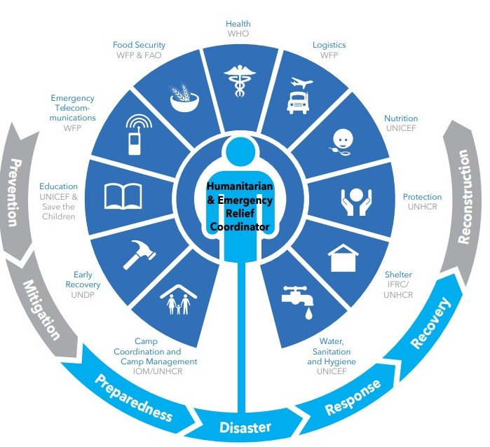





Refugee and mixed settings
Public Health Emergencies
Country- Based
Cluster
Area Based
From humanitarian reform
IASC
Government-OCHA
11 global clusters
HC: Humanitarian Coordinator
CLA: Cluster Lead Agencies
CC: Cluster Coordinator
CM: Cluster Members
Large scale non-refugee
UNHCR
Sectors
Mixed: IDP and Refugee – UNHCR, Government & HC determine best model
International Health Regulations
State capacity
IHR Focal Point
Pillars
Countries with established structures – National Disaster Management Agencies
Few external actors – advisory role
Increasing DRR
Organised around local context: localization
Geographical organisation
Multisectoral
Design through
local participation
Where does MHPSS fit?
What about other cross- cutting issues (e.g., cash-based programming?)
Notes:
In "mixed" context with IDPs, refugee response, etc., UNHCR and OCHA together with the government coordinates the response. UNHCR-OCHA Joint Note on Mixed Situations: coordination in practice (2014)
Area based approach: typically involves: a) targeting of geogr

Slide 51
Clinical
services
Focused (person-to-person) supports
Community and family supports
Strengthening community and family supports
Basic services and security
Social considerations in basic services and security
Notes:
51
Joint Operational Framework between Health and Protection clusters on GBV, Mine Action and MHPSS.

Slide 52
Where do you work if you are…?
Health care & Nutrition
Clinical
services
MHPSS sits uncomfortably in between various sectors.
COORDINATION is important
Child Protection
Focused (person-to-person) supports
Mine Action & community based protection
Community and family supports
GBV
Strengthening community and family supports
Basic services and security
Social considerations in basic services and security
Notes:
52
Joint Operational Framework between Health and Protection clusters on GBV, Mine Action and MHPSS.

Slide 53



Reaching agreement on a model for
MHPSS coordinating in Emergencies
Humanitarian Coordinator / Government leader
Inter-sector Coordination Group
Health sector
Protection sector (with Child Protection, Gender Based Violence and Mine Action AoRs)
Education, Nutrition, CCCM and other sectors
MHPSS Cross-sectoral Working Group
(with focal points in each of the sectors and with accountability in sectors. MHPSS activities to appear as relevant within Appeal chapters, rather than in a separate stand-alone Appeal chapter)

Slide 54
Mental Health and Psychosocial Support (MHPSS)
  Umbrella term used in humanitarian and emergency contexts for mental health and psychosocial interventions that includes any support which people receive to protect and promote their well-being and prevent and treat mental health conditions

Slide 55
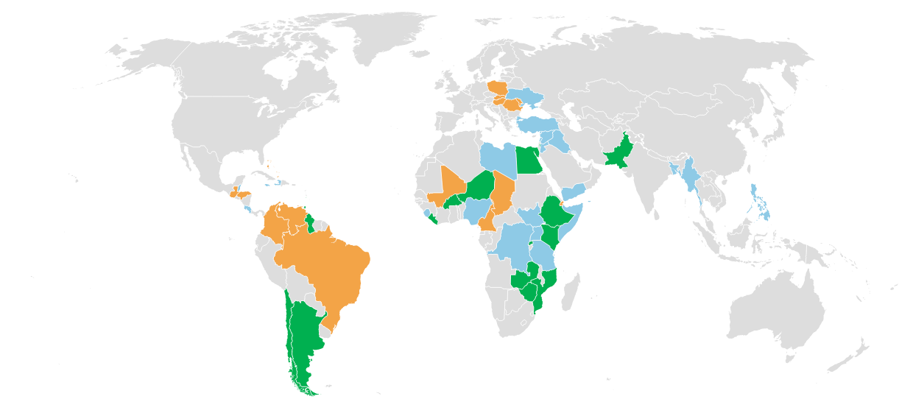
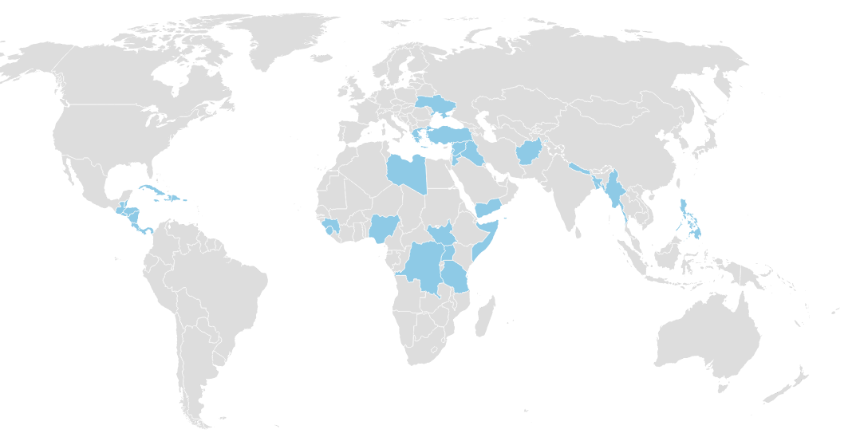
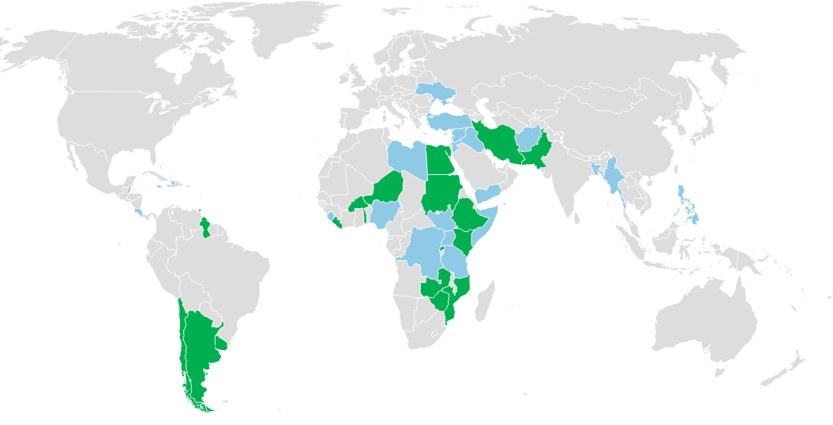

2021
MHPSS Technical Working Groups (TWGs)
Inter-agency coordination groups at country-level
Ukraine
5 new regional TWGs
2020
2021
48
Functional MHPSS TWGs
23
Functional MHPSS TWGs
58
Functional MHPSS TWGs
~60%
All TWGs are guided by the
Global
IASC MHPSS Reference Group
are co-led by local organisations and/or local government
TWGs in 2020, 23 in total
New TWGs in 2021, 48 in total
New TWGs in 2022, 58 in total
Notes:
Carmen
2021 48 functional groups:
Antigua and Barbuda Afghanistan Argentina Aruba* Bangladesh Belize Burkina Faso Chile Costa Rica Democratic Republic of the Congo Egypt Ethiopia Guyana Grenada Haiti Iran Iraq Jamaica Jordan Kenya Lebanon Liberia Libya Mozambique Myanmar Niger Nigeria occupied Palestinian territory Pakistan Philippines Rwanda Saint Kitts and Nevis Saint Lucia Sierra Leone Somalia South Sudan Sudan Syrian Arab Republic Togo Trinidad and Tobago Turkey Uganda Ukraine United Republic of Tanzania Yemen Zambia Zimbabwe Uruguay Curacao
2022 New country-level TWGs
Hungary
Moldova
Poland
Romania
Chad
Honduras
Slovakia
Romania
Regional groups in Ukraine:
Lviv, Zakarpattia, Chernivtsi, Odesa/Mykolaiv

Slide 56


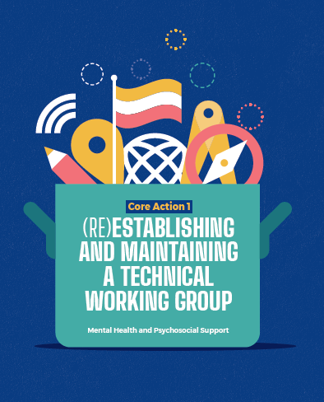

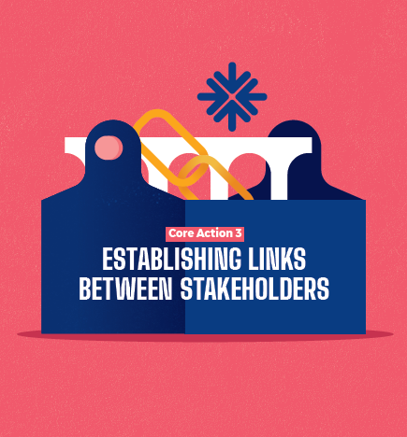
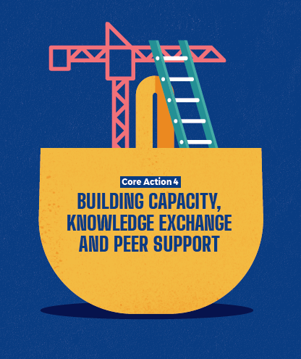



Main actions of MHPSS
(Re) establish and maintain TWG
Information management
Networks and links between stakeholders
Capacity Strengthening
Monitoring and evaluation
Promoting sustainability
Advocacy

Slide 57
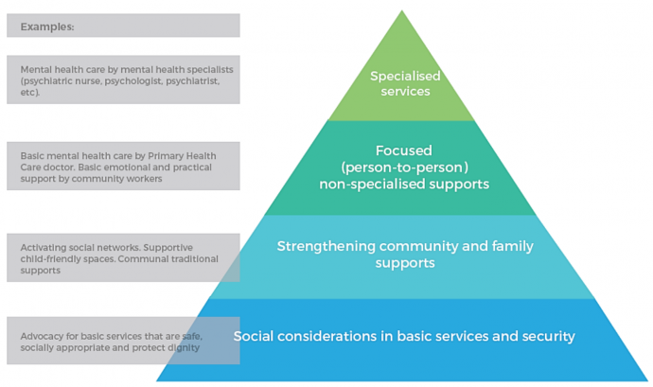
IASC MHPSS Intervention Pyramid

Slide 58
Module 3:
MHPSS assessment and coordination

Slide 59
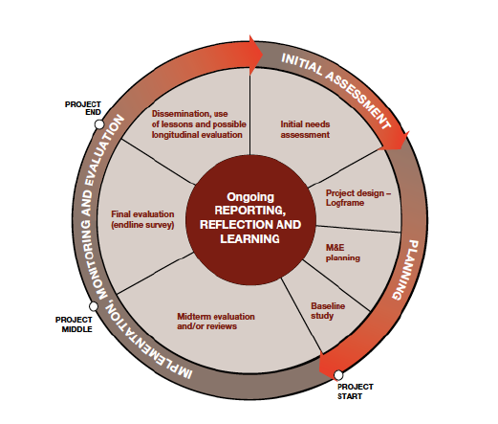
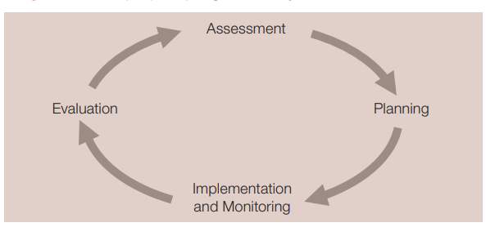
Project/program cycle

Slide 60
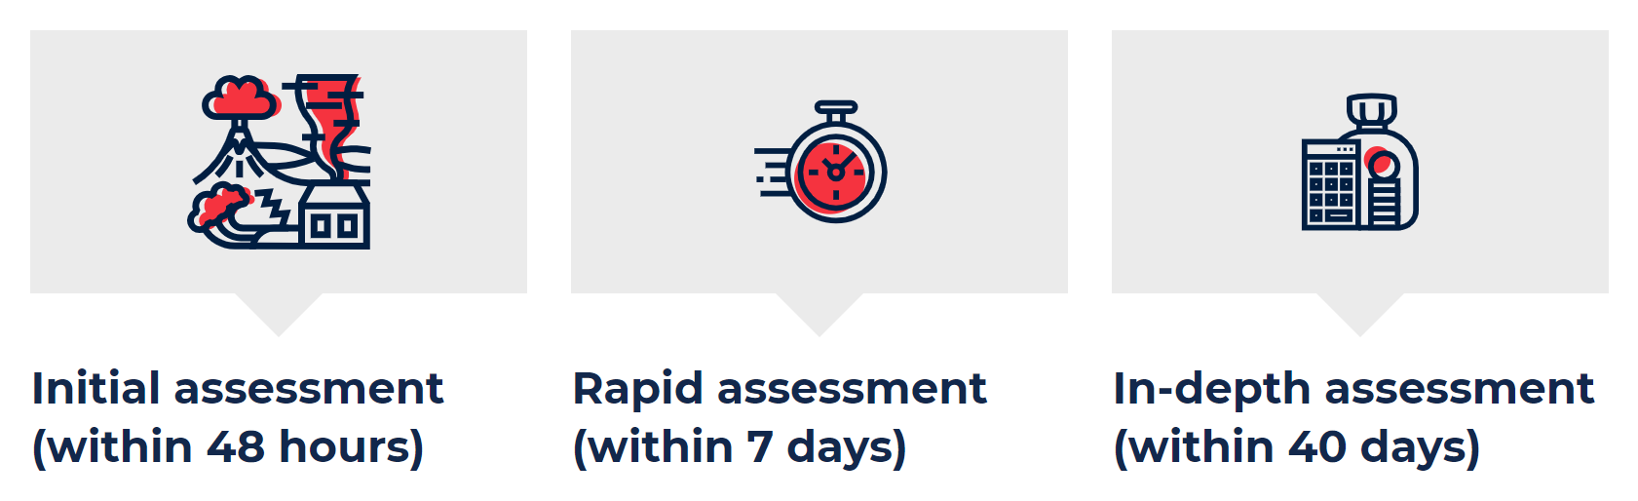
IFRC phases of emergency assessment

Slide 61
Why do we undertake assessments
Create a broad and immediate picture of a population’s well-being
Identify emergency issues requiring immediate follow up
Provide information and recommendations to aid survivors and their families during the recovery process
Inform the development of appropriate policy and practice.

Slide 62
Assessments help us to build:
An understanding of the emergency situation
An analysis of threats to and capacities for mental health and psychosocial well-being
An analysis of relevant resources to determine, in consultation with stakeholders, whether a response is required and, if so, the nature of the response.

Slide 63
MHPSS assessment vs psychological assessment
?

Slide 64
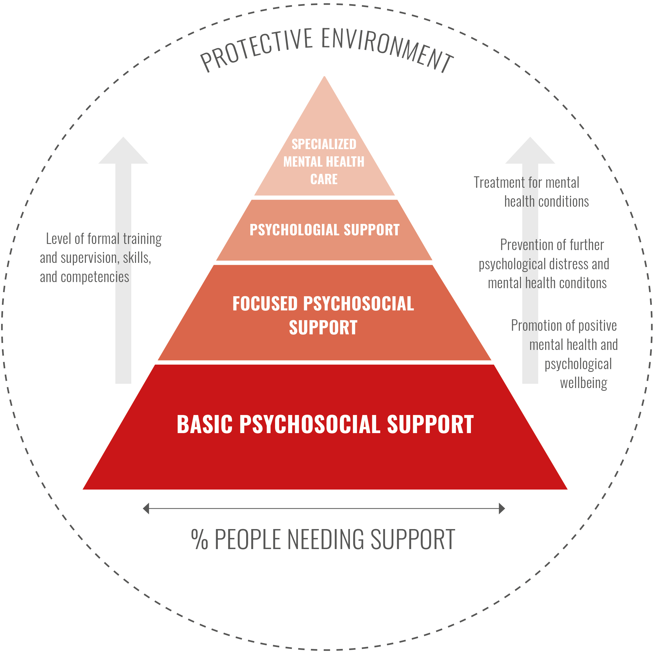
Planning assessments
Your task coming up is to prepare and conduct an MHPSS needs assessment. You will be part of the MHPSS team supporting the local Red Cross branch/chapter. The assessment will be used to inform further activities that Red Cross will undertake for the next 6 months.
You will need to be ready to present your plans for the assessment to the Emergency Coordinator for approval.

Slide 65
Analysing assessment results
Analyze the results of the assessment and prepare a brief assessment report and briefing notes to inform your presentation to the upcoming Coordination meeting.

Slide 66
Module 4:
MHPSS approaches and interventions in emergencies

Slide 67
Psychoeducation
Providing people with information that helps them to better understand their own behaviour and feelings, and those of people around them. An important psychological first aid skill is having knowledge of common reactions to stressful events and the ability to explain these reactions to someone who is in distress. This can help reassure the person that what they are feeling is normal and is not a sign of mental illness. Providing information on stress and coping can also help people prepare for possible reactions that may follow in the days and weeks to come.

Slide 68
Common consequences of crisis events
Social regulations break down
The community reacts with signs of mistrust, fear and insecurity
Religious and moral confusion
Absence of respected leadership
Social uprooting and destructive behavior
Social apathy and loss of trust and hope
Protection systems break down

Slide 69
Module 5: Preparedness for MHPSS responses

Slide 70
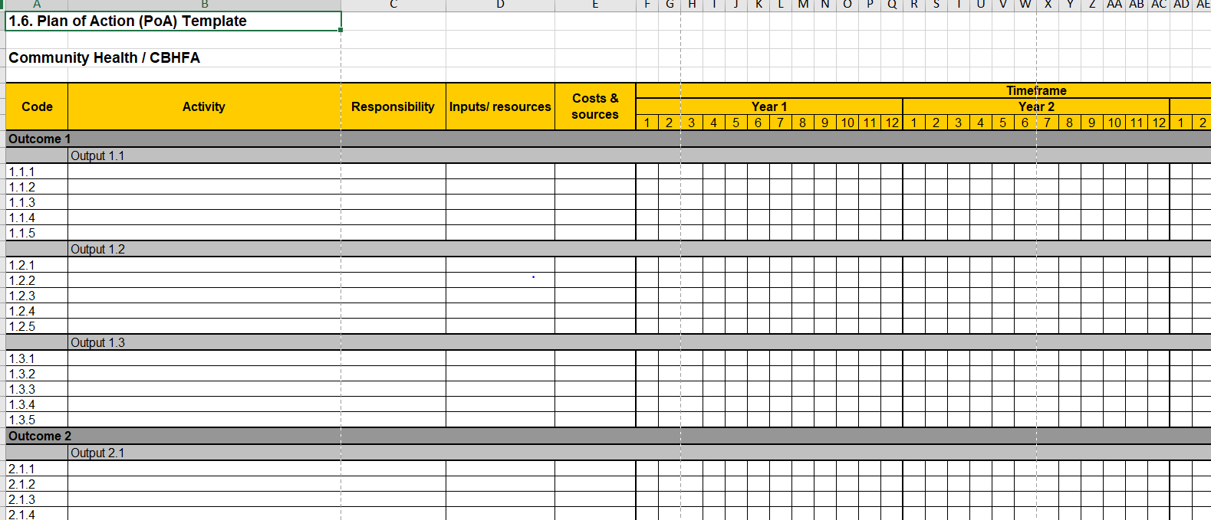
Planning MHPSS responses

Slide 71
Why M&E?
Support project/programme implementation with accurate, evidence-based reporting to guide and improve project/programme performance.
Contribute to organizational learning and knowledge sharing by reflecting upon and sharing experiences and lessons.
Uphold accountability and compliance by demonstrating whether or not our work has been carried out as agreed and in compliance with established standards and with any other donor requirements.
Provide opportunities for stakeholder feedback, especially beneficiaries, to provide input into and perceptions of our work.
Promote and celebrate our work by highlighting our accomplishments and achievements, building morale and contributing to resource mobilization.

Slide 72
Monitoring and evaluation definitions
Monitoring is a continuous process of collecting and analysing information to compare how well a project or programme is being implemented against expected results. Monitoring aims at providing managers and other stakeholders with regular feedback and early indications of progress or lack thereof in the achievement of intended results. It generally involves collecting and analysing data on implementation processes, strategies and results, and recommending corrective measures.
Evaluation is the systematic and objective assessment of an ongoing or completed project or programme, its design, implementation and results. Evaluation determines the relevance and fulfilment of objectives, efficiency, effectiveness, impact and sustainability. An evaluation should provide information that is credible and useful, enabling incorporation of lessons learned into the decision making process of both recipients and donors.
Notes:
Both processes are INTERCONNECTED and Complementary.
Questions to the participants:
In what way the M&E in interconnected and complementary? Maybe if you could give us a concrete example of the project and programme you are implementing ?

Slide 73
Difference between monitoring and evaluation
Monitoring | Evaluation
…is ongoing | …is periodical
Answers questions like: Is the project on track? What do I need to adjust and how to improve it? What is causing delays or unexpected results? | Answers questions like: What changes did the project bring about? Were there any unplanned or unintended changes? Were the operation’s objectives consistent with beneficiaries’ needs
Mainly refers to activities, outputs and intermediate outcomes | Mainly refers intermediate and key outcomes as well as goal (in case of impact study)
Fosters informed re-design of project methodology | Fosters informed design of new projects
Uses data on output indicators on regular basis | Assess all data related to project indicators collected throughout the project
Performed by project staff | Performed by an evaluator “external” to the context, project or organisation

Slide 74
M&E Framework content
Guidance note | Indicator guide | Data collection tools
Psychosocial Concepts and Approaches Why M&E? M&E and the Programme Cycle Management Psychosocial Programme Objectives About Indicators Planning for M&E Key considerations in M&E with children | Goal Indicator Table Outcomes Indicators Table Outputs Indicators Table Goal and outcomes indicators have references to complimentary Means of Verification (data collection tools) | Programme management cycle tools Community and stakeholder survey tools Wellbeing measurement tools Qualitative methods Quality standards tools Supervision tools Training report tools Referral tools Caring for volunteers tools

Slide 75
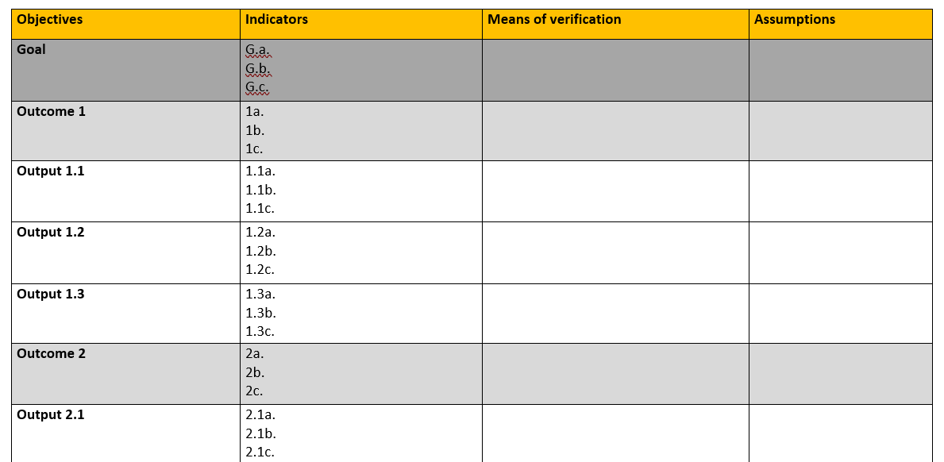
Logframe
Notes:
A logframe is used to do the following [see slide 76]:
The logframe provides a summary of the programme and its operational design.
The logframe outlines the logical sequence of objectives to achieve the programme’s intended results (outputs, outcomes, and goal); the indicators of change in objectives; and the means of verification (tools used to measure the change described by the indicator); and any key assumptions to monitor.
Indicators must be aligned with goal, outcome and output objectives that define the kind of change being sought in PS programmes, as shown in the logframe table (show example.)
[see slide 77] Terminology about logframes can be a bit confusing, as different donors and organisations vary in how they refer to them. It is important that you understand how the terms relate to one another and that you are able to use the appropriate terms as required.

Slide 76
M&E activity
Based on your project planning prepare a logframe.
Determine one or two outcomes for your MHPSS response.
Complete the indicators, means of verification and assumptions for your outcomes.

Slide 77
Thank you
Muchas gracias
Merci beaucoup
شكرا لك

Slide 78
ADDITIONAL SLIDES

Slide 79
Psychosocial principles
Safety
Calm
Self / community efficacy
Connectedness
Hope

Slide 80
Emergency scenario
Discuss in your groups
  What is the context and setting?
  What do you know about the affected population?
  What do you know about different losses?
  What do you know about different emotional reactions?
  How will the NS usually respond to such a crisis event?
  Who are the other actors at the scene?

Slide 81
How to ensure your own wellbeing?
Discuss in your groups
  Share any work-related experiences the group members have that are relevant to the responding to the scenario.
  How will you prepare mentally for the psychosocial work?
  What kind of stress reaction could you expect to have yourself or experience in the team? Ask the participants to refer back to the activity they did on stress reactions. Also point out that responders in national emergencies are often impacted by the emergency themselves directly or indirectly.
  If you start to feel stressed during the response what kind of calming strategies can you use?
  Who do you have that they can call if things are overwhelming or you just need to talk to a fellow human being?

Slide 82
What is PFA?
PFA is…
comforting someone who in distress
helping them feel safe and calm
assessing needs and concerns
protecting people from further harm
providing emotional support
helping to address immediate basic needs (e.g. food, water, a blanket or shelter)
listening to people but not pressuring them to talk
helping people access information, services and social supports.
PFA is not…
something only professionals do
professional counselling or therapy
encouraging a detailed discussion of the distressing event
asking someone to analyze what has happened to them
pressing someone for details on what happened
pressuring people to share their feelings and reactions.

Slide 83
Backpack
Crayons and colouring paper for children
Small stuffed animals
Blowing bubbles/soap bubbles
Water and crackers.
Ear plugs
Small first aid kit
Wet wipes
Aromatic smells Sim card and phone to assist people in finding lost relatives as a form of pre-emptive RFL
Psycho-educational material in relevant languages on coping and managing stress

Slide 84
Look, Listen, Link
Different models are used by different organizations
But the aim of PFA is the same, to empower you with the knowledge and skills to be able to provide PFA to people in distress.
They also all follow the same basic principles of approaching someone in distress, assessing what help the person needs together with him or her, and helping them access this help.
We will use the Look, listen, link model

Slide 85
Look
information on what has happened and is happening
who needs help
safety and security risks
physical injuries
observe/identify immediate basic and practical needs
emotional reactions

Slide 86
Listen
approach someone
introduce oneself
pay attention and listens actively
accept others’ feelings
calm the person in distress
ask about needs and concerns
help the person(s) in distress find solutions to their immediate needs and problems

Slide 87
Introductions
How do you approach someone and introduces yourself?

Slide 88
Active listening
Verbal
Non-verbal

Slide 89
Active listening
Think a problem you feel comfortable talking about. It should not be a big or complicated problem, or one that refers to a traumatic experience, as you will only have a few minutes each to talk about it. If you prefer, you can make something up.
Examples of problems one could talk about are:
An argument with a colleague
Finding it difficult to balance responsibilities at work and at home
Living far from work and having to travel long distances every day
Go in pairs and take turns using your active listening skills

Slide 90
Calming someone in distress
keeping one’s tone of voice calm and soft
trying to stay calm, as that will have a calming effect on the person in distress.
if culturally appropriate, trying to maintain eye contact (without staring) with the person whilst talking with them, or place a hand on his or her shoulder to connect with them.
reminding the person of the intention to help, and that they are safe, if it is true.
ask the person to feel the bench or chair they are sitting on, or their feet against the floor to make them feel connected to the ground. This can make someone feel calmer in their body.

Slide 91
Referral when providing PFA
This could be if someone:
  has not been able to sleep for the last week and is confused and disorientated
  is so distressed that they are unable to function normally and care for themselves or their dependants (e.g., mother not attending to her infant child) by, for example, not eating or keeping clean despite food and washrooms available
  loses control over their behaviour and behaves in an unpredictable or destructive manner
  threatens harm to themselves or others
  starts excessive and out-of-the-ordinary use of drugs, alcohol or medicines.
  If someone shows signs that they might suffer from complex reactions such as severe anxiety, depression or they already have a severe mental health disorder such as psychosis or autism spectrum disorder.

Slide 92
Practice PFA
Go into groups of three
1 PFA responder (focus on look, listen, link)
1 affected person (use the case story for inspiration)
1 observer (use the observation sheet)
Role play using the case story as inspiration.

Slide 93
Emergency safe space
5 groups and a target group for each of the groups (Children, youth, elderly, woman, men).
Discuss the following questions for 10 minutes. Each group should prepare a poster/flip chart with the answers:
  Which type of functions or activities should be available in the safe space for your target group? Think about Hobfolls 5 intervention principles when answering the question (the activities should increase safety, calm, connectedness, efficacy and hope)
  How you will ensure access and relevance for people in your target group who might have a disability or other specific needs

Slide 94
Restoring Family Links

Slide 95
Restoring Family Links activities
registering and keeping track of individuals – identification and accurate documentation help prevent separation
organizing the exchange of family news
tracing lost individuals
reuniting and repatriating families
supporting the authorities in managing dead bodies and tracing family members to inform them of the death
establishing mechanisms to clarify the fate those who are missing

Slide 96
Cooperation with RFL
During your deployment you are meeting up with the RFL team. Before the meeting you and the PS team has some time to discuss how you will explain to the RFL team what you can do in terms of supporting them and on what areas you can work together/complement each other.
Go back to your groups discuss what you think a role of a PS responder could be in relation to RFL services as a preparation for the up-coming meeting

Slide 97
PSS/RFL
Sensitization of RFL personnel in relation to PS issues; consequences of loss, ambiguous loss, communication with people in distress
Support RFL personal in how to deliver distressing news in a sensitive and supportive manner
Sensitization of RFL personnel in relation to child protection when they are managing cases with separated and unaccompanied children
Support “rapid connections” between family members and loved ones
Providing psychological first aid and general care and support to people who are looking for loved ones or have lost loved ones.
Knowing who/where to refer to if you as PS responders comes across cases that needs referral for RFL.

Slide 98
Monitoring and evaluation

Slide 99
M & E
Monitoring is a continuous process of collecting and analysing information to compare how well a project or programme is being implemented against expected results. Monitoring aims at providing managers and other stakeholders with regular feedback and early indications of progress or lack thereof in the achievement of intended results. It generally involves collecting and analysing data on implementation processes, strategies and results, and recommending corrective measures.
Evaluations is the systematic and objective assessment of an ongoing or completed project or programme, its design, implementation and results. Evaluation determines the relevance and fulfilment of objectives, efficiency, effectiveness, impact and sustainability. An evaluation should provide information that is credible and useful, enabling incorporation of lessons learned into the decision-making process of both recipients and donors.

Slide 100
Outcomes and outputs
An outcome is: The changes that occur as a consequence of a specific project’s activities. Meaning the immediate and observable change in the lives and circumstances of people that is brought about as a direct result of project activities and the delivery of outputs.
An output is: The planned achievements (results) ‘put out’ (produced) in the process of implementing a project that signals that the work is on track. Outputs are thus the actual work implemented. Various output should work towards the likely achievement of the outcome.

Slide 101
Indicator
An indicators is: a unit of measurement that specifies what is to be measured. They are intended to answer whether or not the desired outcome or output objective have been achieved. Indicators may be quantitative (e.g. percentages or numbers of people) or qualitative (e.g. perceptions, values, reasons, opinions, motivations).

Slide 102
Developing a plan of action

Slide 103
Plan of action
Outcome: | Responsibility | Week 1 |  |  |  |  |  |  | Week 2 |  |  |  |  |  |  | Week 3
Output 1:
Activity 1:
Activity 2:
Activity 3:

Slide 104
When developing your plan of action remember
Be sensitive to special needs
Respect cultural and behavioral norms
Be realistic
Relevance and timing
Involve the community

Slide 105
Coordination and cooperation

Slide 106
Stakeholders
National Disaster Management Agencies
Civil Protection Agencies
National Society; provincial/branch offices/NS departments
IFRC
ICRC
PNS
Authorities/Gov’t
Ministries
Community leaders
Community members (incl. representative of various vulnerable groups)
Military
OCHA/domestic coordinators
Other Humanitarian organizations
Community NGO’s
Schools
Health Agencies
Media
Religious leaders

Slide 107
Group work
How will you ensure that your activities are filling a gap, complementing other organizations activities and not overlapping?
Who would you need to coordinate with to implement the activities?
Who will be a part of the referral base?

Slide 108
Referrals

Slide 109
A functioning referral system
A functioning referral system is an essential component of good practice when implementing PS programmes.
Careful documentation of referrals ensures beneficiaries receive the specialised support they need for optimal psychosocial well-being.
Referrals may be made for specialised mental health services, as well as other types of services: general health care, protection, social services, legal services, economic support, etc.

Slide 110
Steps in referral
2. Identify & map other service providers
3. Contact other service providers
4. Explain referral to client/ caregiver
5. Document client/ caregiver consent
1. Identify need(s)
6. Make the referral
7. Follow-up with client & receiving agency

Slide 111
IASC referral form
Go into pairs and interview each other using the referral form. One is the person who is being referred and the other is the person doing the referral.

Slide 112
Confidentiality
Make sure that all information gathered about the client is stored securely (e.g. files should be locked, documents on the computer secured with password).
If you need to share information about a client with an outside organization, you must first obtain the survivor’s informed written consent or that of a parent or guardian

Slide 113
Training of volunteers

Slide 114
Training agenda for volunteers
Use all the knowledge you have now regarding activities and the specific context in your case to create a 1 day training for volunteers, who will be working with you when responding to the crisis event. Write the agenda with corresponding objectives for each session on a flip chart. You will have 40 minutes to develop the agenda.

Slide 115
Caring for volunteers

Slide 116
Support systems
National Societies have an obligation to support the well-being of their volunteers. Whether you are responsible for volunteers in emergencies or on-going social programmes, be sure that your psychosocial support system for volunteers includes information and interventions at all three stages of a response, i.e. before, during and after:
Before the actual response, it is important to prepare the volunteers for the task at hand.
During the activity it is important to provide the volunteers with on-going support.
After the response it is time for recovery, reflection and improving future responses.

Slide 117
Volunter managers/leaders
Are responsible for:
  ensure reasonable working hours and conditions for volunteers
  prepare job descriptions or make clear what is expected
  prepare and train volunteers for their task in the field
  check in with volunteers to see how they are coping during the emergency response
  have regular team meetings during the emergency to check in with everyone and offer support
  encourage volunteer work to be carried out in pairs
  set up peer support or buddy systems

Slide 118
Self care
Communicate with others
Take care of yourself
Manage your stress level
Relax and have fun

Slide 119
Peer to peer support

Slide 120
Peer support
Communicate with others
Take care of yourself
Manage your stress level
Relax and have fun

Slide 121
Peer support meetings
Work in your case group and discuss and note down:
  List 5 key elements that are important for peer support
  List 5 things you need to think of when organizing a peer to peer support meeting
  List 5 topics that would important and relevant to discuss in a peer to peer support meeting

Slide 122
Key elements for peer support
Concern, empathy, respect and trust
effective communication and good listening skills
clearly defined roles
teamwork, cooperation and problem-solving
open discussion of on-the-job experiences.

Slide 123
Organising peer support meetings
Make sure to have scheduled meetings on a regular basis.
Try to schedule the meetings at a time where everyone is able to participate.
Provide regular supervision for peer supporters with psychosocial support staff, wherever possible.
Organize willing volunteers into a peer support team to reach out to other volunteers, particularly new recruits. This team can connect with peers to raise awareness of available support and provide assistance.
Organize peer support groups, led by experienced and trained volunteer peer supporters or by psychosocial support staff.

Slide 124
Peer support meeting topics
Difficult cases
Socializing
Stress and reactions coping strategies
Practice skills (PFA, active listening)
Organizational issues and possible solutions

Slide 125
Peer support meeting topics
Go into pairs
Tell each other three things you have learned that were important for you:
1 thing you will orient/train others in
1 thing you will use in your daily work
1 thing you learned about yourselves related to soft skills you can use in your personal and work life (e.g. having good problem solving skills, being successful in presenting, networking with others etc.)

Slide 126
Hobfoll principles
In your groups:
  Imagine you are from the Disaster Response Team and are asked to assist the family the day after they have moved to the hotel. The family is clearly devastated by the loss and by having to be temporarily living in a hotel until an interim solution is found for them. However, they seem like a resilient family. Even though it’s sad and challenging for the family, they would very much like to meet with you to have concrete guidance on what they can do to come through this difficult time.
  Discuss how you will use your assigned principle in your concrete guidance to ensure they will have information, knowledge and skills that will help them to maintain their well-being when living in the hotel?

Slide 127
Disaster scenario discussion
In your groups first discuss:
  How psychosocial needs in emergencies are addressed?

Slide 128
Child protection in emergencies
Child protection involves prevention and responses to abuse, neglect, exploitation, and violence affecting children.
UN Convention article 19: Children have the right to be protected from being mistreated, physically and mentally.

Slide 129
Child friendly spaces
Group 1: Which activities would you plan in the shelter for children from 6 to 12 years of age?
Group 2: Which activities would you plan in the shelter for children from 13 to 18 years of age?
Group 3: What can the PSS, or disaster response, team do to improve the overall child protection situation in the shelter?
Group 4: How can the PSS, or disaster response, team ensure the safety for children in the CFS?

