Slide 1
Building MHPSS evidence within the RCRC Movement
Rebecca Horn

Slide 2

Overview of the project
MHPSS Roadmap Working Group 4
  To demonstrate the impact of, and strengthen the evidence for, MHPSS interventions through research, monitoring and evaluation
Aims of project
  To map the current situation regarding MHPSS evidence-building within the Movement
  To produce a set of practical tools to support NSs to plan and implement MHPSS-focused research projects and M&E activities
Methodological approaches
  Desk review (including analysis of 2019 and 2021 Roadmap survey data)
  Key informant interviews (39)
Outputs
  Repository of resources to support MHPSS evidence-building activities within the Movement
  Report to provide a rationale for the materials included in the repository
Use of terms
  ‘Evidence-building’

Slide 3
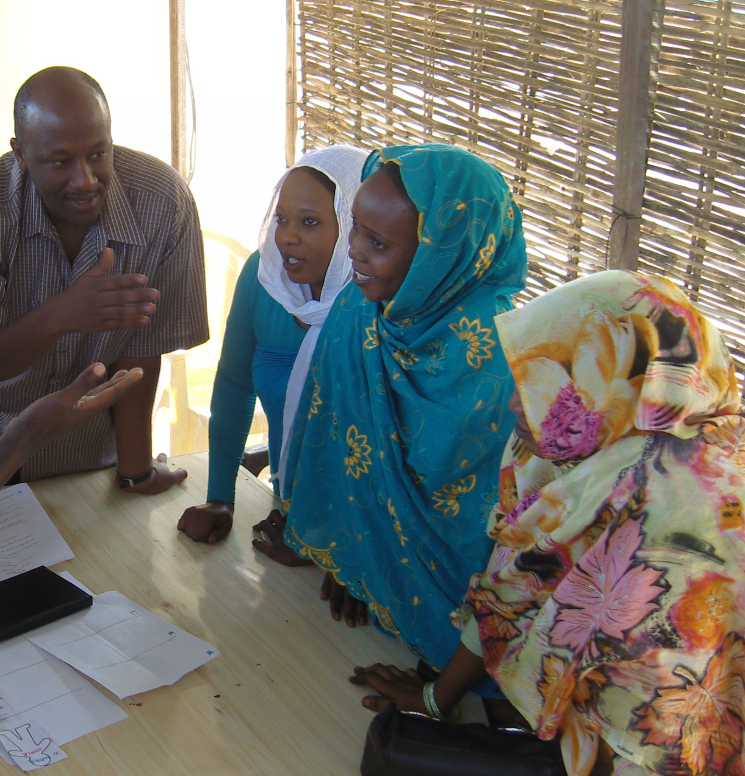
Building and using MHPSS evidence within the Movement: The current situation
Building and using evidence around MHPSS activities and services is not a priority within the RCRC Movement,
  We’re very operational. We’re focused on delivering services rather than the higher level ‘did this work?’ questions. (Key informant)
This reflects the situation in humanitarian organisations more broadly
  A culture of ‘we need immediate action’ has contributed to a certain acceptance of ‘quick and dirty’ data-gathering to underpin needs analysis, implementation, and evaluation. In addition, the humanitarian domain often is normative and agencies derive their legitimacy and credibility by making reference to their principles rather than to their evidence-based approaches. (Dijkzeul et al, 2013)
The consequences of this include:
  Potential for harm
  Ineffective and inefficient use of resources (financial, human and other)
  Difficult to make the case for funding of MHPSS services and activities

Slide 4
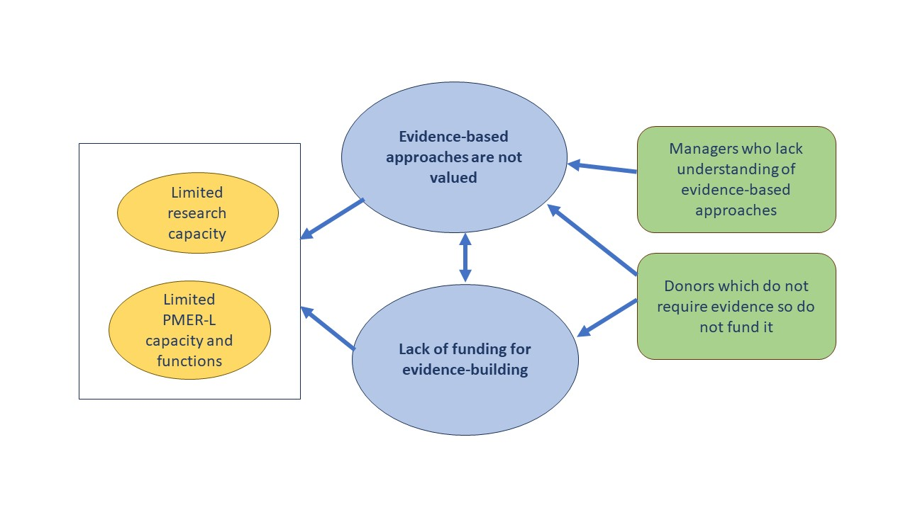
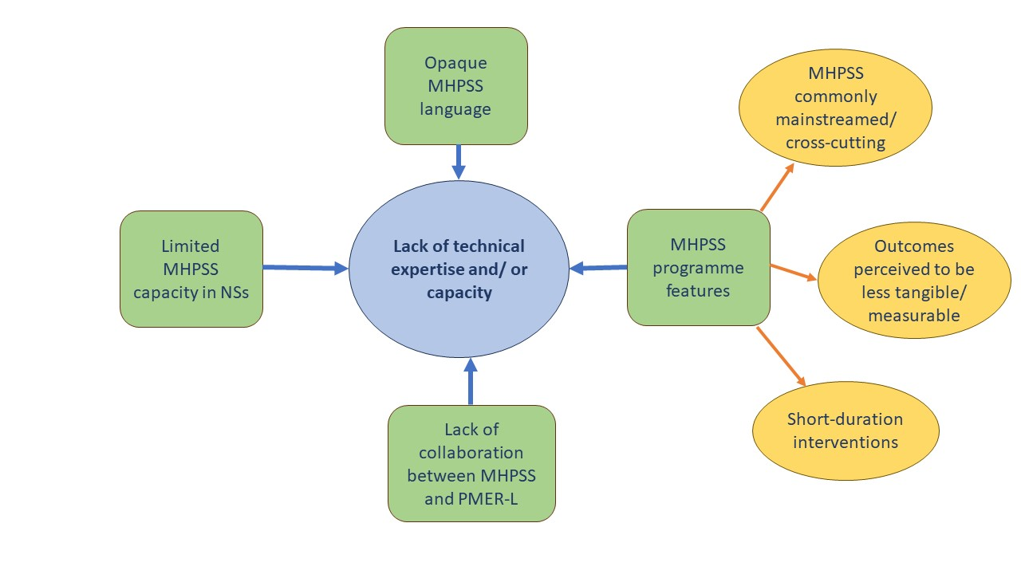
Barriers to MHPSS evidence-building
General
MHPSS-specific

Slide 5

Using MHPSS evidence to create change: ICRC
Analysis of ICRC’s MHPSS M&E data found that for individuals with acute financial needs resulting from exposure to violence, MHPSS outcomes cannot be achieved unless financial needs are addressed in parallel with the psychological support.
The authors recommended a more systematic inclusion of a financial component of projects for victims of violence, along with regular monitoring of MHPSS outcomes of financial support.
The findings were used to advocate internally with the management and Economic Security department to include victims of violence in their projects. As a result, victims of violence did become systematically included in economic activities, including Cash and Voucher Assistance (CVA).

Slide 6
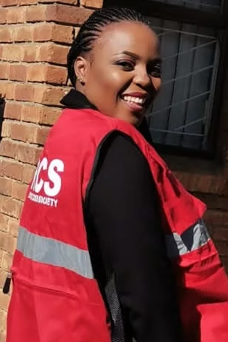

Using MHPSS evidence to create change: Lesotho Red Cross
The NS is at an early stage in strengthening systems around MHPSS.
MHPSS focal point, Lintle Mathosi, developed a short survey to learn more about staff and volunteer needs in terms of providing MHPSS support.
Identified gaps not only in confidence and competence, but in terms of the staff and volunteers’ own wellbeing.
Findings were presented to managers within NS who mobilised resources to address the issues raised.
  All staff and volunteers in contact with community members have been trained to have supportive conversations (PFA) and make referrals
  The whole management team and some external partners came together for a workshop to develop a MHPSS action plan for the NS.
Lintle says ‘Staff and volunteer mental health and wellbeing was not prioritised until the survey came and showed that there are MHPSS issues amongst staff and volunteers. The survey gave me confidence and credibility to advocate for MHPSS. It was something small but it was very impactful’.

Slide 7
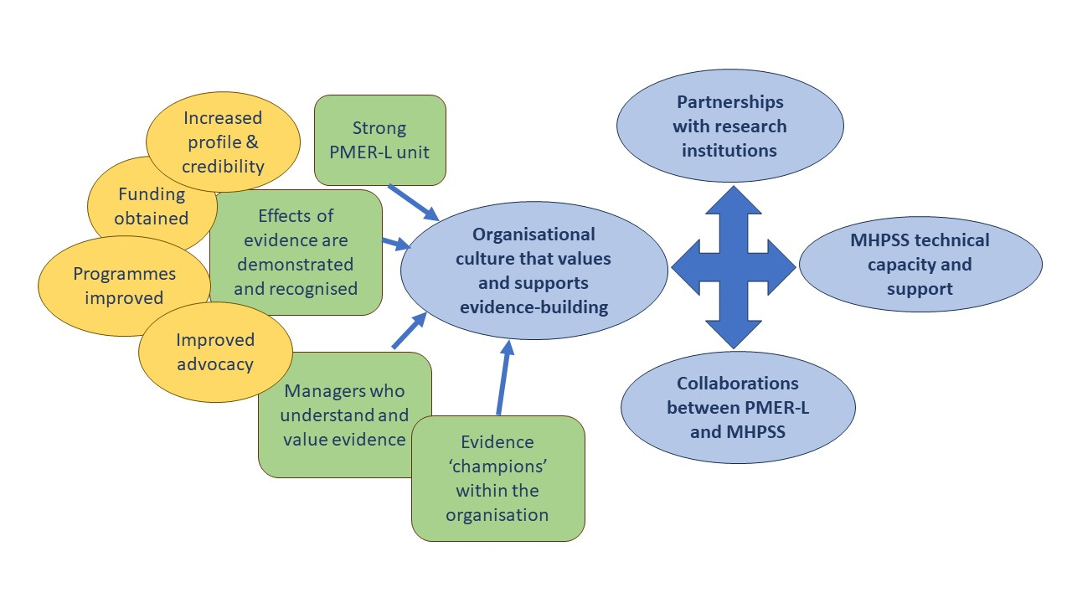
Factors facilitating MHPSS evidence-building

Slide 8
Creating a shift towards MHPSS evidence-building
Advocate for MHPSS evidence-building activities within your NS
Strengthen your own understanding of MHPSS evidence-building concepts and approaches
Start building partnerships and relationships
  With research institutions and bodies both within and outside the Movement
  With PMER teams in your NS
  With MHPSS peers interested in evidence-building
Start identifying gaps in knowledge and developing research questions
‘We need to develop a culture within the Movement around the need for evidence’ (Key informant)
‘We need to take baby steps, not rush it, because I want it to be sustainable’ (NS MHPSS focal point)

Slide 9
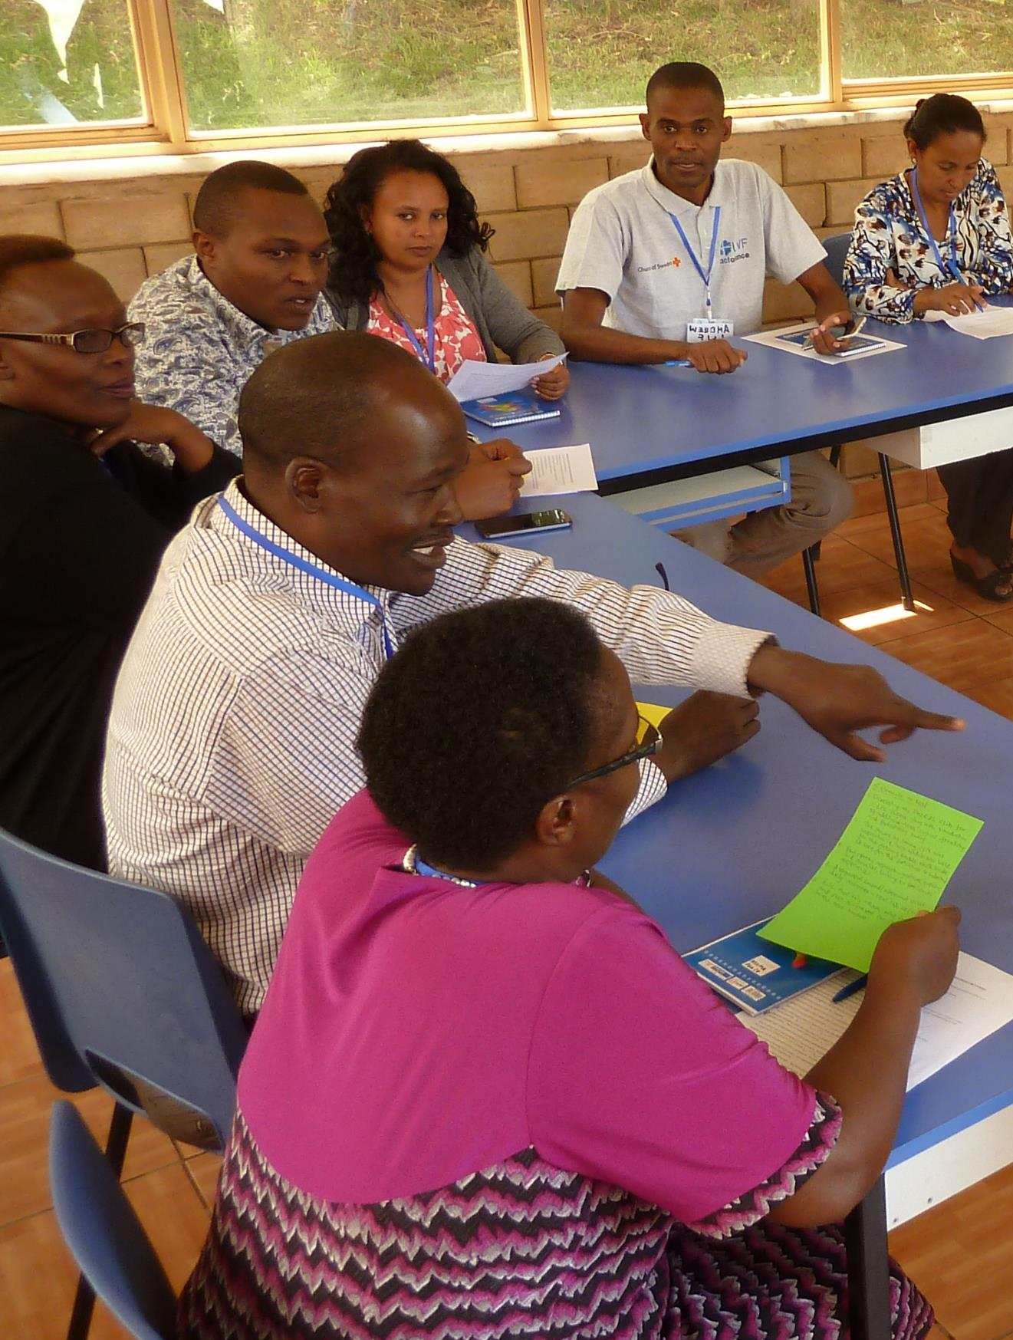
Advocacy
  Among the critical factors driving effective organisational approaches to promoting use of evidence are commitment, prioritisation and leadership by senior management. If evidence agendas are driven from the very top of an organisation, and are front and centre in organisational strategy, this makes it easier to carve out the financing and resources necessary for implementation. (Carden et al, 2021)
Managers determine priorities. Those who understand and value evidence-building activities are a key catalyst in the process.
‘Champions’ in NSs play a crucial role in helping others to see the value of evidence around MHPSS, and the benefits that evidence can bring to the organisation. This involves taking all opportunities, formal and informal, to demonstrate the value of evidence and advocate for such activities to be included in MHPSS programming.
  Relevant repository materials:
  1. Advocacy messages and processes to support MHPSS evidence-building
  2. Advocacy case studies: MHPSS evidence which contributed to change

Slide 10
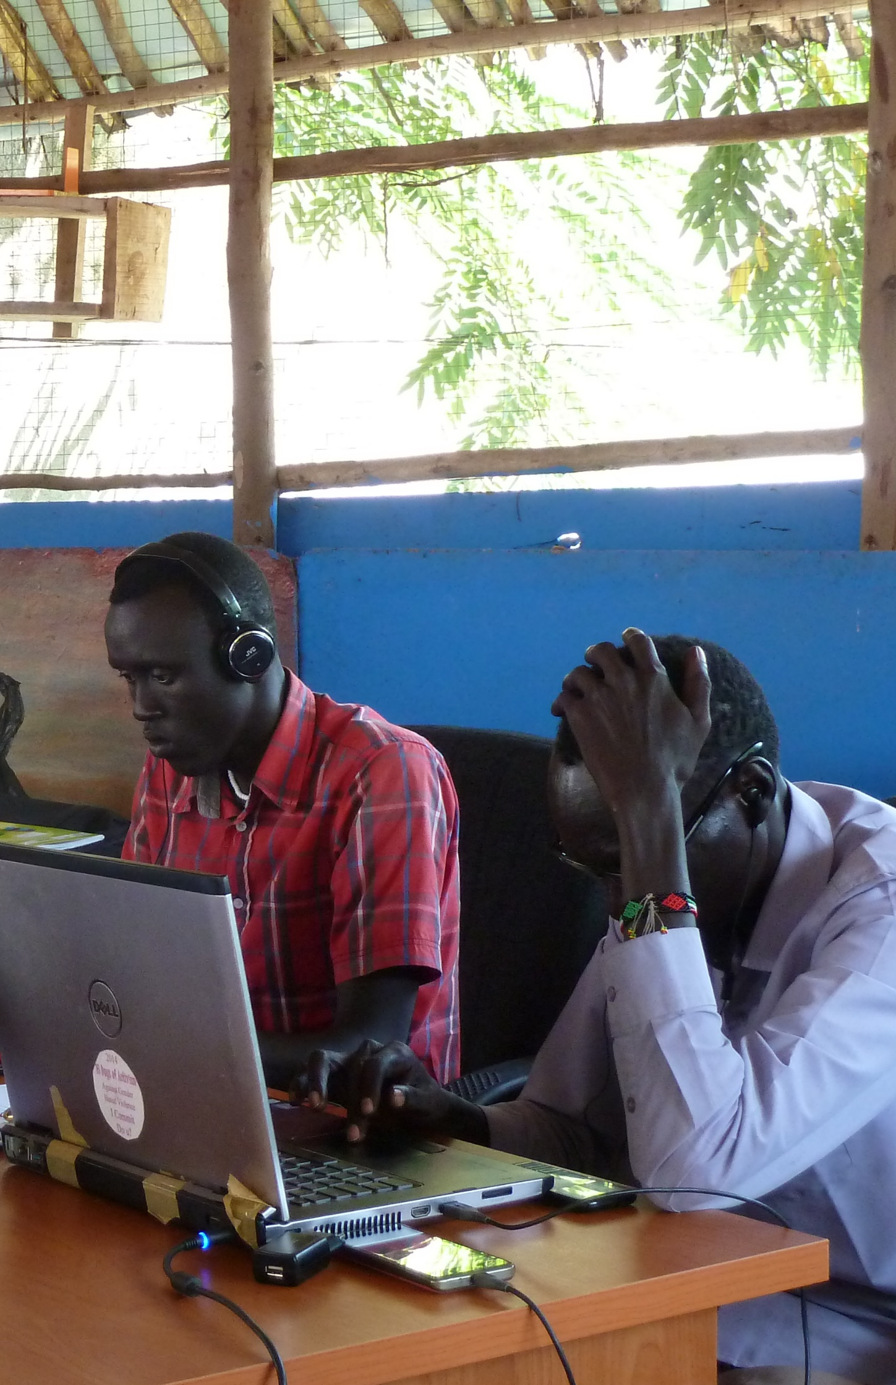
Strengthening understanding of MHPSS evidence-building concepts and approaches
MHPSS focal points are interested in building evidence around their MHPSS activities, but some feel they lack the knowledge and skills to get involved, or even to advocate for this.
  Relevant repository materials:
  • Nine resources on MHPSS M&E.
  • Three recommended free online courses.

Slide 11

Start building partnerships and relationships
There are individuals and organisations both within and outside the Movement that MHPSS staff can connect with in order to get support with planning and implementing research and evaluations to strengthen the evidence around their MHPSS activities.
  research institutions and bodies both within and outside the Movement
  PMER teams in your NS
  MHPSS peers interested in evidence-building
  Relevant repository materials:
  3. RCRC Movement Evidence-Building Actors with some focus on MHPSS
  4. Developing effective partnerships with research institutions
  5. ELRHA Guide to Constructing Effective Partnerships

Slide 12

Identify gaps in knowledge and develop research questions
Humanitarian actors need to be more organised and coherent in identifying priority evidence needs and evidence gaps, not only within humanitarian organisations but also at sector level. (Carden et al, 2021)
  Relevant repository materials:
  6. How to develop a research question

Slide 13
Other actions
Simplify and contextualise tools that can be used for MHPSS evidence-building
Building an evidence-base from existing information
Communicate MHPSS evidence in ways perceived as practically useful within the Movement
  The most frequently mentioned barrier to the use of evidence by humanitarian organisations was the lack of (obvious) relevance of much research evidence to policy, programme and response design, and especially to operations on the ground (Carden et al, 2021)
  Relevant repository materials:
  9. Most Significant Change technique: A Guide to its use
  10. Analysing qualitative data

Slide 14
Communication of MHPSS evidence
  Relevant repository materials:
  11. Reporting evidence: template
    11a. Reporting evidence example – Portuguese Red Cross
  12. Sharing results of evidence-building activities
  13. R2HC Guidance Note: Presenting research effectively in online meetings
  14. R2HC Policy brief template guidance & Policy brief template
  15. R2HC Research snapshot guidance and template
  16. Examples of Research Snapshots
    a. Psychological First Aid with Children (Portuguese Red Cross)
    b. Child Friendly Spaces
    c. Mental Health of Informal Care Givers (Serbia Red Cross)
    d. Long-term care of older persons and persons with disabilities (Serbia Red Cross)
    e. Violence against older women (Serbia Red Cross)
  17. Example of a MHPSS evaluation using qualitative data published in a peer reviewed journal.

