Slide 1
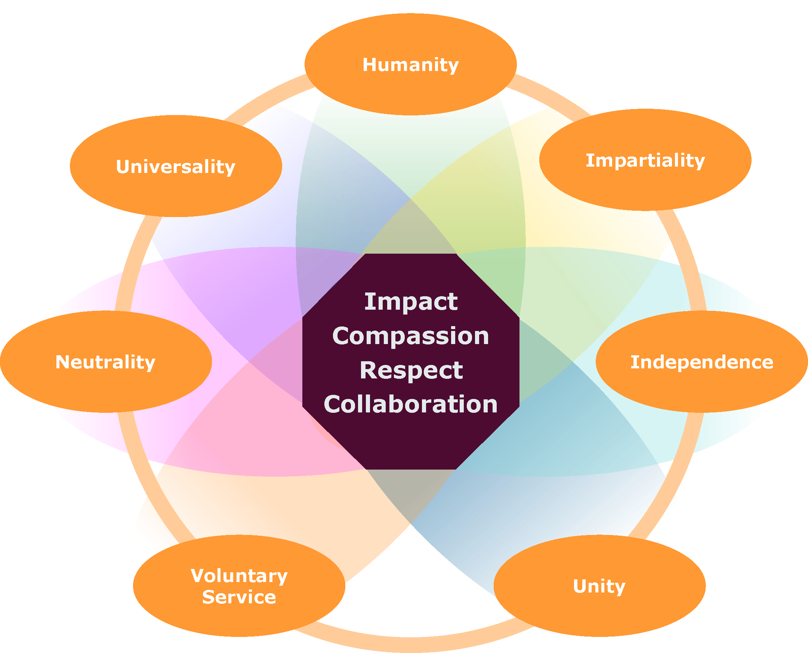

The ICRC Values Compass
Key words based on staff feedback:
Impact
Service
Purpose
Making a difference
Responsibility
Compassion
Care
Emotional Intelligence
Empathy
Consideration
Affection
Kindness
Respect
Integrity
Fairness
Honesty
Equity, Equality Accountability
Justice
Collaboration
Dialogue
Listening
Inclusion
Cultural sensitivity

Slide 2


“Because the ones who are crazy enough to think that they can change the world are the ones who do” - Henry Dunant
Key words
Service
Purpose
Making a difference
Responsibility
Impact
We focus on the difference we make for people.
Examples of related behaviors
Working for the organization and others, not for personal gain
Challenging the status quo
Putting people at the heart of decision-making
Holding myself responsible for my own words and actions
Communicating in a way that fosters understanding and trust
Ask yourself
How do I contribute to my team’s goals?
What are we trying to achieve?
To what extent are we using our resources effectively?
What other solutions will improve our response?
What might prevent us and our ideas from succeeding?

Slide 3

Key words
Care
Emotional Intelligence
Consideration
Affection
Kindness
Empathy
Compassion
We act with care.
Examples of related behaviors
Showing care for people’s feelings and circumstances
Noticing when people are struggling and offering them support
Being attentive to the needs, thoughts and emotions of myself and others
Actively listening to others without any preconceived beliefs
Taking care of myself and others, in all circumstances
Ask yourself
What will help people feel safe sharing their concerns with me?
How can I better understand others’ needs?
How can I create the conditions for others to feel empowered?
How can I communicate my own needs to those who need to know?
Notes:
“Compassion is a spontaneous movement, an instantaneous affective reaction to the sufferings of others.” - Jean Pictet

Slide 4

Key words
Integrity
Fairness
Justice
Honesty
Equity and equality
Accountability
Respect
We respect and value difference, acting fairly and equitably.
Examples of related behaviors
Treating everyone as equals, with dignity and with equity
Rejecting favouritism and nepotism
Being humble and mindful of my privileges
Striving for fairness and valuing differences
Ask yourself
How can I help others be heard and valued?
How do we ensure respect across cultures, hierarchies, identities and abilities?
What can I do to foster transparency and honesty?
How do I know that my colleagues feel respected by me?

Slide 5

Key words
Listening
Inclusion
Dialogue
Cultural sensitivity
Collaboration
We are more than the sum of our parts.
Examples of related behaviors
Reaching out to others to achieve the best outcomes
Being open to ideas and valuing different perspectives
Developing and maintaining constructive relationships
Remembering our goals are the same even if our priorities differ
Ask yourself
How can I work with colleagues to achieve better outcomes?
If we disagree, how can we work constructively to find a solution?
How can I manage differences constructively?
How do I acknowledge and work with my assumptions and bias?
How can I contribute to finding a solution?

