Slide 1
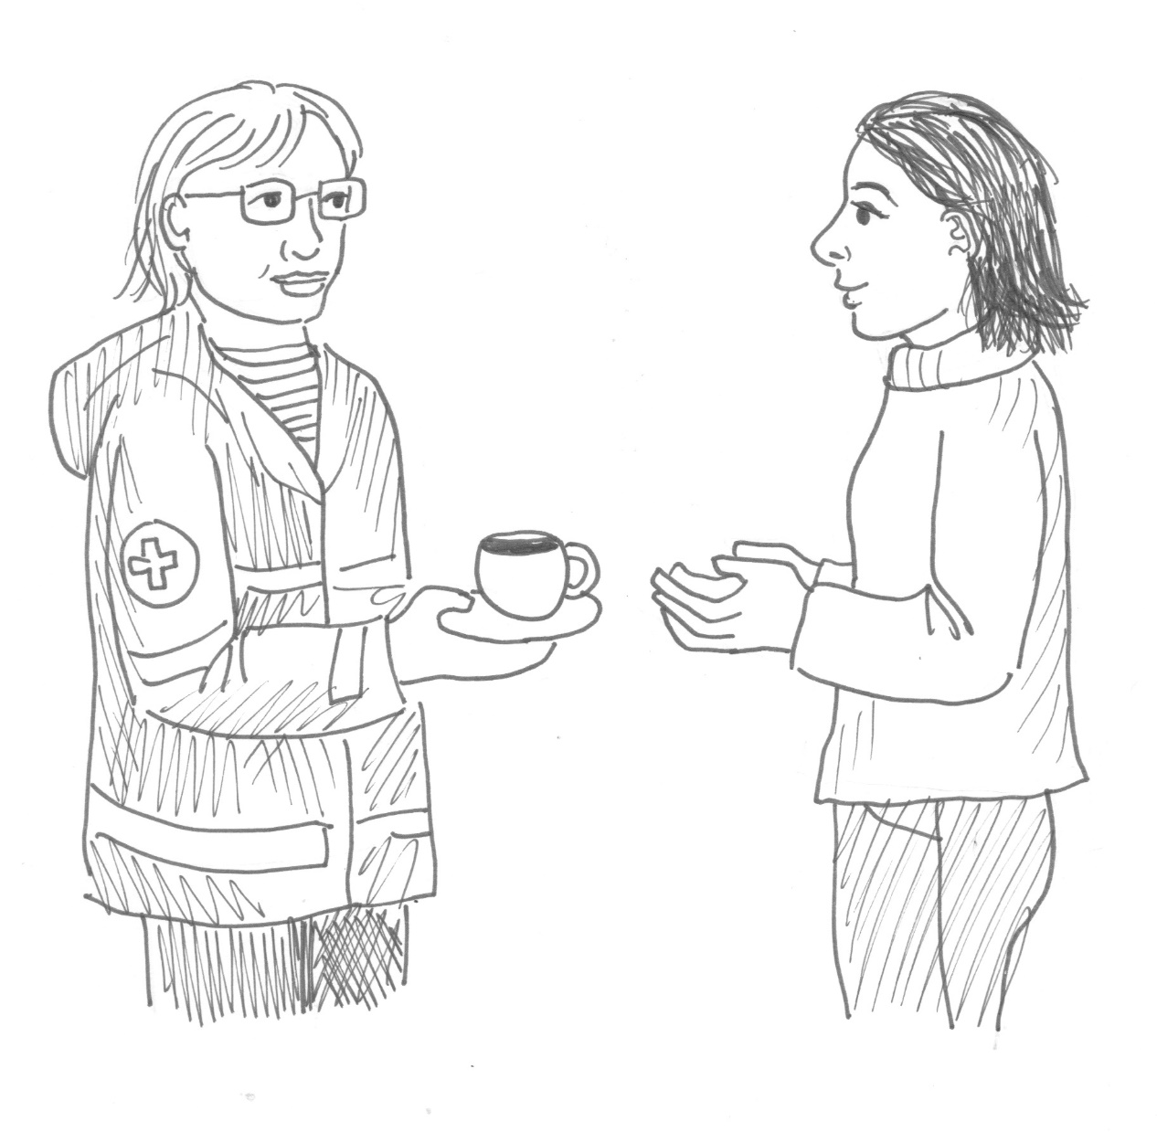
WELCOME​ to this three-hour orientation on ​ Basic Psychological First Aid (PFA) ​ While we wait to start, please check your tech, and introduce yourself in the chat.​ ​
And try to ensure that you….​
are in a quiet space where you feel comfortable participating actively.
can turn your camera and microphone on when needed.
have some paper and pens or pencils, and some drinking water nearby.

Slide 2
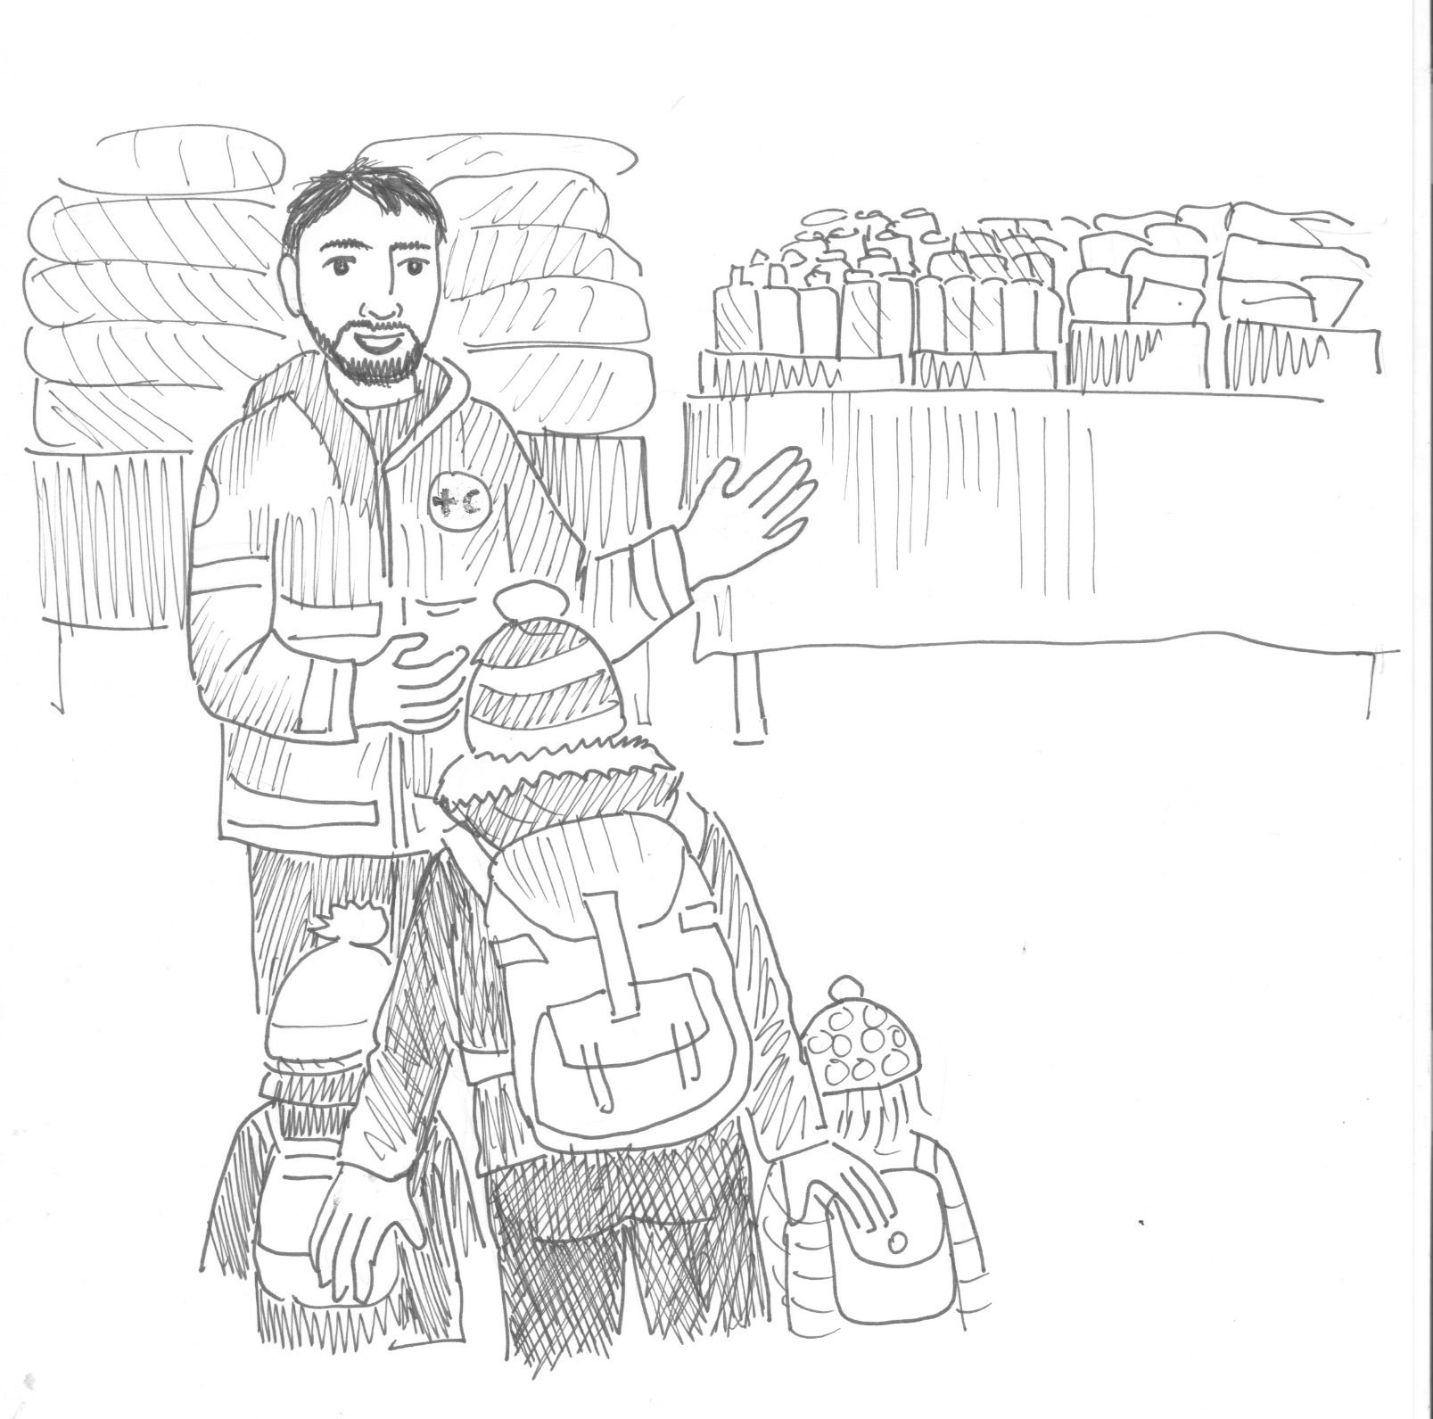



Orientation on Psychological First Aid in times of conflict and uncertainty
YOSHI SHIMIZU
Notes:
[Present yourself, and your role. See the example below. Adapt to details of the facilitator.]
Hi, my name is XXXXXX . I am a MHPSS Global Delegate working with Danish Red Cross.
Welcome to this three-hour orientation on Psychological First Aid, also known as PFA. This training is designed to fulfill our commitment in the Movement to ensure that All staff and volunteers in the Movement will be/are able to deliver PFA.

Slide 3
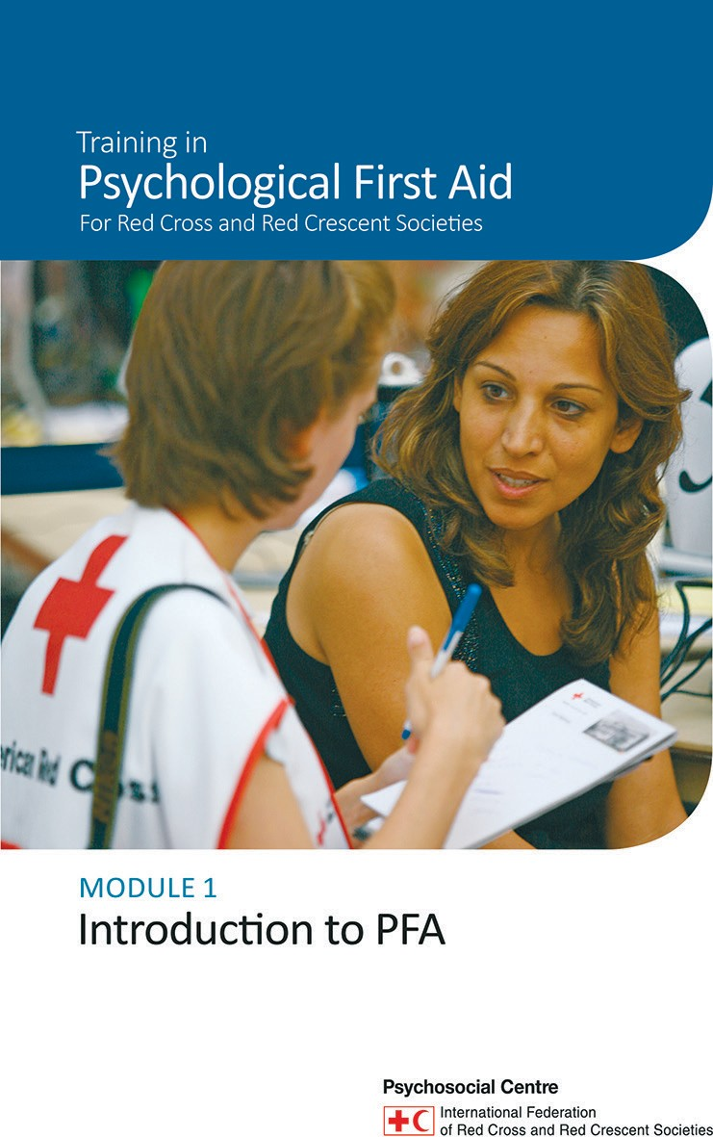
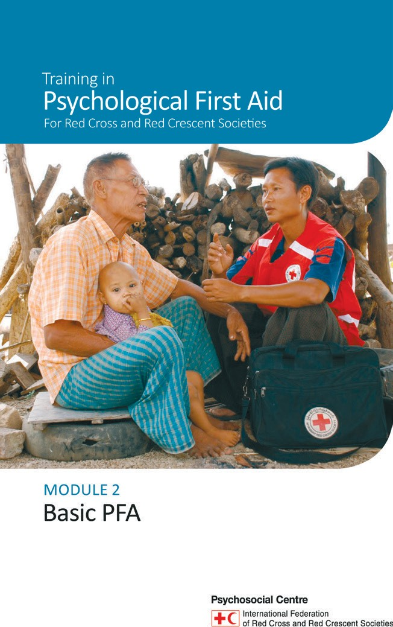
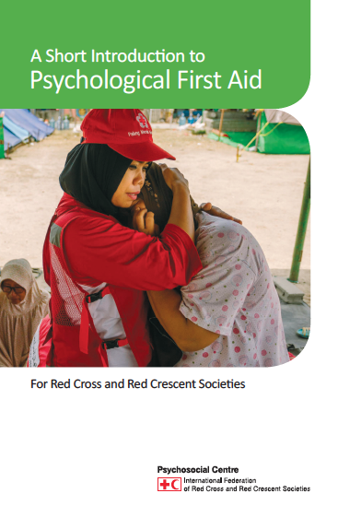


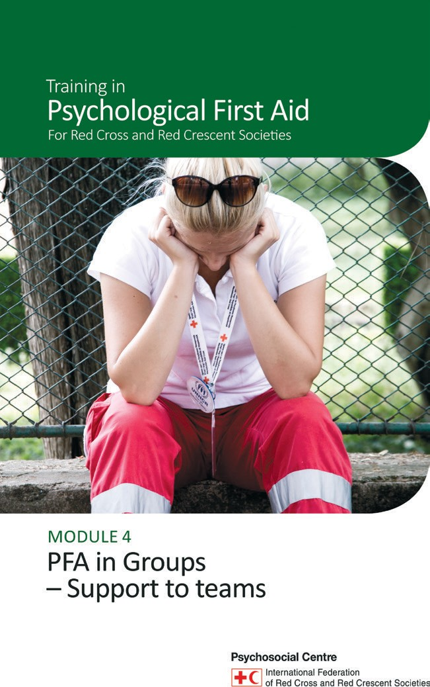
Notes:
This orientation is based on the resource and training materials on Psychological First Aid developed by the IFRC PS Center that include a reference guidebook, a short introduction book and four training modules. I will share the link to their website at the end of the orientation where all materials can be downloaded.

Slide 4
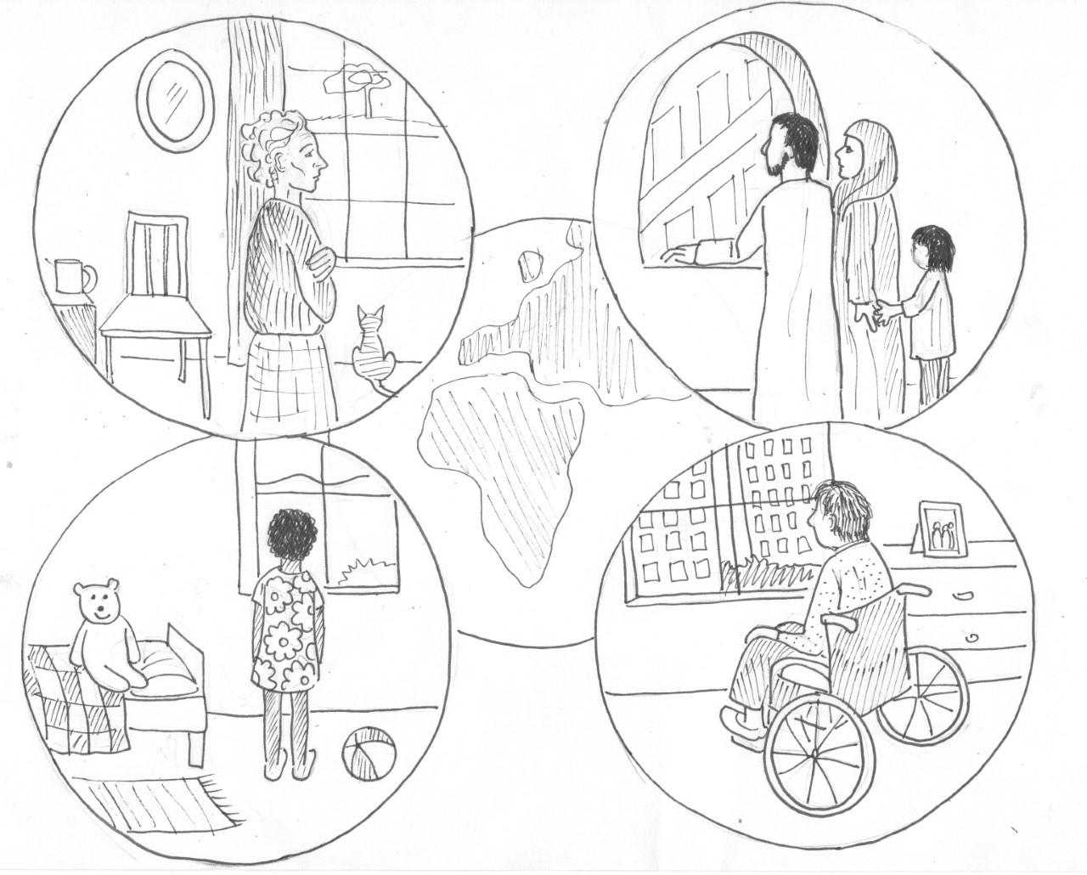

Psychological First Aid for Covid19 response
For Red Cross and Red Crescent Societies
YOSHI SHIMIZU
Notes:
This online orientation is adapted from online trainings that were developed in response to the global Covid19 pandemic

Slide 5
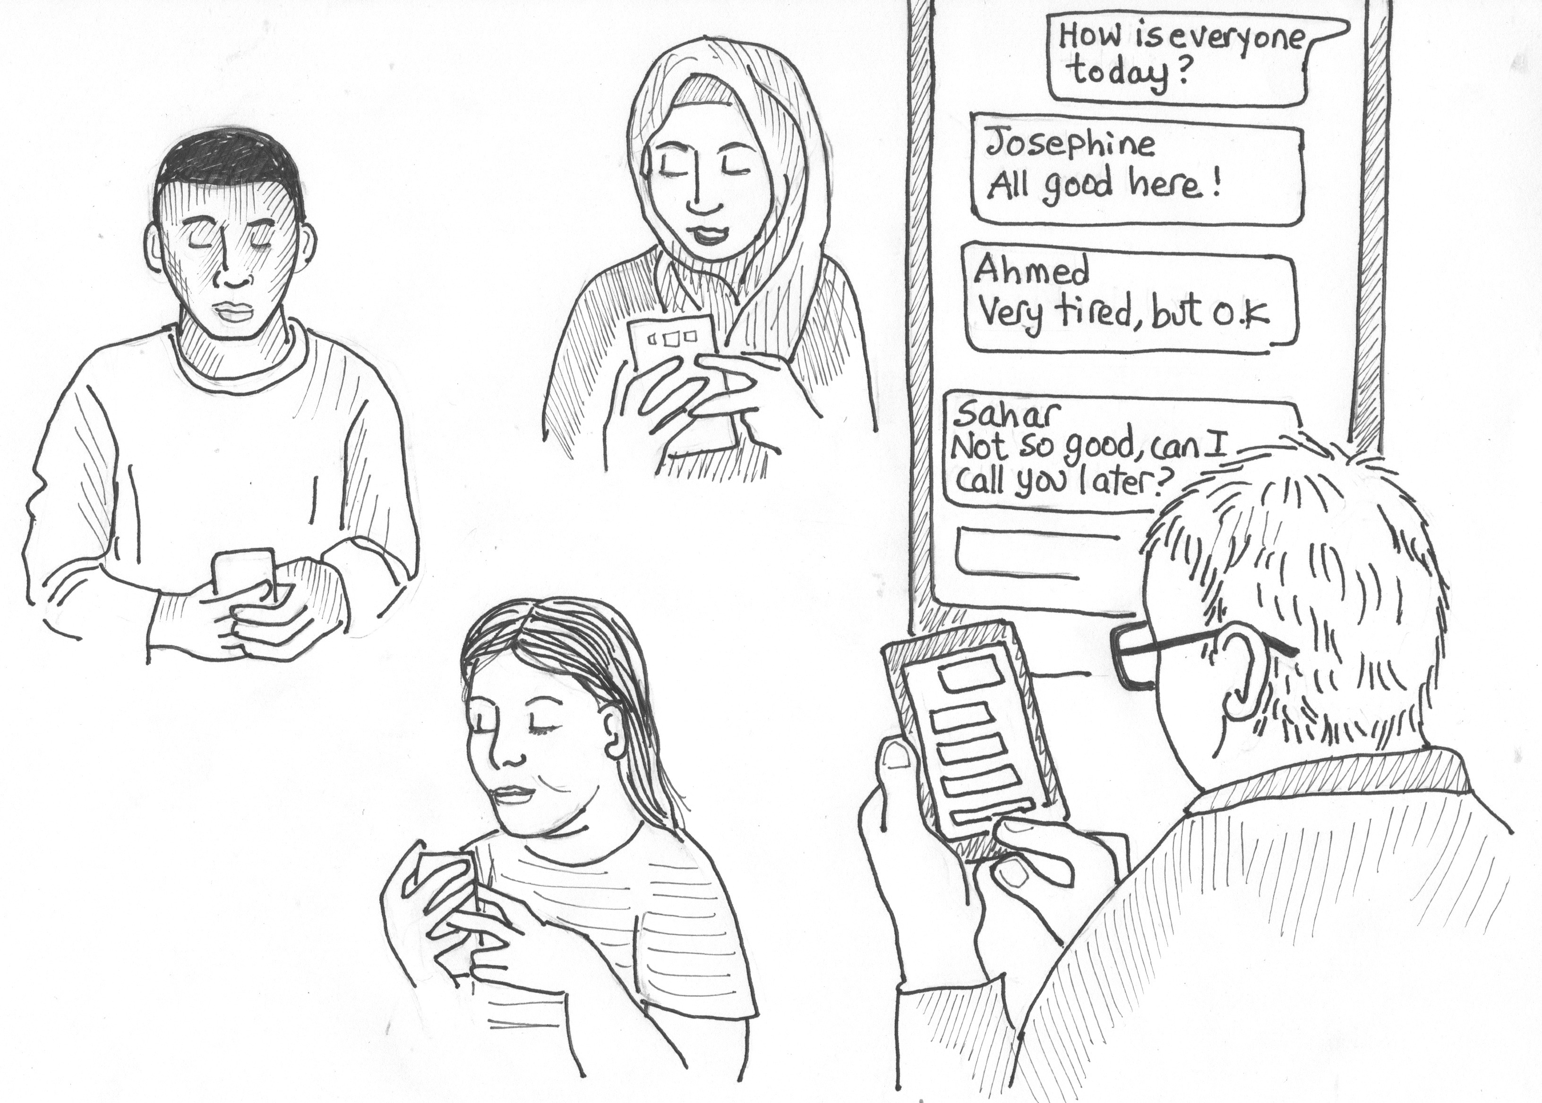
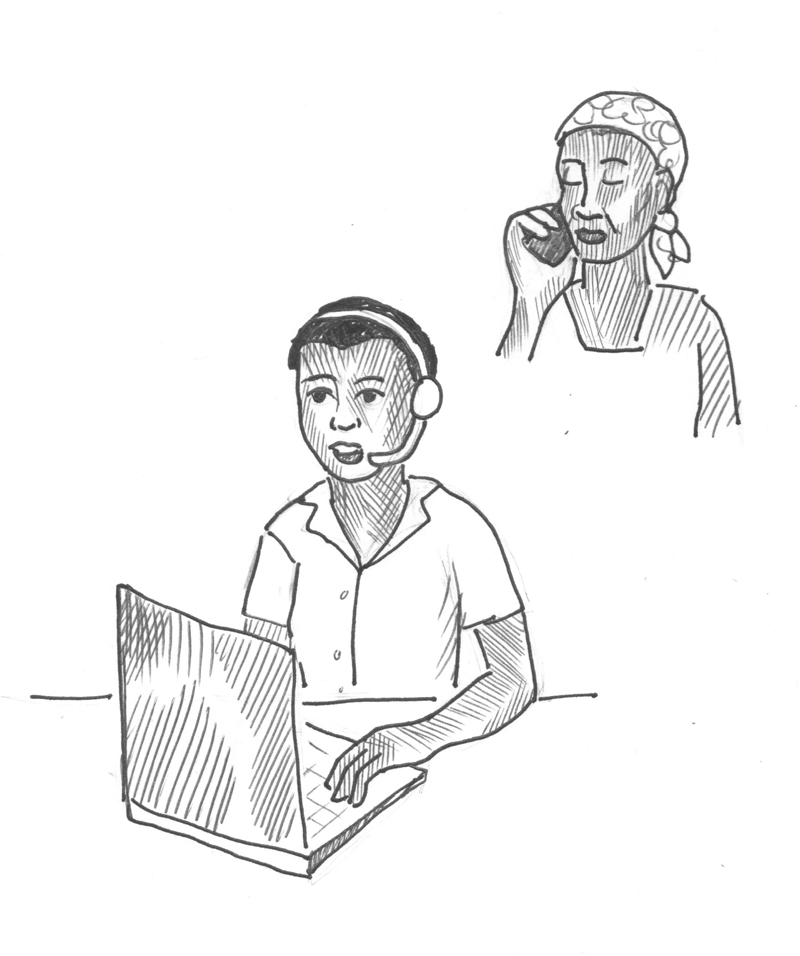
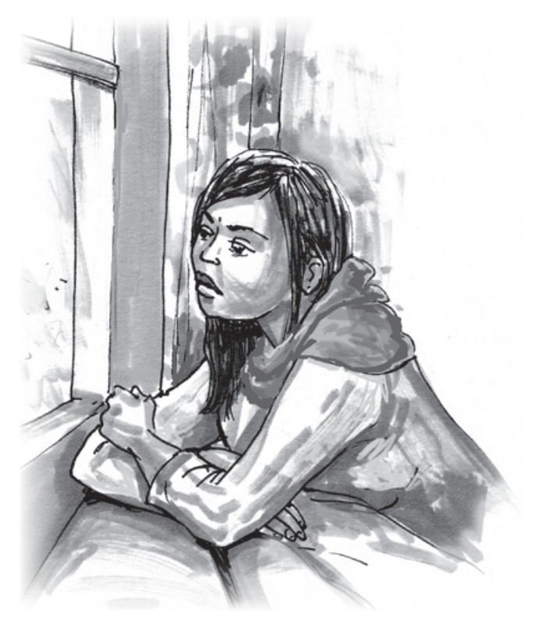
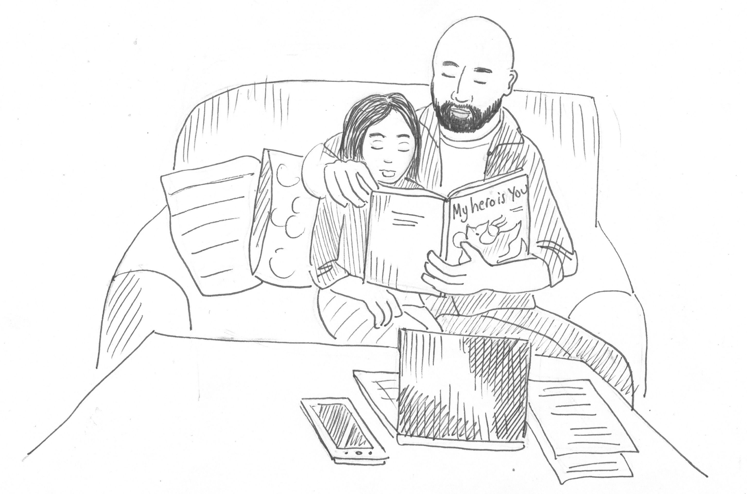
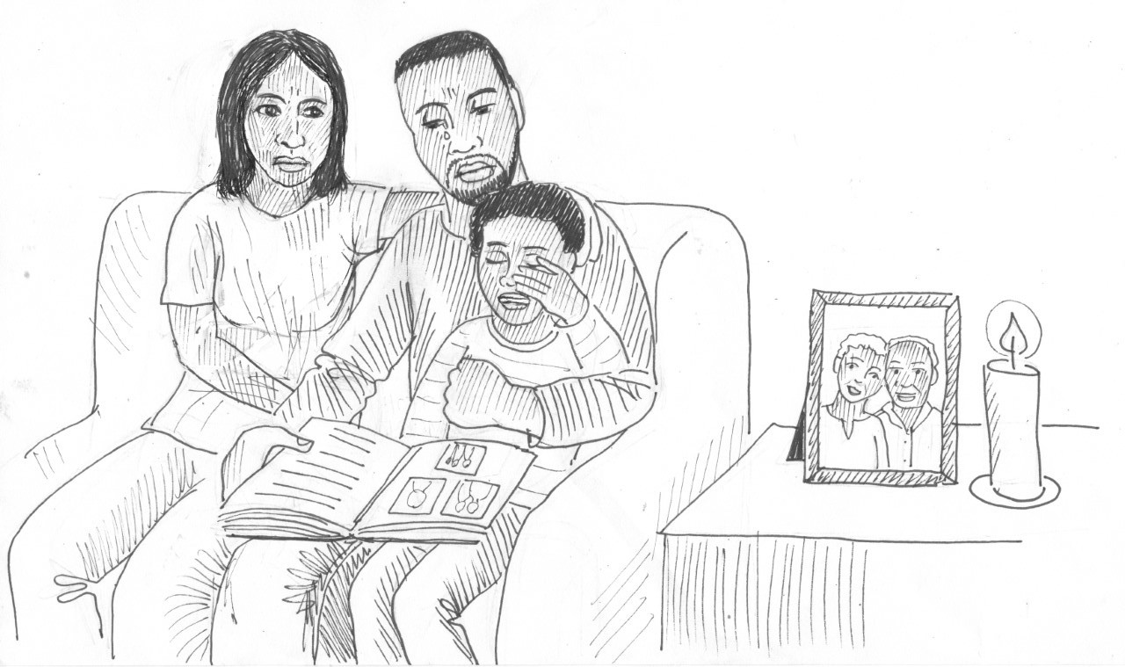
Remote supportive communication
Caring for staff and volunteers remotely
PFA for children
Loss and grief
Vaccine hesitancy
Notes:
The training on PFA for Covid19 is supplemented by five additional modules, on Remote supportive communication, PFA for children, Loss and grief, Caring for staff and volunteers remotely, and Vaccine hesitancy. These trainings are also available on the PS Centre website, and some of them have been recorded and you can download them and listen to the recordings in your own time.

Slide 6
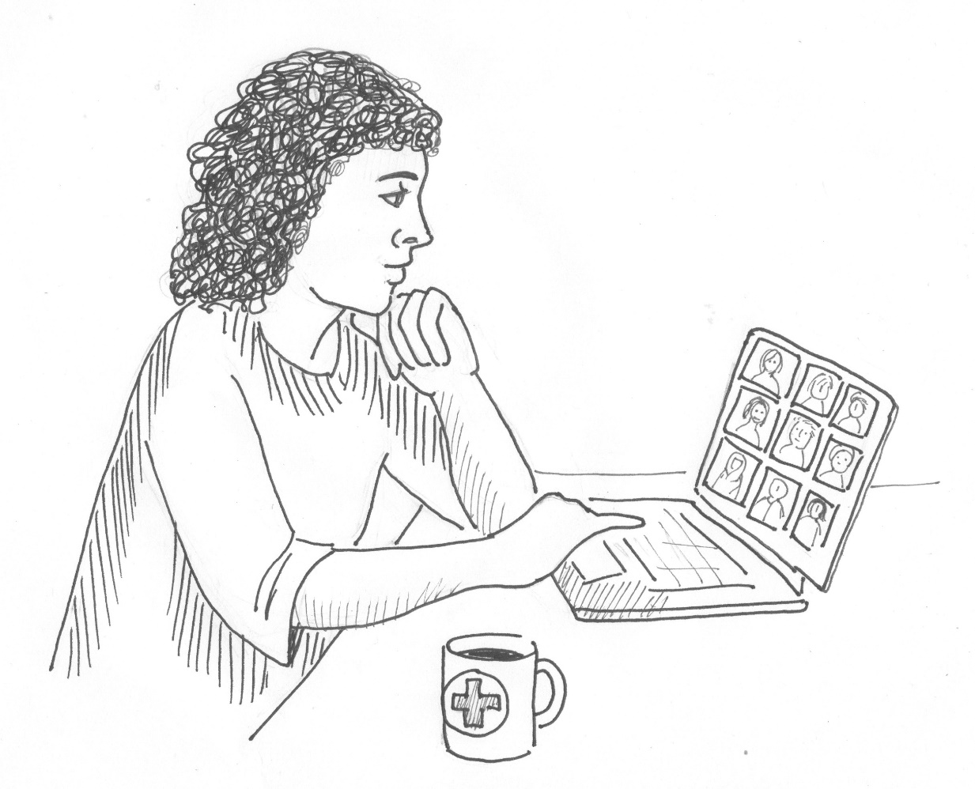
Introduction to training methods
Ground rules
Using chat
Breakout rooms
Role plays
Notes:
As this is an online training, a few points about how we will work together in the next four hours. Establish some ground rules with participants on how they will communicate and interact during the training. For example, as a trainer you can ask that they try to clear their work desk and turn off their phones and email notifications if possible.
[Provide technical information about how the training will function.
For example, here are some things to explain:
Breakaway rooms
Mute when not speaking
Raise your hand if you want to speak
Write short comments in the chat box.]
A good practise with online meetings is to manage feedback and pick on random people to contribute. See below for an example of what you can say:
“During the orientation when we have feedback sessions, I will pick you randomly and ask for your input, to make sure everyone gets a chance to contribute. If you have something very important you want to add after your colleagues have shared, raise your hand and we will see if we have time for more input.’
Participant introductions - optional
If it is a small group ask them to open their cameras and microphones to introduce themselves. If it is a larger group, ask them to introduce themselves on the chat.

Slide 7
Aim of training
Introduce Psychological First Aid (PFA)
Apply PFA skills in short practice role plays
Discuss self-care strategies
Notes:
The aim of the training is to introduce psychological first aid, practice PFA skills, and discuss self-care strategies.
Ask participants why it is important to consider self-care for PFA helpers?
Explain:
It is difficult to encounter people in distress, and very important for helpers to know their own limits and take care of themselves as well, when helping others.
PFA is the abbreviation for Psychological First Aid, and I will use that from now.

Slide 8
Agenda
What is PFA?
Who needs PFA?
When do you provide PFA?
How do you provide PFA?
Self-care
Notes:
During our three hours together, we will look at what PFA is, who can benefit from PFA, when you would provide PFA, and how to provide PFA. And end with a short discussion on self-care.

Slide 9
What is Psychological First Aid?
On a piece of blank paper
Complete the sentence in the simplest way you can:
Psychological First Aid is ……
SYRIAN ARAB RED CRESCENT
Notes:
so, let’s jump straight into it. Before I tell you more about PFA, I would like you to reflect on what you know already. In your worksheet, complete the following sentence in the simplest way you can. I will give you a few minutes to do that.
Psychological First Aid is…..
[Give participants 3 minutes to work on this]
I will now ask some of you to share your definitions.
[Pick different people, and thank them after each presentation.]

Slide 10
Psychological First Aid is ……
a set of skills and knowledge that can be used to help people who are in distress.
a way of helping people to feel calm and able to cope in a difficult situation.
SYRIAN ARAB RED CRESCENT
Notes:
A simple explanation of PFA is that it is
a set of skills and knowledge that can be used to help people who are in distress.
and a way of helping people to feel calm and able to cope in a difficult situation.
PFA rarely stands alone, and is usually accompanied by other support.

Slide 11
Helpful behaviour
Remember a time when you were in distress, and someone helped you.
What was it about the person’s actions or behaviour that was helpful? Or not helpful…?
Raise your hand and share, or write in the chat
SYRIAN ARAB RED CRESCENT
Notes:
Now let’s start focusing on PFA.
I would like all of you to take a minute or so and remember a time when you were in distress, and someone helped you or tried to help you. I don’t want you to focus on the event that led to your feelings of distress, but instead on the helping behaviour of the person helping you.
What was it about the person’s actions or behaviour that was helpful? Or not helpful…?
Please write responses in the chat…..
(Start reading the responses out as people write them)

Slide 12
Psychological First Aid skills involve
knowing how to assess a situation
familiarity with common patterns of reactions to crises
how to approach someone in distress and how to calm them if needed
how to provide emotional support and practical help.
SYRIAN ARAB RED CRESCENT
Notes:
The Psychological First Aid skills that you learn in a PFA training involve
• knowing how to assess a situation
• familiarity with common patterns of reactions to crises
• how to approach someone in distress and how to calm them if needed
• how to provide emotional support and practical help.

Slide 13
Hobfoll et al. (2007)
Psychosocial support
Safety
Calming
Self- and collective efficacy
Connectedness
Hope
SYRIAN ARAB RED CRESCENT
Notes:
Psychological First Aid is psychosocial support and is based on the intervention principles identified by Hobfoll and his colleagues’ for providing psychosocial support in emergencies:
1.The first principles is about promoting a psychological sense of safety, which can be done on individual, group, organization, and community levels.
2.The second principle is promoting calming. It is natural in emergency and crisis situations that people feel anxiety. In fact, some anxiety is a normal and healthy response required to make people pay attention. However, high levels of continued feelings of anxiety and difficult emotions is not good.
3.The third principle, promoting a sense of self-and collective efficacy, supports the importance of having a sense of control of positive outcomes. When we are exposed to crises and emergencies an immediate effect is often a feeling of having lost control. It is important to support people to regain a sense of competency and belief in themselves that they can act, and handle the situation.
4.The fourth principle is promoting social connectedness which provides opportunities for knowledge to essential emergency response information, as well as opportunities for social support activities, including emotional support and understanding.
5. The fifth principle is about promoting and instilling hope. Those who remain positive are likely to have favourable outcomes after going through tough experiences.

Slide 14
True or False? Psychological First Aid is…….
SYRIAN ARAB RED CRESCENT
Notes:
I am now going to show a poll with some statements about PFA, and I would like you answer whether you think the statements are true or false.
Launch the poll and when everyone has completed the questions show the results. If some people give the incorrect answer, ask them to explain why, and also sometimes ask someone who has given the correct answer to explain why.
PFA is
protecting people from further harm (true)
assessing needs and concerns (true)
asking someone to analyze what has happened to them (false)
helping people access information, services and social supports (true)
professional counselling or therapy (false)
something only professionals do (false)

Slide 15
Psychological First Aid is
comforting someone in distress and helping them feel safe and calm
assessing needs and concerns
protecting people from further harm
providing emotional support
helping to address immediate basic needs, such as food and water, a blanket or a temporary place to stay
helping people access information, services and social supports.
SYRIAN ARAB RED CRESCENT
Notes:
Here is a summary of the statements that are true for PFA:
PFA is
comforting someone in distress and helping them feel safe and calm
assessing needs and concerns
protecting people from further harm
providing emotional support
helping to address immediate basic needs, such as food and water, a blanket or a temporary place to stay
helping people access information, services and social supports.

Slide 16
Psychological First Aid is not
something only professionals do
professional counselling or therapy
encouraging a detailed discussion of the event that has caused the distress
asking someone to analyze what has happened to them
pressing someone for details on what happened
pressuring people to share their feelings and reactions to an event.
Notes:
There are some misunderstandings about PFA that are important to clear up. These are listed here and include attention to that
PFA is not something only professionals do.
It is also not professional counselling or therapy, or
encouraging a detailed discussion of the event that has caused the distress
It is not asking someone to analyze what has happened to them, or
pressing someone for details on what happened, or
pressuring people to share their feelings and reactions to an event.
(Ask participants for any questions and answer these).

Slide 17
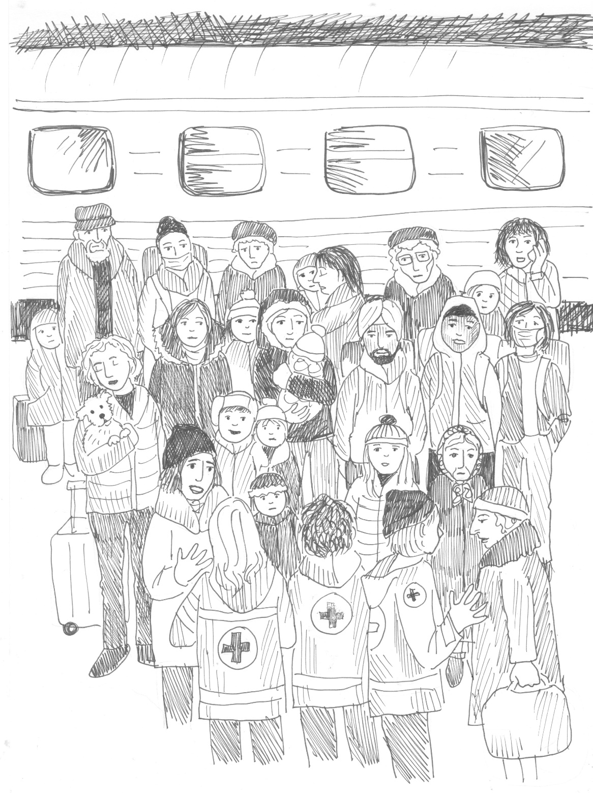
Who needs PFA?
Remember…
Not all people need or want PFA!
CARL WHETHAM / IFRC
Notes:
(Ask participants before giving your input “Who do you think needs PFA?”)
PFA can be of help to anyone in distress. However, not everyone who is in distress may need or want PFA. Some people can manage difficult situations on their own or with help from others and may not need your help.
PFA can help people who are going through personal crises, including social or health challenges. It is also an important part of larger scale responses to disasters, conflict and violence and forced migration.

Slide 18
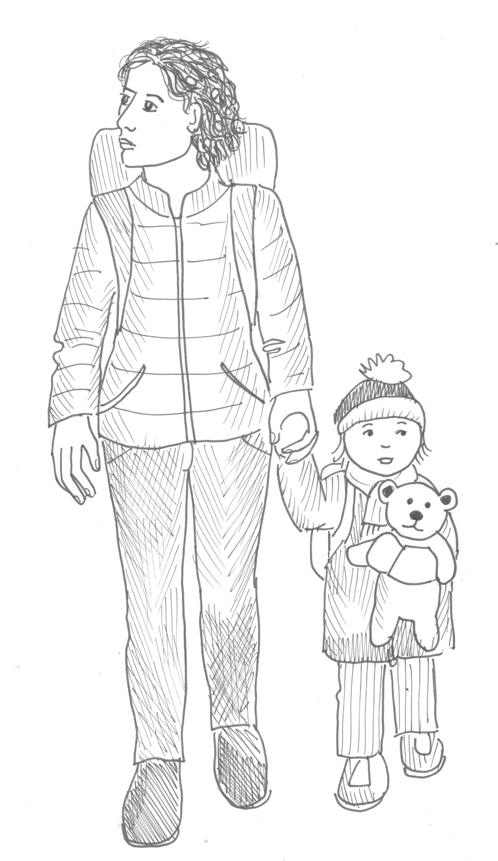
When do you provide PFA?
CARL WHETHAM / IFRC
Notes:
When do you think PFA helps?
[Ask for input from participants by raising their hands]

Slide 19
When do you provide PFA?
when someone is in distress
during, immediately after, shortly or long after a crisis
emergency and non-emergency
personal or larger crises
CARL WHETHAM / IFRC
Notes:
A simple answer is – when someone feels distress.
It can be during a stressful situation – for example while someone is going through a life changing event, such as a divorce. It can be immediately after something has happened, for example after someone has heard some stressful news, or been in a car accident. It can be weeks after an event has taken place, or even months or years, if something reactivates feelings of distress. [It is really good to stress this point!]
PFA skills can help in emergency and non-emergency situations, and in personal or public crises. The key factor to consider is whether a person is in distress, and if the person needs and wants your help.

Slide 20
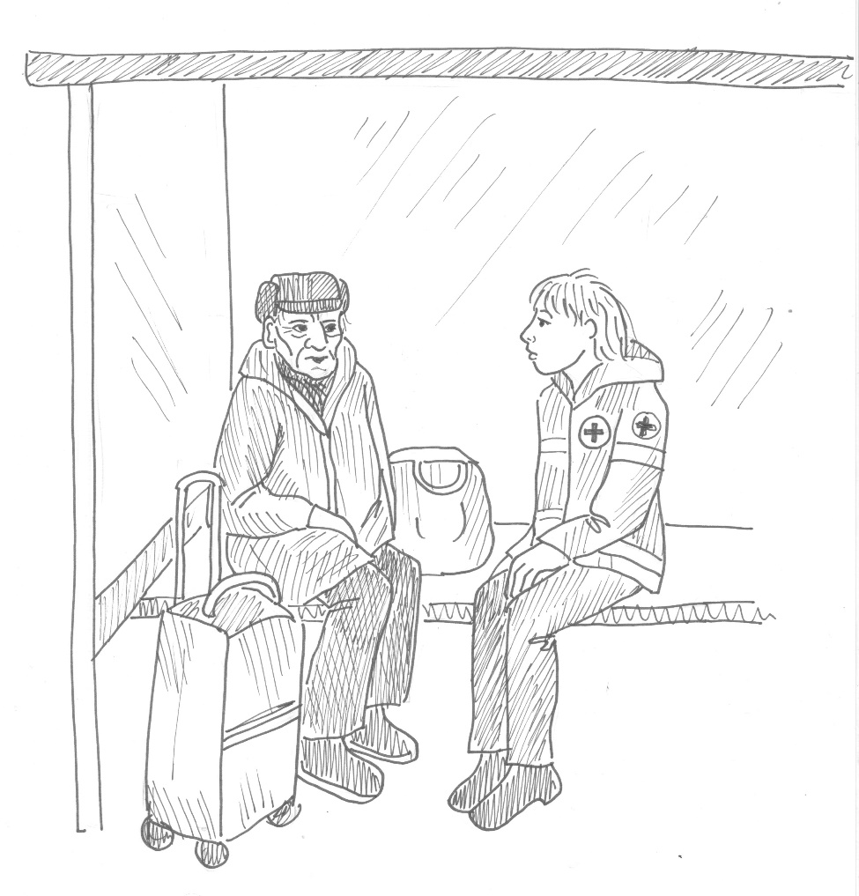
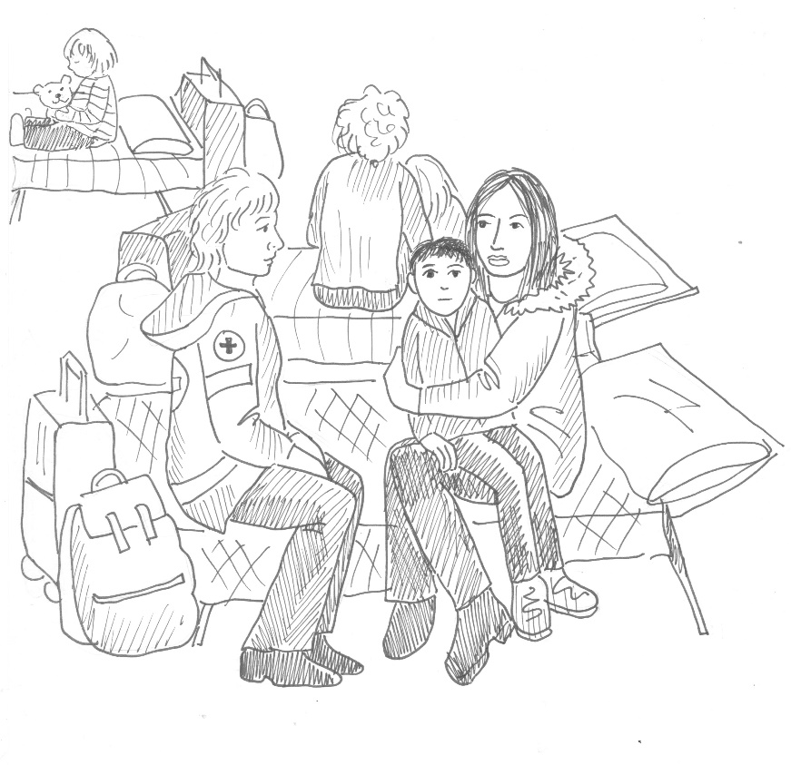
Where can you provide PFA?
CARL WHETHAM / IFRC
Notes:
Where do you think you can provide PFA to someone?
[Ask for input from participants by raising their hands]
You can provide PFA in any location where you and the person in distress are both safe. If possible, it is best to provide PFA in a private setting, where the person in distress can feel comfortable sharing the challenges they are facing. If this is not possible, it is good to try to talk with the person a little away from others, to give them as much privacy as possible.
If you are talking with a child, or someone who is sitting on the ground, it is good practice to also sit on the ground with them, or crouch down so you are at the same levels as them. It can be intimidating for a person in distress to talk with someone who is hovering above them.

Slide 21
DO NO HARM
Safety
Avoid putting people at further risk as a result of your actions.
Make sure to the best of your ability that the people you help are safe and protect them from physical or psychological harm.
Dignity
Treat people with respect and in accordance with their cultural and social norms.
Rights
Make sure people can access help fairly and without discrimination.
Help people to claim their rights and access available support.
Act only in the best interest of any person you encounter.
Psychological First Aid
CARL WHETHAM / IFRC
Notes:
PFA is a method of helping people in distress that is based on the fundamental principle of DO NO HARM that we always follow in Mental Health and Psychosocial Support responses.
To ensure that we do no harm, we pay attention to offering help that promotes safety, dignity and is rights based.
This means that we make efforts to
Avoid putting people at further risk as a result of our actions, and do everything we can to ensure the people we are helping are safe, and protected from physical or psychological harm.
Concerning dignity, it means always treating people with respect and in accordance with their cultural and social norms.
Fulfilling people’s rights involves making sure people can access help fairly and without discrimination. It also means helping people to claim their rights and access available support.
And we always act only in the best interest of any person we encounter.

Slide 22
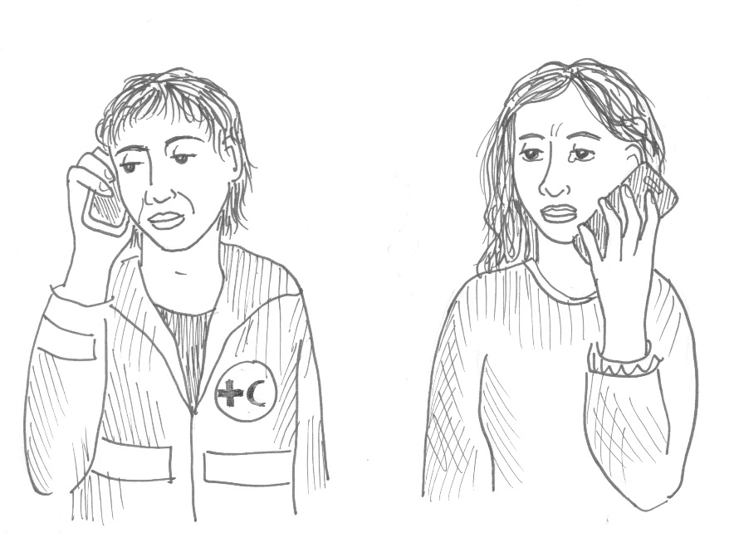

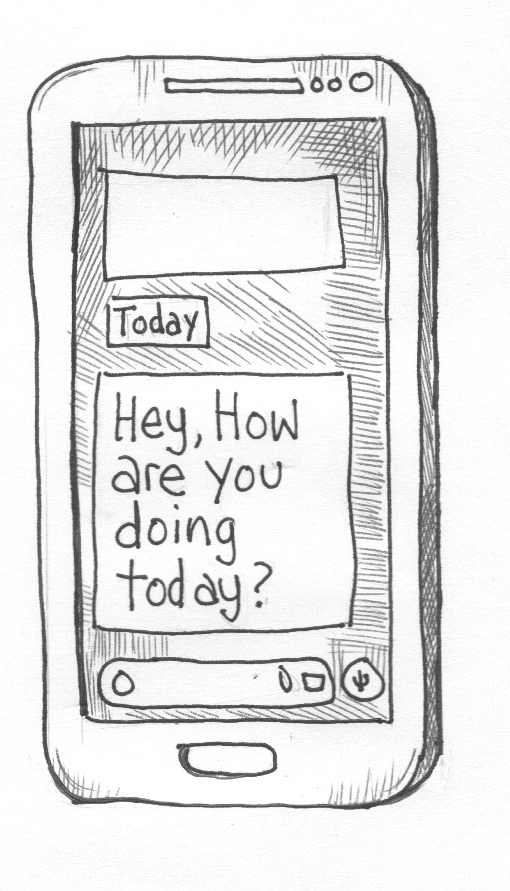
How to provide PFA
Face-to-face
Phone calls
Video calls
SMS/WhatsApp/Messages
CARL WHETHAM / IFRC
Notes:
There are many ways we can support someone who is in distress and provide. It can be face-to-face, or it can be remote support through phone calls, videos calls, and short messages on the phone.

Slide 23

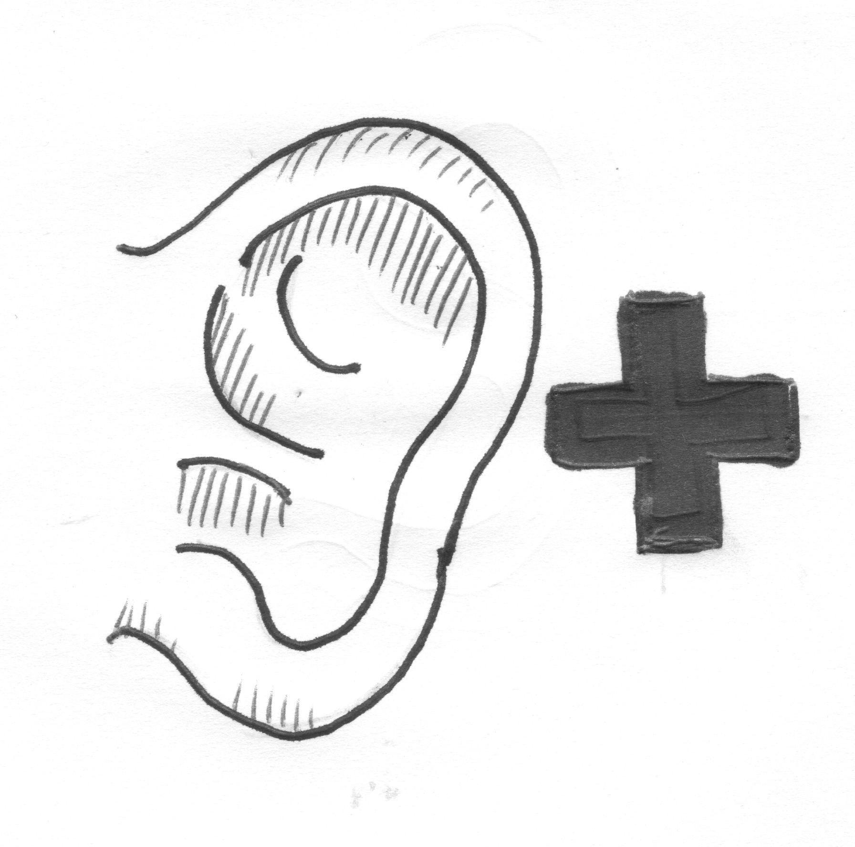
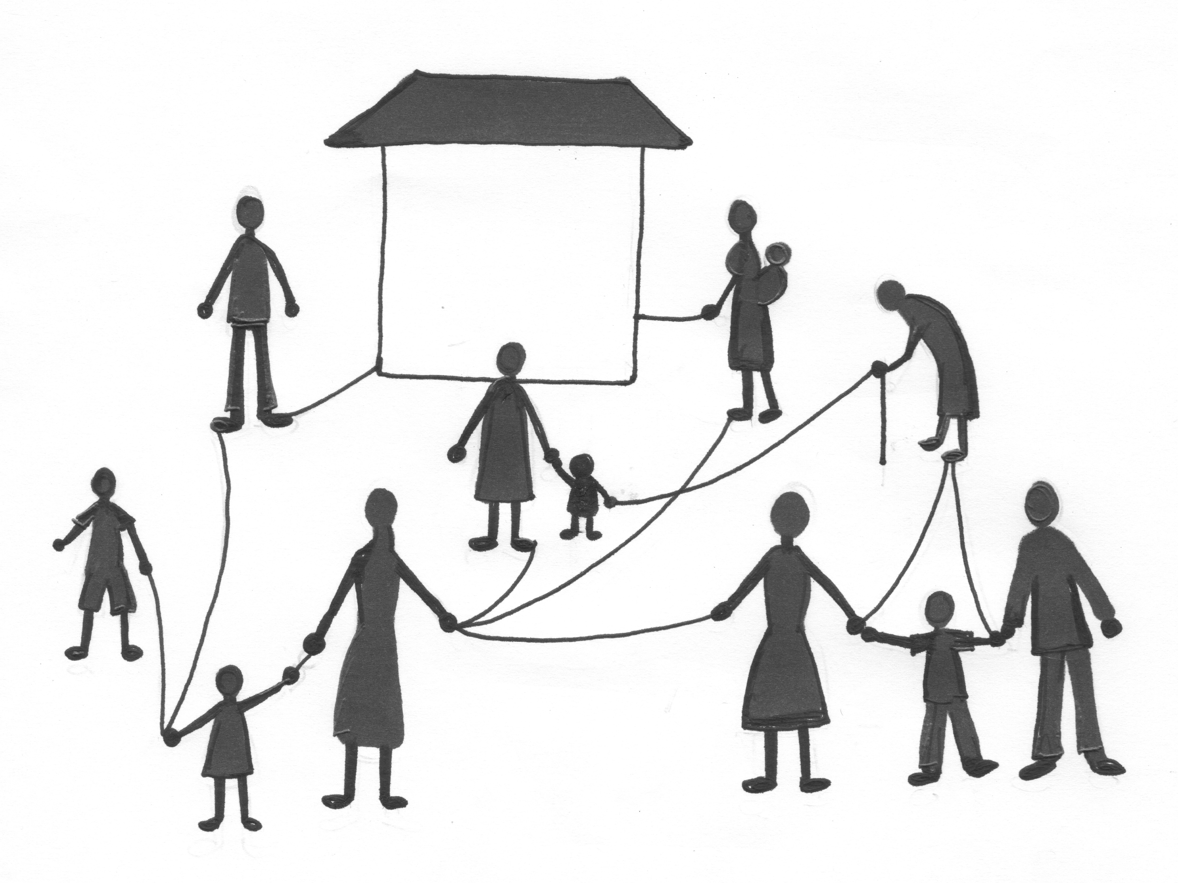
LOOK
Action principles
LISTEN
LINK
CARL WHETHAM / IFRC
Notes:
PFA is based on the three action principles of Look, Listen and Link. This model and approach to PFA was developed by the World Health Organization, and is used by many humanitarian actors throughout the world.
We will look at what each of these action principles involve.

Slide 24
Look for
information on what has happened and is happening
who needs helps
safety and security risks
physical injuries
immediate basic and practical needs
emotional reactions.
CARL WHETHAM / IFRC
Notes:
The first action principle LOOK involves assessing the situation to find out who needs help, what the safety and security risks are and if there are any physical injuries. It also involves attending to any immediate basic and practical needs, such as providing the person in distress with a blanket, or a glass of water, to help them feel safe and comfortable. LOOK also involves observing and identifying emotional reactions.

Slide 25
Common reactions
What are common reactions of people facing situations of conflict and uncertainty?
Group activity
Discuss and list the different common reactions people have when facing situations of conflict and uncertainty.
Consider physical, behavioural, emotional, cognitive, or spiritual.
CARL WHETHAM / IFRC
Notes:
5 minutes to work on task, each group has max 2 mins to present – 15 mins in total

Slide 26
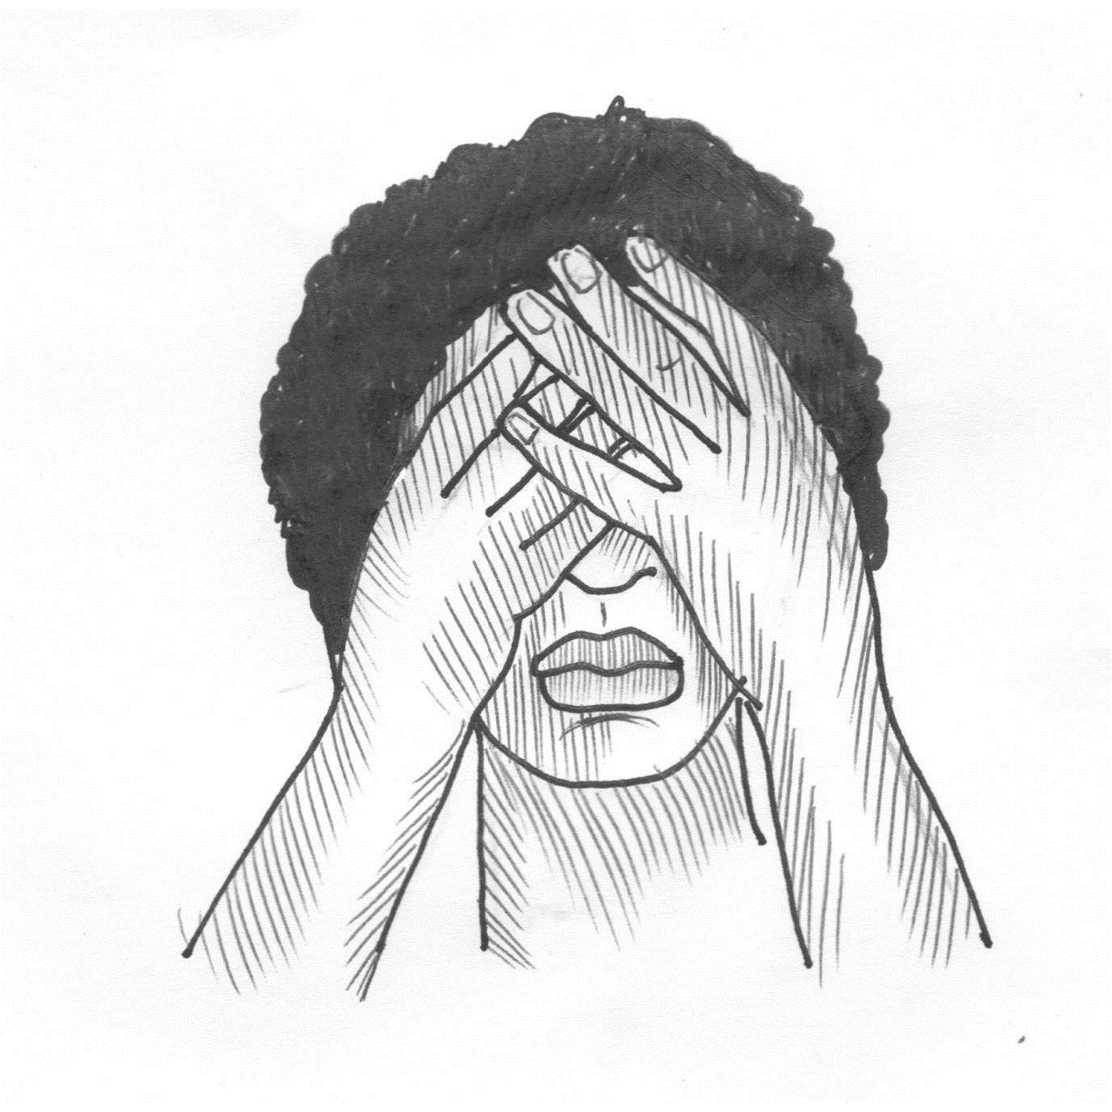
Signs and symptoms of distress
Physical
CARL WHETHAM / IFRC
Notes:
What are some physical signs of distress that you know of? This can be symptoms you know you have when you are stressed, or that you know others have.
(First ask participants for their contributions, and when they have given all their contributions, then click to show your list and explain these are the things you thought of before the training, some may already have been mentioned by participants).
Here are the ones I thought of:
Problems with sleeping
Stomach problems like diarrhea or nausea
Shaking
Sweating
Rapid heart rate
Feeling very tired
Muscle tremors and tension
Back and neck pain due to muscle tension
Headaches
Inability to relax and rest
Being frightened very easily

Slide 27

Behavioural
Signs and symptoms of distress
CARL WHETHAM / IFRC
Notes:
What are some behavioural signs of distress that you know of? This can be symptoms you know you have when you are stressed, or that you know others have.
(First ask participants for their contributions, and when they have given all their contributions, then click to show your list and explain these are the things you thought of before the training, some may already have been mentioned by participants).
Here are examples you can use:
Screaming
Crying
Laughing uncontrollably
Not moving
Unable to keep still
Over-eating or under-eating
Hyper-alertness
Aggression and verbal outbursts
Withdrawal and isolation
Risk-taking e.g. driving recklessly
Increased smoking
Having no energy at all
Alcohol or drug use
Compulsive behaviour, i.e. nervous tics and pacing

Slide 28
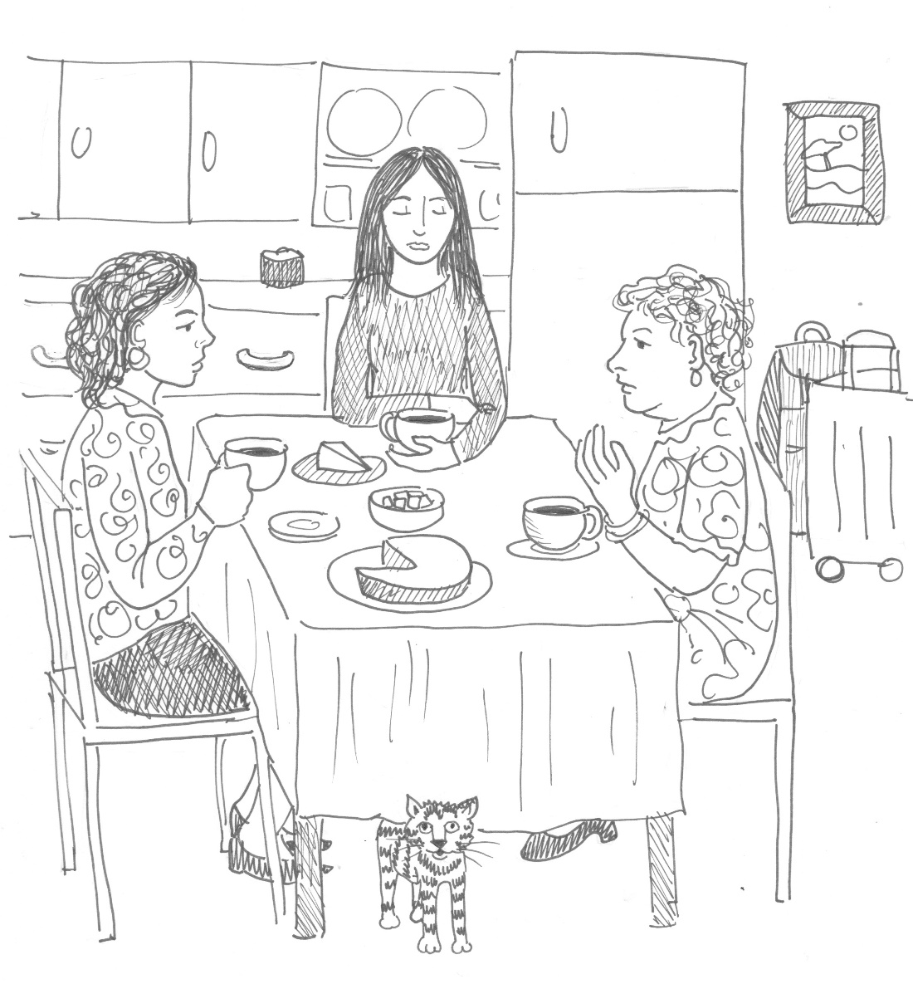
Emotional
Signs and symptoms of distress
CARL WHETHAM / IFRC
Notes:
What are some emotional signs of distress that you know of? This can be symptoms you know you have when you are stressed, or that you know others have.
(First ask participants for their contributions, and when they have given all their contributions, then click to show your list and explain these are the things you thought of before the training, some may already have been mentioned by participants).
Here are the ones I thought of:
Shock
Fear
Anger
Sadness
Anxiety
Not feeling any emotions
Mood swings: feeling happy one moment and sad the next moment
Feeling over-emotional
Being quickly irritated

Slide 29
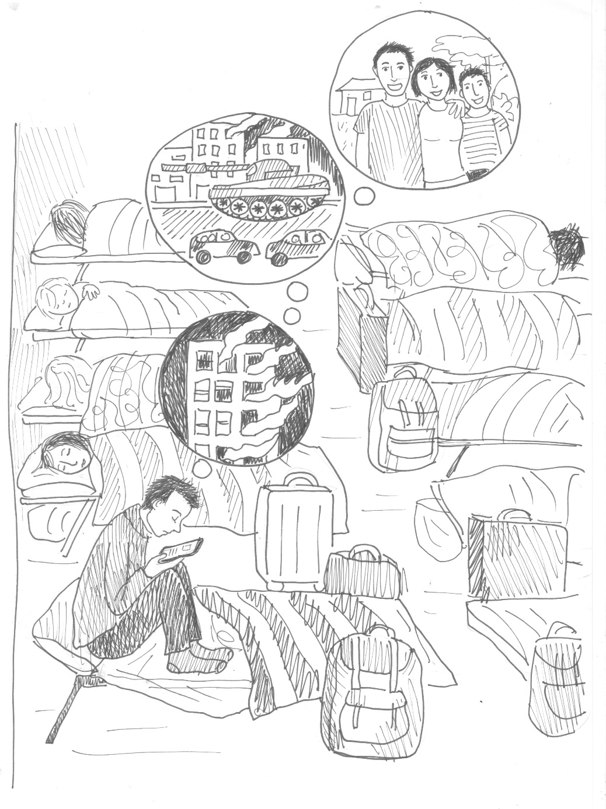
Cognitive
Signs and symptoms of distress
CARL WHETHAM / IFRC
Notes:
What are some cognitive signs of distress that you know of? This can be symptoms you know you have when you are stressed, or that you know others have.
(First ask participants for their contributions, and when they have given all their contributions, then click to show your list and explain these are the things you thought of before the training, some may already have been mentioned by participants).
Here are the ones I thought of:
Poor concentration
Feeling confused
Disorganised thoughts
Forgetting things quickly
Difficult making decisions
Dreams or nightmares
Intrusive and involuntary thoughts

Slide 30
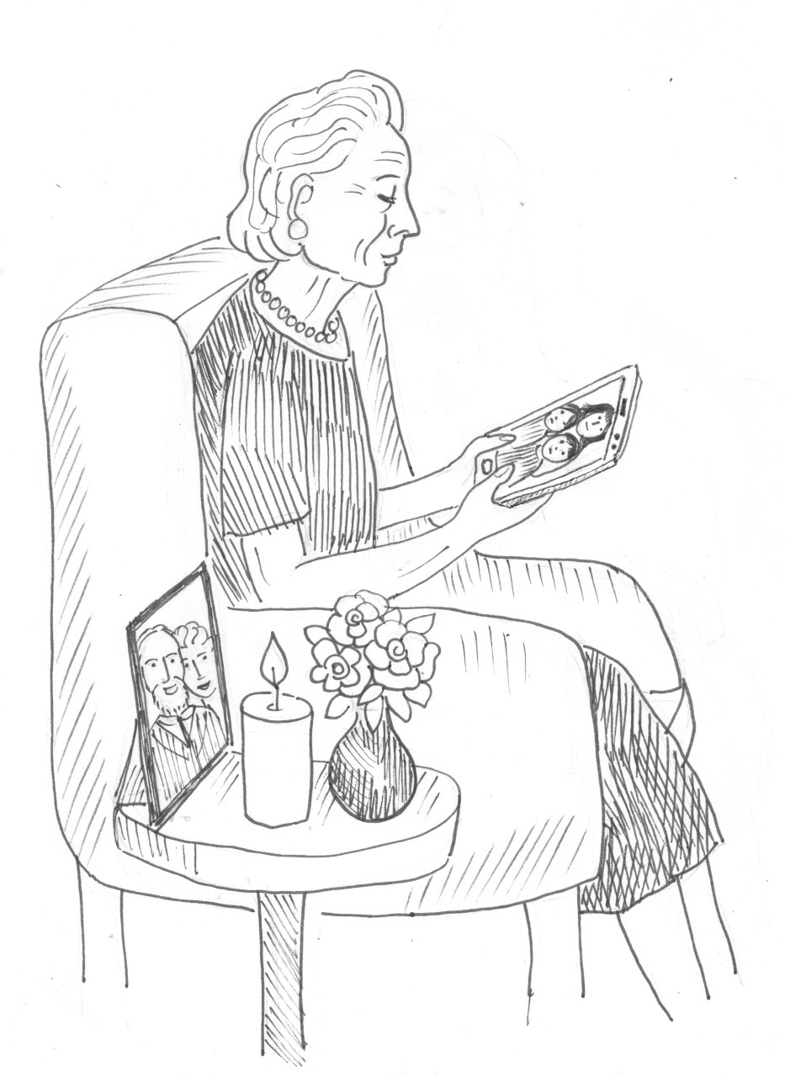
Spiritual
Signs and symptoms of distress
CARL WHETHAM / IFRC
Notes:
What are some spiritual signs of distress that you know of? This can be symptoms you know you have when you are stressed, or that you know others have.
(First ask participants for their contributions, and when they have given all their contributions, then click to show your list and explain these are the things you thought of before the training, some may already have been mentioned by participants).
Here are the ones I thought of:
Feelings of emptiness
Loss of meaning
Feeling discouraged and loss of hope
Increasingly negative about life
Doubt
Anger at God
Alienation and loss of sense of connection

Slide 31

Common vs. severe reactions
CARL WHETHAM / IFRC
Notes:
An important part of LOOK, is being able to identify common and severe reactions and what to do if severe reactions require immediate referral for further help.
Some people react more strongly than others, either due to the excessive stress they are feeling, or due to other influential factors, such as earlier experiences, levels of perceived threat or danger, or because of their chosen coping strategies. When reactions are more severe, they interfere with daily functioning and can lead to harm. It is important to be able to identify such reactions and to know what to do and who to refer to, if the person in distress needs immediate or urgent additional help.

Slide 32
Examples of severe reactions
Is unable to sleep for a week or more and is confused and disorientated
unable to function normally and care for themselves or their family (e.g. not eating or keeping clean)
has lost control over their behaviour and is unpredictable or destructive
threatens to harm themselves or others
starts excessive or out-of-the-ordinary use of drugs or alcohol
presents chronic health conditions which need specialised support
presents symptoms of mental health disorders
CARL WHETHAM / IFRC
Notes:
Examples of severe reactions that call for immediate attention and intervention and or referral include
Is unable to sleep for a week or more and is confused and disorientated
unable to function normally and care for themselves or their family (e.g. not eating or keeping clean)
has lost control over their behaviour and is unpredictable or destructive
threatens to harm themselves or others
If a person presents with any of these signs or symptoms, the helper should help the person in distress access additional help as soon as possible.

Slide 33
Activity
View the video clip and note down how the helper applied the LOOK actions in the call.
CARL WHETHAM / IFRC
Notes:
Introduce the video and ask them to pay attention to how I apply the LOOK actions –
[Show first video/audio clip that includes introduction where helper asks some questions to get a fuller picture of what is going on and how the person is].

Slide 34

LISTEN refers to how the helper
introduces oneself
pays attention and listens actively
accepts others’ feelings
calms the person in distress
asks about needs and concerns
helps the person in distress find solutions
to their immediate needs and problems.
Notes:
This action principle refers to the way the helper communicates with the person(s) in distress from the moment they are in contact with and start to interact with them. The reason the icon for Listen is an ear with a plus is the actions of LISTEN are more than only what we do with our ears. What we do with our ears is hearing. Listening involves a person’s attitude and behaviour, as well as hearing. Listen refers to how we communicate with others, and in PFA this refers to what we call supportive communication, and active listening.
LISTEN also refers to calming the person in distress and helping them find solutions to their immediate needs and problems.

Slide 35


Supportive communication and active listening
CARL WHETHAM / IFRC
Notes:
LISTEN actions rely on the PFA skills of supportive communication and especially on active listening. Active listening is a powerful skill that can benefit in all aspects of life, and not only in the context of psychological first aid.
Active listening is more than just hearing what someone says. It is a communication skill that is both verbal and nonverbal.
Ask participants of examples of how one can demonstrate nonverbal listening?
Nonverbal listening is demonstrated through body language, eye contact, the space between two people, body positioning and focusing on the other person. If it is on a video call, facing the person and showing they have your full attention. Some people show they are listening by nodding or moving their head a little. If it is on a phone-call it is having the conversation in a private and quiet setting and responding to the caller every now and then to show you are listening. Some people make small noises, like uh-huh, or ‘hmm’ to show they are listening if a person talks for a while.
Ask participants of examples of how one can demonstrate verbal listening?
Verbal parts of active listening are asking questions to improve understanding of the situation; rephrasing and summarizing what the person has said in your own words (to ensure and confirm understanding) and being encouraging and supportive.

Slide 36

Calming someone in distress
What are some of the ways you know can help to calm someone in distress?
Answer in CHAT
CARL WHETHAM / IFRC
Notes:
Now we will look more closely at how to calm someone remotely, as this is a PFA skill that may come in handy during this time of physical distancing.
First, let me hear from you, what are some examples of ways you know that one can use to help calm someone down who is in distress?
[Ask participants to write their responses in the chat)

Slide 37
Calming someone in distress
Activity
View the video clip and note down how the helper applied the LISTEN actions in the call and what methods the helper used for calming.
CARL WHETHAM / IFRC
Notes:
[Show a video clip or play an audio clip that demonstrates one or more ways of calming a person down.]
Have a look at the next part of the video, and see if there are any additional methods of calming we can add to our list that we don’t have yet.
[Add any additional methods of calming to the list mentioned by the group, after watching the video.]

Slide 38

Calming someone in distress
keep the tone of your voice calm and soft
try to stay calm yourself
assure the person you are listening
explore physical symptoms and assess if there is a need for medical help
remind the person of your intent to help and that they are safe, if it is true
encourage calm and mindful breathing
encourage the person to ground with the earth or chair they are sitting on.
CARL WHETHAM / IFRC
Notes:
Here is a summary of different things you can do to help calm someone in distress, and these are all methods you can use when supporting someone remotely.
keep the tone of your voice calm and soft
try to stay calm yourself
assure the person you are listening
explore physical symptoms and assess if there is a need for medical help
remind the person of your intent to help and that they are safe, if it is true
encourage calm and mindful breathing
encourage the person to ground with the earth or chair they are sitting on.

Slide 39
LINK refers to helping the person in distress
access information
connect with loved ones and social support
tackle practical problems
access services and other help.
DIEGO CASTELLANOS/ECUADORIAN RED CROSS
Notes:
Remember what I said at the beginning of the orientation? PFA rarely stands alone, and is usually accompanied by other support.
The actions of LINK usually have practical outcomes. They include giving information, and helping people address immediate basic needs so they can cope better with their situation. The role of the helper is to help the person help themselves and to regain control of their situation.
LINK actions include helping a person access information, connecting someone in distress with loved ones and social support, providing help to tackle practical problems and to get access to other help as needed. An key part of LINK skills is for the helper to know and understand their own limits, in terms of what help they can provide, and when (and where) they need to refer for help to elsewhere.

Slide 40
Severe reactions
Is unable to sleep for a week or more and is confused and disorientated
unable to function normally and care for themselves or their family (e.g. not eating or keeping clean)
has lost control over their behaviour and is unpredictable or destructive
threatens to harm themselves or others
starts excessive or out-of-the-ordinary use of drugs or alcohol
presents chronic health conditions which need specialised support
presents symptoms of mental health disorders
CARL WHETHAM / IFRC
Notes:
When we earlier talked about the LOOK actions, we explored signs and symptoms of distress that call for immediate referral for additional help. Here is the list again.
If a person presents with any of these signs or symptoms, the helper should try to help the person in distress access additional help as soon as possible.

Slide 41
LINK – knowing how and where to refer
Where can you refer someone having a severe reaction in your community?
Answer in CHAT
DIEGO CASTELLANOS/ECUADORIAN RED CROSS
Notes:
An important skill to learn is where to refer someone who has a severe reaction? Can you share where you would refer someone who is having a severe reaction in your community?
(Ask participants to write their responses in the chat.)

Slide 42
LINK – knowing how and where to refer
Besides formal services, where else can you refer people for support?
Answer in CHAT
DIEGO CASTELLANOS/ECUADORIAN RED CROSS
Notes:
An important skill to learn is where to refer someone who has a severe reaction? Can you share where you would refer someone who is having a severe reaction in your community?
(Ask participants to write their responses in the chat.)

Slide 43
Activity
View the video clip and pay attention to what the helper does well and what the helper misses.
CARL WHETHAM / IFRC
Notes:
Watch the next video clip. Pay attention to all of the PFA skills that are demonstrated and in particular the ones related to LINK actions.
NOTE: In the video clip LINK that accompanies this training, the helper DOES NOT mention Restoring Family Links or where the person in distress can find help to locate her sister. This is a key part of LINK in PFA; and should be discussed after viewing the video. Ask participants what they think was missing, and ask them to demonstrate how they would say this in a similar situation.
[Show a video clip that demonstrates some LINK actions, such as exploring or encouraging contact and social support with loved ones, or referring the person in distress for further help elsewhere. You can also demonstrate psychoeducation and providing information to the person that will help them understand their own reactions and behaviours and with advice on how to manage this. An example is providing information and tips on how to sleep better.]

Slide 44
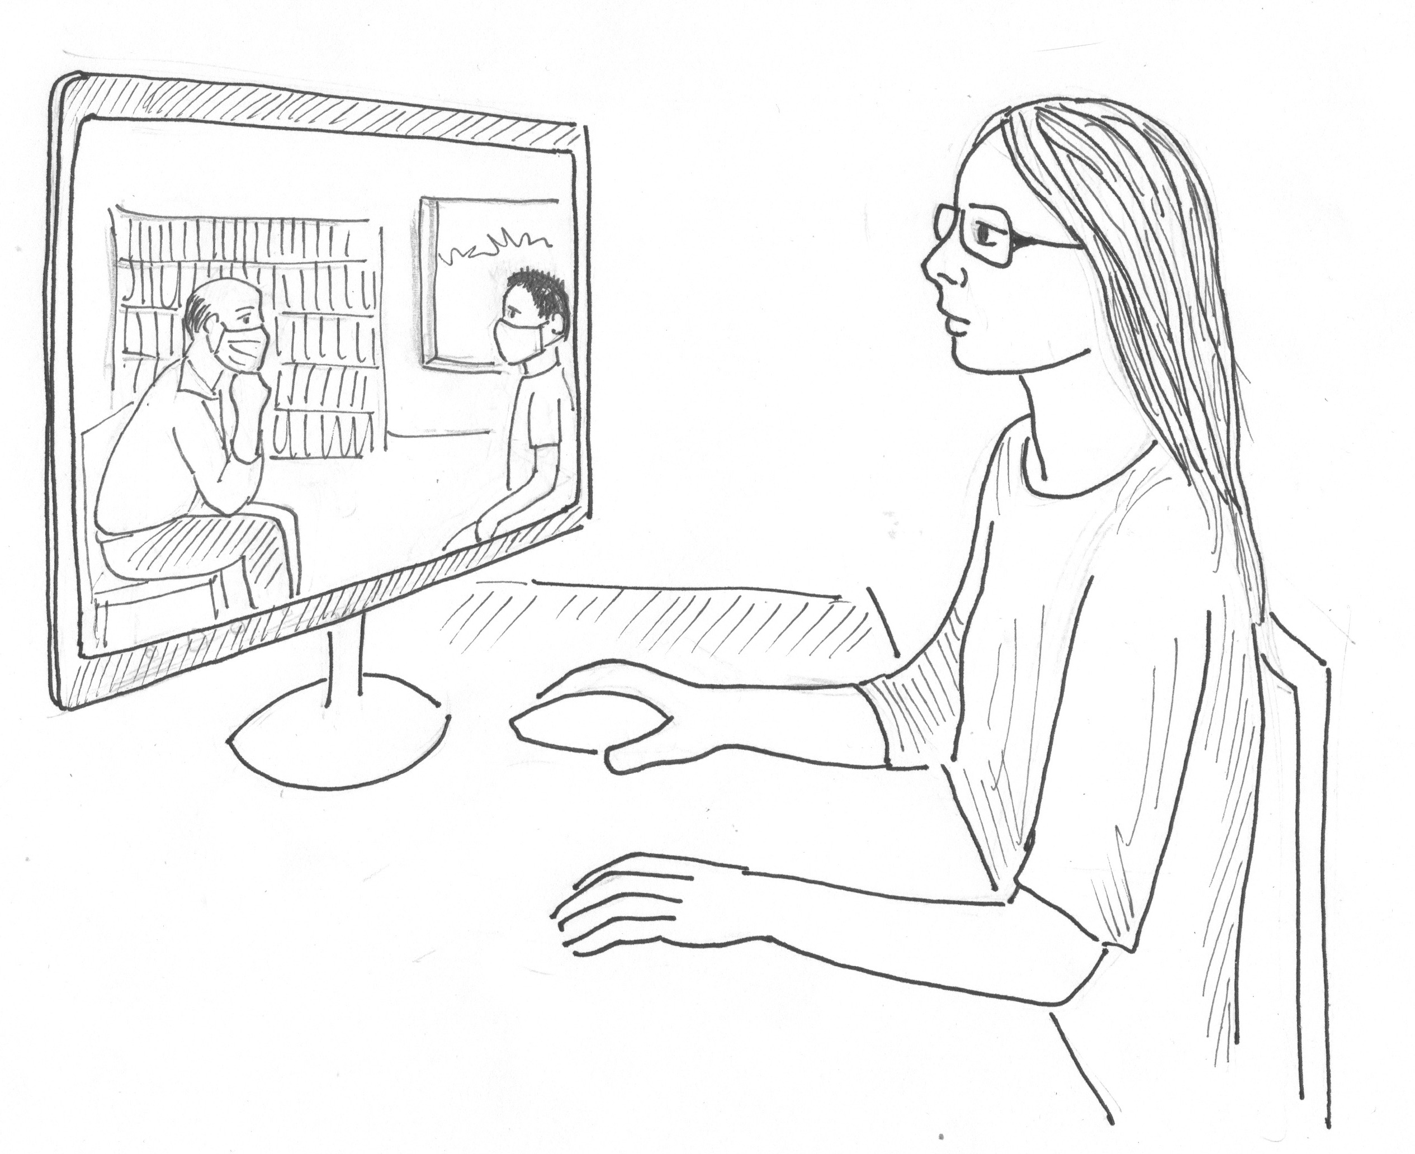
Role plays
Practice PFA in groups of 3
One person will be the PFA helper
One person will be in distress
One person will observe and give feedback
You have 3 x 5 minutes for this activity. Divide the session like this:
1 minute for role allocation and preparation.
2.5 minutes for PFA practice
1 minute for feedback
30 seconds break
When giving feedback follow these steps:
1. What did the helper do well?
2. What can they improve next time?
3. End with an overall positive comment.
CARL WHETHAM / IFRC
Notes:
Divide into groups of 3.
Give participants 15 minutes – 3 x 5 minutes
Give instructions:
You will now have a chance to practise your newly learnt PFA skills in groups of three.
One person will be the PFA helper
One person will be in distress
One person will observe and give feedback
You have 3 x 5 minutes for this activity. Each set can be divide like this:
1 minute for role allocation and preparation.
2.5 minutes for PFA practise
1 minute for feedback
30 second break
When giving feedback follow these steps:
1. What did the helper do well?
2. What can they improve next time?
3. End with an overall positive comment.
After 4 minutes, switch case study and switch roles. At the end of the activity, everyone has had a chance to be in each role.
Case study 1:
You are working as RC volunteer on a hotline. A teenager calls you in distress because they have been told to evacuate their town due to violence. They feel scared and don’t know what they should do.
Case study 2:
Your friend calls you in distress for advice because their child is very upset after seeing news about a war on television/social media.
Case study 3:
Your work colleague starts telling you how completely overwhelmed and exhausted they feel due to all the extra work they are being asked to do related to a humanitarian crisis. They feel like they cannot say no to the work and shouldn’t complain because the people affected are worse off than they are.

Slide 45

Preparing to help
Group activity
Discuss and list what you need to prepare to provide PFA?
CARL WHETHAM / IFRC
Notes:
Now we have looked at what PFA is, and what it is not.
We have also looked in detail at the three action principles of Look, Listen and Link.
Now let’s look at what you, as a helper – either as a frontline responder, or a health care worker, need to prepare to be able to provide helpful PFA to people who are in distress.
Take are few minutes to think about what you need to prepare to provide such help. These may be personal things you have to prepare (such as practicing active listening skills), or they may be more practical things (such as updating your knowledge of the local referral system).
[Give participants 1 minutes to work on this. After 1 minute pick a few people to share what they have listed]

Slide 46
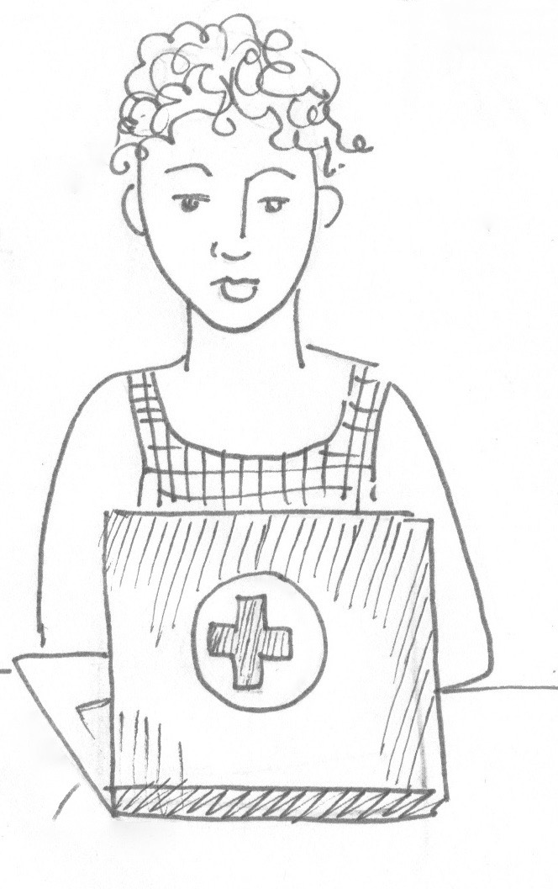
Preparing to help
Safety and security – choose a method of interaction that is safe for you and the person in distress
Prepare your equipment – e.g. airtime, internet, privacy,
Know the local referral system and be ready to share
Be aware of groups with specific needs (e.g. children, older adults, people living with pre-existing health conditions)
Have psychoeducation materials ready to share (e.g. on healthy coping strategies, sleeping better, etc)
CARL WHETHAM / IFRC
Notes:
Here is a list I prepared. You may have other things that are not on here, which are just as important as the ones on my list.
Safety and security – choose a method of interaction that is safe for you and the person in distress
Prepare your equipment – e.g. PPE (if going to help face-to-face), or if planning to help remotely, make sure you have airtime, internet, privacy,
Know the updated local COVID-19 response protocol (be prepared to adapt along the way)
Know the local referral system and have this readily available to share with others
Have updated referral information ready to share
Be aware of groups with specific needs (e.g. children, older adults, people living with pre-existing health conditions, etc
Have psychoeducation materials ready to share (e.g. on healthy coping strategies, sleeping better, etc)

Slide 47
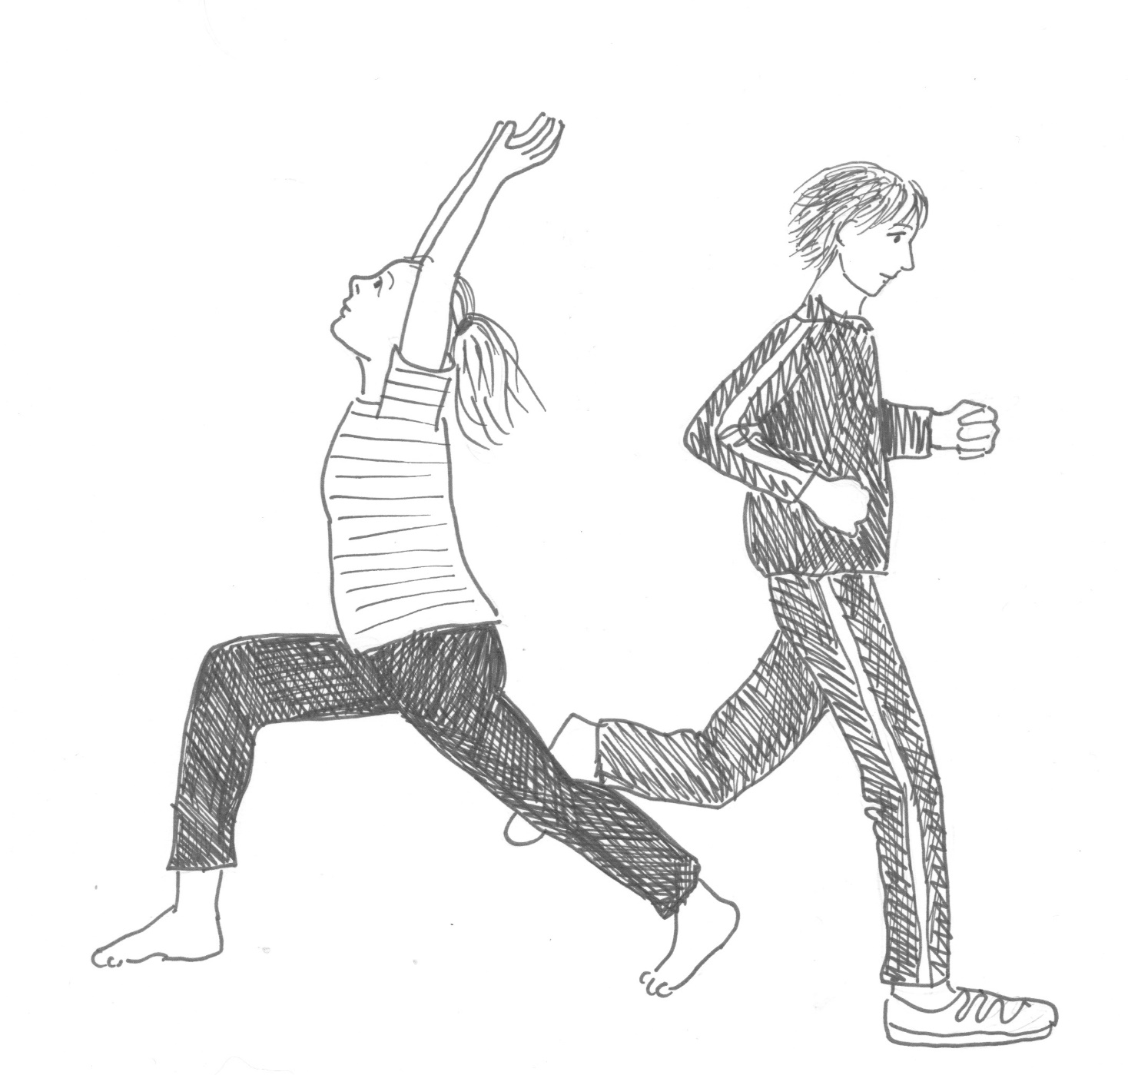
PFA and self-care
How do you apply the action principles of LOOK, LISTEN and LINK to self-care?
CARL WHETHAM / IFRC
Notes:
It can sometimes be hard to interact with others who are in distress, and it can be difficult to meet people who are suffering and going through crises. This is often part of our work as RCRC staff and volunteers. It is very important we also look after ourselves and pay attention to our own wellbeing.
When you learn PFA skills, you can also use these skills to take care of yourself. How do you think you can apply the action principles of Look, Listen and Link to taking care of yourself?
(Ask participants for their input first, and then add the following if it is not mentioned):
LOOK: You can LOOK for your own symptoms of distress and recognise when you are out of balance and need support.
LISTEN: Part of listening is accepting your own feelings, and recognising you need to change something or ask for help and support from others.
LINK: When you are in distress it is important you reach out to others, or make use of services that can support you.
Remember, it is a strength to ask for help, and not a sign of weakness.

Slide 48
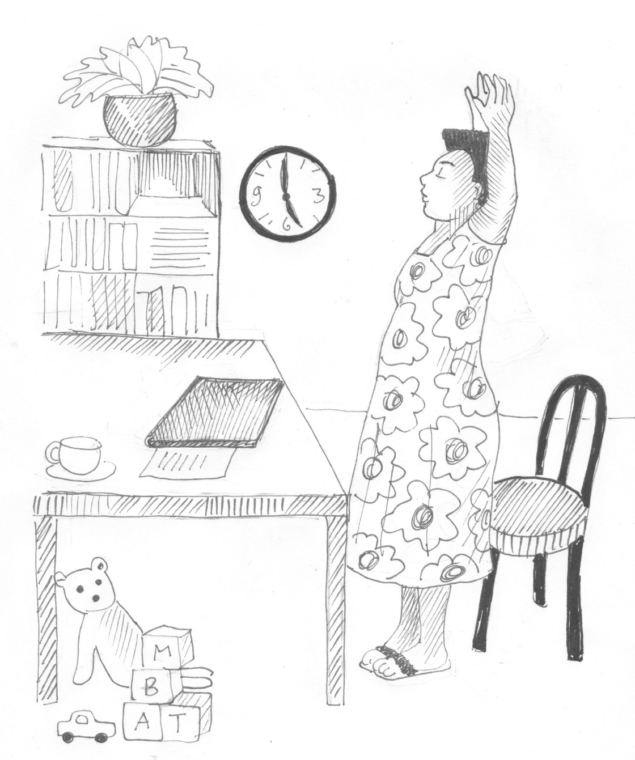
Examples of self-care
Focus on simple and routine tasks
Peer support – talk to friends or colleagues about how you are feeling
Try to socialize in new ways
Exercise
Rest and sleep well
Eat and drink healthy
Avoid alcohol and use of substances
Do things you enjoy
Ask for help when you need it
CARL WHETHAM / IFRC
Notes:
Be aware that certain reactions are normal and inevitable when working under difficult circumstances. If you feel overwhelmed by the situation or by your responsibilities, focus for a moment on simple and routine tasks.
Let your peers and supervisors know how you feel and be patient with yourself. Talking to someone about your thoughts and feelings can help you absorb and accept any unpleasant experiences you have had.
Keep in touch with your loved ones and try to socialise in new ways
Exercise a bit every day.
Get enough rest and sleep. If you have sleep problems or are anxious, avoid caffeine, especially before going to bed.
Eat healthy and at regular times.
Limit your consumption of alcohol and tobacco and use of any other substances.
Do things you enjoy and try to have some fun in your spare time.
Ask for help when you need it. Talk about your experiences and feelings (even those that seem frightening or weird to you) with colleagues or someone you trust. Don't be ashamed or afraid to get help if you feel stressed, sad, or unable to take responsibility. Many other people may experience these same feelings. Hear what others have to say about how the event affected them and how they are coping.
NB: remember to ask what are the things that seem to get in the way of us practising self-care??

Slide 49
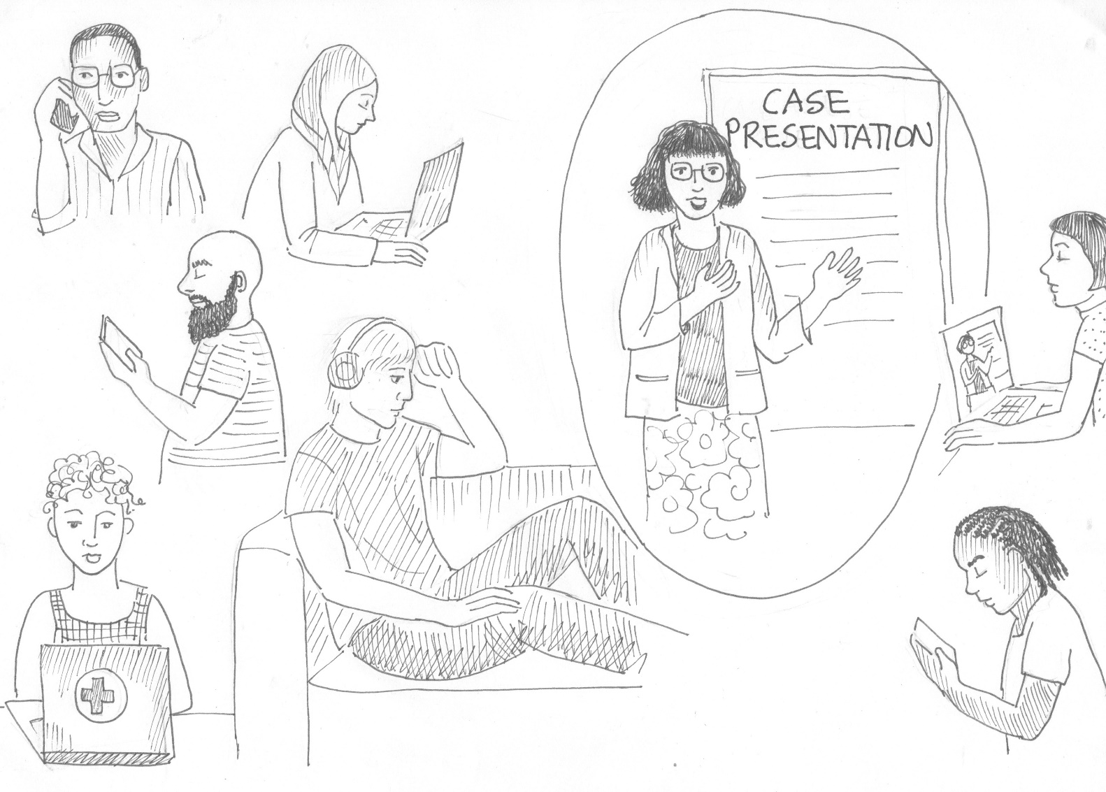
Peer support and buddy systems
SYRIAN ARAB RED CRESCENT
Notes:
One way of looking after yourself is to make sure that you have a buddy either at work, or out of work, who you can rely on to check in on you regularly, and who you can reach out to for support when you need it.
Additionally, you can also advocate for support systems in your work place or work group – and one of these methods is to ask for buddy systems to be set in place.

Slide 50
Notes:
Another method of self-care and improving your wellbeing, is to continue to educate yourself, for example learn more about PFA, and how it can be used with different groups, such as children, or teams of staff or volunteers, as taught in the training on PFA for groups.

Slide 51
Get more information
https://pscentre.org
https://www.who.int
https://mhpss.net
CARL WHETHAM / IFRC

Slide 52
Thank you!!
Look after yourself and your wellbeing!
Help those around you so they can cope better.
CARL WHETHAM / IFRC
Illustrations by Aleta Armstrong
Notes:
Thank you so much for participating in this short orientation on PFA.
Remember to look after yourself and your wellbeing and to help those around you so they can cope better.

