Slide 1

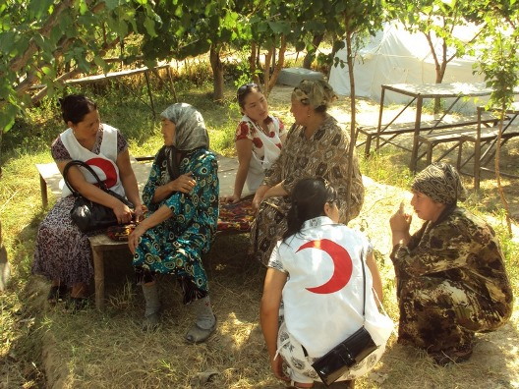
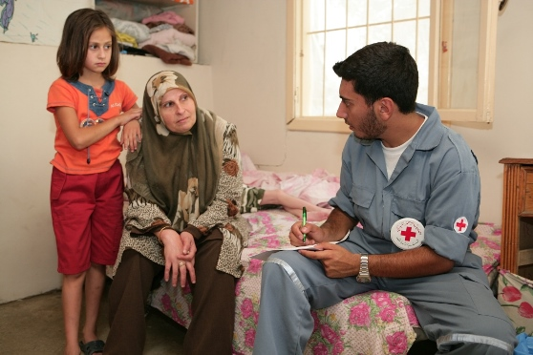
Programming and M&E for psychosocial interventions - Training
Copenhagen: 9-10 March 2017
Facilitators: Louise Vinther-Larsen and Sarah Harrison

Slide 2
Learning objectives
To familiarize participants with the M&E framework
To give participants the opportunity to apply the tools of the M&E framework
To provide the knowledge and tools necessary for developing and adapting indicators for monitoring and evaluating PS interventions

Slide 3
Sessions
Day 1
Setting the scene – programming for psychosocial support interventions
Introduction to M&E framework
Basic M&E principles and programme management
Indicator guide
Data collection – principles and ethics
Day 2
Assessment
Psychosocial interventions – programme design
Logframe
Day 3
Getting to know the toolbox – means of verification
Measuring PS wellbeing
Development of M&E plan
Organising data
Evaluation of PS programmes – lessons learned

Slide 4

Setting the scene – PS interventions

Slide 5
Psychosocial support interventions
Group work:
What is psychosocial wellbeing?
What is resilience?
What are some key psychosocial activities?
What is meant by community-based PS approach?

Slide 6
Intro to the M&E framework

Slide 7
M&E - Barriers and strengths
Place yourself in two rows, facing a person from the row opposite yourself
Imagine you are in the project team who is setting up a psychosocial support intervention.
You will either be an advocate for M&E in psychosocial interventions or you will be a project team member who only focuses on all the challenges related to M&E.

Slide 8
Why M&E?
Support project/programme implementation with accurate, evidence-based reporting to guide and improve project/programme performance.
Contribute to organizational learning and knowledge sharing by reflecting upon and sharing experiences and lessons.
Uphold accountability and compliance by demonstrating whether or not our work has been carried out as agreed and in compliance with established standards and with any other donor requirements.
Provide opportunities for stakeholder feedback, especially beneficiaries, to provide input into and perceptions of our work.
Promote and celebrate our work by highlighting our accomplishments and achievements, building morale and contributing to resource mobilization.

Slide 9
M&E framework - content
Guidance note
Indicator guide
Data collection tools
Psychosocial Concepts and Approaches
Why M&E?
M&E and the Programme Cycle Management
Psychosocial Programme Objectives
About Indicators
Planning for M&E
Key considerations in M&E with children
Goal Indicator Table
Outcomes Indicators Table
Outputs Indicators Table
Goal and outcomes indicators have references to complimentary Means of Verification (data collection tools)
Programme management cycle tools
Community and stakeholder survey tools
Wellbeing measurement tools
Qualitative methods
Quality standards tools
Supervision tools
Training report tools
Referral tools
Caring for volunteers tools

Slide 10
Basic M&E concepts and programme management cycle

Slide 11
Monitoring and evaluation definition
Monitoring is a continuous process of collecting and analysing information to compare how well a project or programme is being implemented against expected results. Monitoring aims at providing managers and other stakeholders with regular feedback and early indications of progress or lack thereof in the achievement of intended results. It generally involves collecting and analysing data on implementation processes, strategies and results, and recommending corrective measures.
Evaluation is the systematic and objective assessment of an ongoing or completed project or programme, its design, implementation and results. Evaluation determines the relevance and fulfilment of objectives, efficiency, effectiveness, impact and sustainability. An evaluation should provide information that is credible and useful, enabling incorporation of lessons learned into the decision making process of both recipients and donors.

Slide 12
Difference between monitoring and evaluation
Monitoring | Evaluation
….is ongoing | …is periodical
Answers questions like: Is the project on track? What do I need to adjust and how to improve it? What is causing delays or unexpected results? | Answers questions like: What changes did the project bring about? Were there any unplanned or unintended changes? Were the operation’s objectives consistent with beneficiaries’ needs
Mainly refers to activities, outputs and sometimes outcomes | Mainly refers outcomes as well as goal (in case of impact study)
Fosters informed re-design of project methodology | Fosters informed design of new projects
Uses data on output indicators on regular basis | Assess all data related to project indicators collected throughout the project
Performed by project staff | Performed by an evaluator “external” to the context, project or organisation

Slide 13
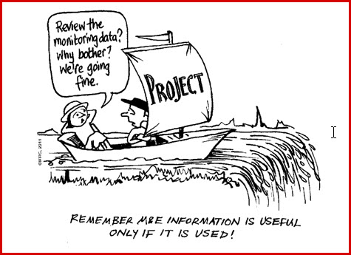

Slide 14
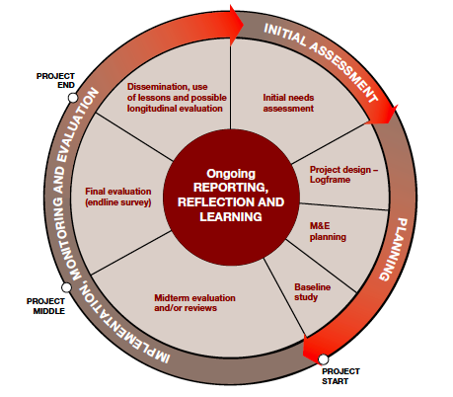
Programme management cycle

Slide 15
What are objectives
Objective Level | Question and Explanation
Goal | What changed? Long-term and sustainable change in the lives of people resulting from an intervention.
Outcome | What happened? The immediate and observable change in the lives and circumstances of people that is brought out as a direct result of project activities and the delivery of outputs.
Output | What was done? The planned achievements (results) ‘put out’ (produced) in the process of implementing a project that signals that the work is on track.

Slide 16
Objectives development
Objectives for the goal, outcomes and outputs of PS programmes are based upon information from needs assessments
Objectives are best decided upon by project staff in active engagement with beneficiaries and other relevant stakeholders.
Objectives often relate not only to the lives of individuals (e.g., children-at-risk, lonely elderly people, women survivors of domestic violence), but also to their family and wider community.
The people involved in the project or progarmme are the “target population” or “beneficiaries” of PS programmes.

Slide 17
Indicators
Indicators are: A unit of measurement that specifies what is to be measured; indicators are intended to answer whether or not the desired goal, outcomes or outputs objective have been achieved. Indicators may be quantitative (e.g. percentages or numbers of people) or qualitative (e.g. perceptions, values, reasons, opinions, motivations)
Progress in PS programmes is measured at all levels to provide feedback on areas of success and areas where the programme may need to improve.
Each programme must define how to measure success by identifying indicators at the start of the programme (baseline) and measure these through the course of implementing the programme (at various target points).

Slide 18
SMART indicators
SMART | Explanation
Specific | Is the indicator specific enough to measure progress towards the objective?
Measurable | Is the indicator a reliable and clear measure of the objective statement and can the data be collected?
Achievable | Are the objectives in which the indicator seeks to chart progress realistic and achievable?
Relevant | Is the indicator relevant to the intended outputs and outcomes objectives?
Time-bound | The indicator is attached to a time frame. The indicator should state when it will be measured. If there is no time included on when to measure the indicator, how will anyone know if and when there is a result/outcome?

Slide 19
Designing/using indicators wisely
Use “standard” indicators when appropriate so you can compare across programmes
Using too many indicators strains capacity – only measure what is necessary to inform the programme/project
  1-3 indicators per objective is usually sufficient
Be sure you have the capacity to measure the indicator
  Measuring complex indicators can be costly and time intensive, unless you can use secondary data source (e.g., from government ministry)
Measure BOTH “counts” and “depth of change” (e.g., knowledge, attitudes, behaviors) – both are important in M&E

Slide 20
How to report on indicators
Report on an indicator… | By using…
Quantitatively | Numbers, proportions, ratios
Qualitatively | Words, descriptions, case studies
Both quantitatively and qualitatively | Using both words and numbers (different means of verification for one indicator statement)
Other ways | Yes or no statements Pictures or photographs showing change over time Proxy statements about change in a related phenomenon

Slide 21
Qual/quant measurement
Indicator statement | Means of Verification
PS programme recipients report a change in skills and knowledge through participation in the programme | Quantitative: satisfaction survey tallying the # of respondents who report they have gained skills and knowledge through participating in the programme.
 | Qualitative: focus group discussions and case studies capturing reports from PS recipients of gaining skills and knowledge through participating in the programme.

Slide 22
Triangulation
Remember that both quantitative and qualitative data are important in measuring the extent to which programmes have been successful in meeting their objectives.
Together, quantitative and qualitative indicators can measure both the scale and depth of change for people involved with PS programmes.
Using different types of indicators (quantitative and qualitative) and different sources of information (talking with different groups of people or using different tools or methods to access information) is called “triangulation”.
Triangulating the data strengthens the evidence we gather about change in PS programmes. Some indicators in the Indicator Guide are described by using “mixed methods” – a mixture of quantitative and qualitative methodologies and tools.

Slide 23
Baseline and endline
A baseline study (sometimes just called “baseline” is an analysis describing the initials conditions (appropriate indicators) before the start of a project/programme against which the progress can be assessed or comparison made.
An endline study is a measure made at the completion of a project/programme (usually as part of its final evaluation), to compare with baseline conditions and assess change.
Baseline and endline studies are not evaluations themselves, but an important part of assessing change. They usually contribute to project/programme evaluation, but can also contribute to monitoring changes on longer-term projects/programmes.

Slide 24
Baseline, midline, endline example
Sample Indicator | Project Baseline | Project Midline [e.g., 3 months] | Project Endline (Target) [e.g., 6 months]
# of meetings with community members to plan and organize PS activities | 0 meetings. | 3 meetings | 6 meetings.

Slide 25
Getting to know the indicator guide

Slide 26
Indicator guide
The Indicator Guide describes objectives and corresponding indicators at the level of the goal, outcome and outputs for many PS programmes.
It is intended to help with M&E across PS programmes implemented by different NS’s.
In the indicator tables, each set of objectives and their accompanying indicators describe those frequently used in monitoring and evaluating PS programmes.

Slide 27
Tailor it to your programme
The objectives and indicators developed for each level are phrased in such a way that they can be tailored to specific programmes – that, is, for a particular type of target group or problem
You can use this Indicator Guide as a roadmap to help you in developing an M&E framework and indicators that will be most relevant for your own programme
It is important to consider your specific programme (e.g., target group, activities, cultural context) in using this indicator guide. You can:
  pick and choose from the objectives and indicators in this guide;
  use the objectives and indicators as written or adapt them as needed; and/or
  develop your own objectives and indicators for your particular programme.

Slide 28
Structure of the guide
Goal
Outcome 1: Capacity building | Outcome 2: Caring for staff and volunteers | Outcome 3: PS service provision | Outcome 4: Community engagement
Outputs for outcome 1 | Outputs for outcome 2 | Outputs for outcome 3 | Outputs for outcome 4

Slide 29
Structure of the objective statements
Group work:
Place the objective statements in the most logical manner, so the statements correspond with their header and goal, outcome, output level.

Slide 30
Using the indicator guide
Select your goal: The programme might be a stand-alone PS programme or a component in a larger programme. Define the goal based on needs assessment and the longterm impact the whole programme wish to achieve.
Select Outcomes: Look over the key outcomes to determine how they may relate to your programme. Consider outcomes for both the target beneficiaries and the NS staff and volunteers Consider how to tailor the outcomes and indicators to your target group, programme approach and specific context. Remember the outcomes and indicators are not an exhaustive list!
.
Select Outputs: For each outcome, review the outputs and indicators to see how they may relate to your programme and its specific activities. Remember to consider activities you will implement related to VP/protection and care for NS volunteers. Then consider how to adapt relevant outputs and indicators to your programme, and what additional outputs and indicators you may want to develop.

Slide 31
All objective statements have corresponding indicators and MOV
Outcome | Indicators | MoV
A supportive and caring working environment is achieved and sustained for volunteers in the PS programme. | Awareness of caring working environment % of NS managers, staff and volunteers aware of their NS self and team care policies, procedures and resources (e.g., materials, referrals) for volunteers. | Caring for Volunteers Tools*
 | Volunteer satisfaction Volunteers report satisfaction with self and team care support from their NS. Volunteers report feeling supported by managers and team members in their work. Volunteers report a caring and supportive working environment in their NS. | Caring for Volunteers Tools Focus group discussions Case Studies
 | Volunteer utilization % of volunteers utilizing self and team care strategies (e.g., peer support, personal supervision, learned stress management skills). | Caring for Volunteers Tools
 | Volunteer change in self- and team-care capacity % of volunteers reporting change in ability to recognize and manage stress within themselves and their team. | Caring for Volunteers Tools

Slide 32
Relevance to your programme?
Individual work:
Go through the indicator guide and see if there are any objective statements and indicators that you find could be applicable or adapted for a programme you are currently working on.

Slide 33
Data collection – ethics and principles

Slide 34
Data collection – ethics and principles
Assessments - as well as general M&E of PS programmes - involve collecting, analysing and communicating information about people and often involves direct interactions with people in difficult circumstances
Data collection and M&E should be conducted in an ethical and legal manner to safeguard the welfare of those involved in and affected by it
Programme or M&E managers in each NS have the overall responsibility to maintain best practices in M&E, including training of data collectors

Slide 35
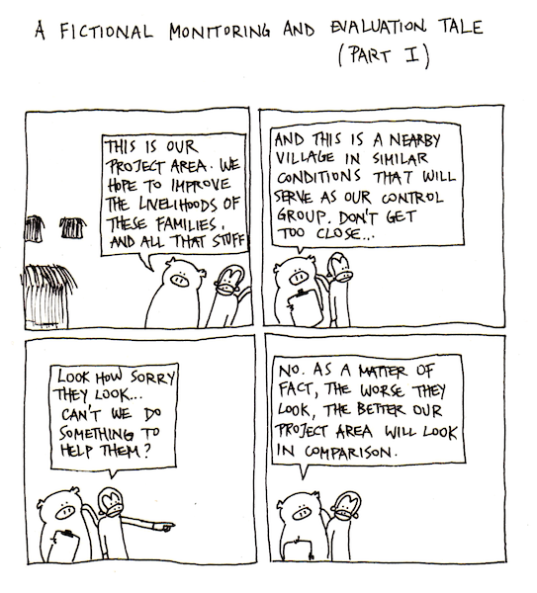

Slide 36
Data collection – ethics and principles
  Role play: prepare a short role play (3-4 minutes for each role play) that illustrates the principles (could be do’s or don’ts or any other idea that illustrates the principle). Have the rest of the group guess what principle you are role playing

Slide 37
Assessment

Slide 38
Why assessments?
  Why are assessments important?
  What kind of information should an assessment include?

Slide 39
Information an assessment should include
Demographics – how many people are affected, where they are, how old they are¨, vulnerabilities etc.
Impact – how the disaster has affected the population physically, emotionally and socially
Problems – what are existing problems or what potential problems are likely to arise in the near future
Resources and capacities –what capacities the affected population has to help themselves including their usual coping mechanisms and what resources exits in their community
Assistance – what is needed to help the population achieve PS well-being

Slide 40
Step by step
Road map:
Develop a step-by-step guideline/process for when conducting assessments, that includes the most important steps to take using pre- written assessment steps

Slide 41
Step by step
  Collect secondary data/desk review
  Consider if any primary data need to collected
  Coordinate and liaise with other stakeholders/agencies on data collection
  Consider time frame
  Coordinate and liaise with the communities and local authorities
  Decide on methodologies to collect the data
  Design your questionnaire/discussion guide
  Identify data collectors
  Train data collectors
  Pilot test of data collection tool
  Identify sites
  Map available services and referral mechanisms
  Make practical and logistical arrangements for data collection
  Identify informants
  Get informed consent
  Collect data
  Analyze data
  Reporting of data
  Dissemination of results
  Design intervention/plan for activities

Slide 42
Discussion guide
Group work:
You will be going to a community to conduct an assessment.
In groups develop a discussion guide for a key informant interview including specific questions related to PS support and protection on a flip chart (maximum 8 questions)
Spend also a few minutes discussing important considerations when conducting assessment interviews

Slide 43
Psychosocial interventions/programme design

Slide 44
Different types of programme
Stand-alone psychosocial programmes: This type of programme usually has an independent staff and budget and is administered as a separate pro­gramme from others.
Psychosocial plus: This is a psychosocial programme that also integrates psychosocial needs with other basic needs, such as food, shelter, water, clothing or livelihood.
Integrated into other responses: In this approach psychosocial activities are a component of another larger programme that addresses a range of needs.

Slide 45
A holistic response

Slide 46
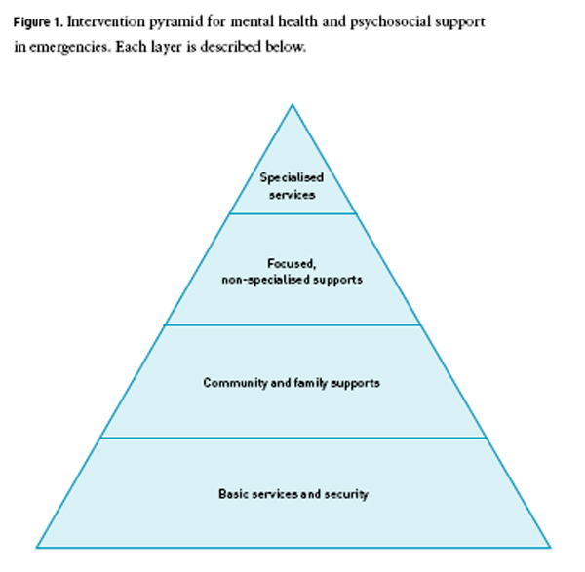
- Referrals to specialized services e.g. mental health professionals (psychiatric nurses, counsellors, psychiatrists, psychologist)
- Psychological first aid
Support groups
Lay counselling
- Safe spaces
Psychoeducation on stress and coping in communities
Restoring family link
Assisted mourning and communal healing ceremonies
Activation of social networks e.g. woman’s groups, youth groups etc.
Recreational activities aimed at enhancing PS wellbeing
-Advocating for services to implemented in a safe, dignified and social-cultural appropriate manner
- Other sectors are sensitized to psychosocial support approaches

Slide 47
Psychosocial interventions
Group work:
Read through your case story and brainstorm on possible PS interventions.
What are the unique psychosocial needs?
What activities or interventions are appropriate as a response to the needs identified in the case story?
What level of the pyramid does the activities fall under?

Slide 48
Considerations when programming
Be sensitive to special needs
Respect cultural and behavioral norms
Be realistic
Relevance and timing
Be flexible
Involve the community
Be mindful of costs and use resources wisely

Slide 49
Logframe

Slide 50
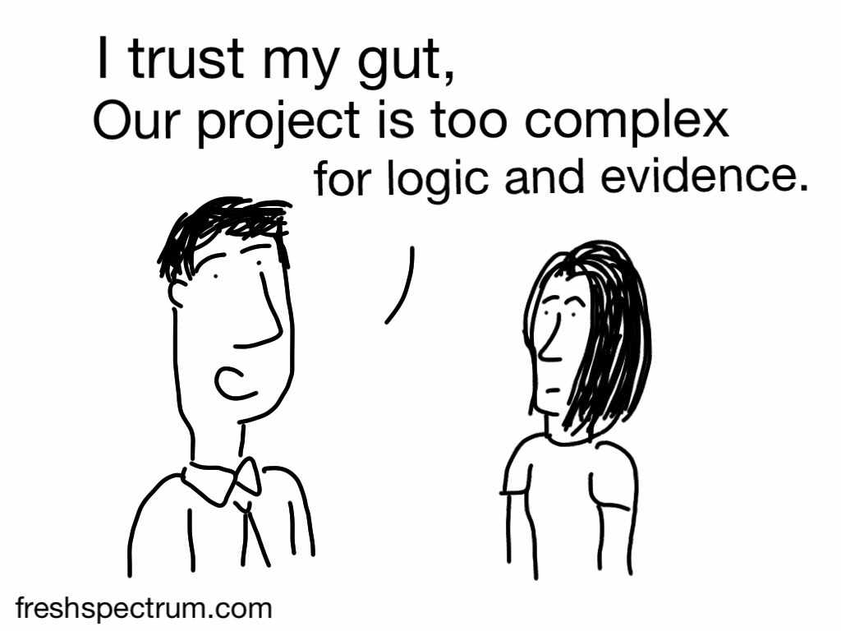

Slide 51
Logical Framework Approach
The logframe serves as the model for the indicator tables in the Indicator Guide
The logframe provides a summary of the programme and its operational design.
The logframe outlines the logical sequence of objectives to achieve the programme’s intended results (outputs, outcomes and goal); the indicators of change in objectives; means of verification (MOV) – tools used to measure the change described by the indicators; and any key assumptions to monitor.
Indicators must be aligned with goal, outcome and output objectives that define the kind of change being sought in PS programmes, as shown in the logframe table

Slide 52
Different terminologies
 | Ultimate Impact | End Outcomes | Intermediate Outcomes | Outputs | Interventions
Needs-based | Higher Consequence | Specific Problem | Cause | Solution | Process | Inputs
CARE terminology | Program Impact | Project Impact | Effects | Outputs | Activities | Inputs
CARE logframe | Program Goal | Project Final Goal | Intermediate Objectives | Outputs | Activities | Inputs
PC/LogFrame |  | Goal | Purpose | Outputs | Activities
USAID Results Framework | Strategic Objective | Intermediate Results |  | Outputs | Activities | Inputs
USAID Logframe |  | Final Goal | Strategic Goal/ Objective | Intermediate results | Activities | 202E
DANIDA + DfID | Goal |  | Purpose | Outputs | Activities
CIDA + GTZ | Overall goal |  | Project purpose | Results/outputs | Activities | Inputs
European Union | Overall Objective | Project Purpose | Results | Activities
FAO + UNDP + NORAD | Development Objective |  | Immediate Objectives | Outputs | Activities | Inputs
UNHCR | Sector Objective | Goal | Project Objective | Outputs | Activities | Input/Resources
World Bank | Long-term Objectives |  | Short-term Objectives | Outputs |  | Inputs
AusAID | Scheme Goal |  | Major Development Objectives | Outputs | Activities | Inputs
IFRC M&E PS framework | Goal | Key outcome | Intermediate outcome | Outputs

Slide 53
Logframe template
Objectives (What we want to achieve) | Indicators (How to measure change) | Means of verification (Where/how to get information) | Assumptions (What else to be aware of)
Goal The long-term results that an intervention seeks to achieve, which may be contributed to by factors outside the intervention | Impact indicators Quantitative and/or qualitative criteria to measure progress against the goal | How the information on the indicator(s) will be collected (can include who will collect it and how often) | External factors beyond the control of the intervention, necessary for the goal to contribute to higher-level results
Outcome(s) The primary result(s) that an intervention seeks to achieve, most commonly in terms of the knowledge, attitudes or practices of the target group | Outcome indicators Quantitative and/or qualitative criteria to measure progress against the outcomes | As above | External factors beyond the control of the intervention, necessary for the outcomes to contribute to achieving the goal.
Outputs The tangible products, goods and services and other immediate results that lead to the achievement of outcomes | Output indicators Quantitative and/or qualitative criteria to measure progress against the outputs | As above | External factors beyond the control of the intervention, necessary if outputs are to lead to the achievement of the outcomes

Slide 54
Developing your logframe
Group work:
Fill out a logframe using the project/programme you decided upon in their previous case story and by using the indicator guide
Start by only filling in 1 outcome and 2 outputs with corresponding indicators.
You may need to adapt the indicators or objective statements from the guide or even develop new ones
Include the MoV and, if possible, assumptions.

Slide 55
Homework
Tomorrow you will be to get to know the toolbox (MoV).
You will be divided into 6 numbers. Each person will orient themselves to the tools contained in selected chapters (corresponding to the number you have received) of the toolbox:
No 3 “Qualitative methodologies”
No 4 “Quality standards tools”
No 5 “Supervision reporting tools”
No 6 “Training report tools”
No 7 “referral tools”
No 8 “Caring for volunteers tools”
Note that chapter 1 “programme management cycle tools” and chapter 2 “wellbeing measurement tools” will be covered in subsequent sessions

Slide 56
Getting to know the toolbox (MoV)

Slide 57
Content of toolbox
The tools presented are templates that can be adapted to your PS programme, depending upon your target group, activities and scope. These are tools you are likely to find useful for your programme and many are drawn from existing PS programme monitoring and evaluation (M&E) tools.
The tools presented here are not an exhaustive list, but may inspire you in creating your own tools. You may want to find local tools used in different programmes and/or develop additional tools for your programme.
The tools described in the toolbox are those listed in the Means of Verification (MoV) column in the indicator tables of the Indicator Guide. The tools are focused mainly upon MoV for at outcomes level; however, many of the tools can also be used as MoV on output level (particularly for the programme management cycle tools and supervision reporting tools).

Slide 58
Overview of toolbox
Programme management cycle tools
2 Wellbeing measurement tools
Qualitative methods
4 Quality standards tools
5 Supervision tools
6 Training report tools
7 Referral tools
8 Caring for volunteers tools

Slide 59
Getting to know the toolbox
Orientate yourself in your assigned chapter and present:
Overview of the different tools in the chapter
When and how the tools can be used
Provide some practical examples of one or more of the tools
Discuss if you find the tools useful and why/why not
Discuss possibilities of adaptation
No 3 “Qualitative methodologies”
No 4 “Quality standards tools”
No 5 “Supervision reporting tools”
No 6 “Training report tools”
No 7 “referral tools”
No 8 “Caring for volunteers tools”

Slide 60
Measuring PS wellbeing

Slide 61
PS wellbeing
Psychosocial wellbeing describes the positive state of being when an individual thrives. It is influenced by the interplay of both psychological and social factors. PS wellbeing is experienced both in the personal individual and the social interactive domain, and is also determined largely by the context within which people live. External factors and basic human needs such as livelihood, shelter and physical health may significantly impact the PS wellbeing of individuals and communities. Since contexts are always changing, so will the experience of PS wellbeing. Its dynamic nature makes it difficult to provide a standard definition of wellbeing or to know how to recognize it from country to country, or even in different populations within the same country.

Slide 62
Generic domains of PS wellbeing
Personal
Capacity for coping and functioning
Inter-personal/ Social

Slide 63
Exploring local concepts of wellbeing
Group work:
Prepare sample questions for exploring wellbeing
  How do you understand psychosocial wellbeing?
  What words do you use to speak about being well?
  How can you see in your community if someone is doing well or not doing well?
Facilitator interviews other participants in small groupa
Compile responses
Develop domains/headers

Slide 64
Sample wellbeing questionnaire
A sample wellbeing questionnaire has been developed for contexts where there is not capacity to develop a questionnaire from scratch.
The questions are grouped according to the wellbeing domains: personal, interpersonal and capacity.
You can pick and choose from questions in each domain, or adapt the questionnaire to local understandings of wellbeing (delete, change or add questions).
Before you use your questionnaire widely, be sure to pilot test it with a small sample of respondents similar to your target group, to be sure they understand and relate well to the questions.

Slide 65
Developing your M&E plan

Slide 66
Planning for M&E
After selecting indicators to measure the objectives of your PS programme and creating your logframe, the next step is to develop an M&E plan.
Knowing now what data collection tools you may use makes it easier to develop your M&E plan.
Additional tools from the toolbox
  Staff and volunteer activity records
  Programme monitoring templates
    Sample monitoring visit report format
    Sample monthly activity report format

Slide 67
M&E plan
The M&E plan takes the logframe one stage further to support programme implementation and management.
The M&E plan expands the statements in the logframe matrix to identify key informational requirements for each indicator.
It is a critical tool for planning and managing data collection, analysis and use of the information:
Makes data collection and reporting more efficient and reliable
Helps project/programme managers plan and implement their projects/programmes through carefully consideration of what was being implemented and measured.
Serves as critical cross-checks of the logframes, ensuring that they are realistic to field realities.
Helps to transfer critical knowledge to new staff and senior management, which is particularly important with projects/programmes lasting longer than two years.

Slide 68
M&E plan template
“Project Name” M&E Plan
Indicator | Indicator description | Data collection methods/sources | Frequency & schedule | Responsibilities | Information use/audience
GOAL:
Indicator G.a
Assumption G.a
OUTCOME 1:
Indicator 1.a
Indicator 1.b
Indicator 1.c
Assumption 1.a
OUTPUT 1.1:
Indicator 1.1a
Assumption 1.1a
OUTPUT 1.2:
Indicator 1.2a
Assumption 1.2a

Slide 69
Organising the data

Slide 70


Slide 71
Data analysis
Data analysis involves converting the raw data you collect into usable information to inform ongoing and future PS programming. This is a critical and continuous process throughout the programme cycle.
Data analysis involves looking for trends, clusters or other relationships between different types of data, assessing performance against plans and targets, forming conclusions, anticipating problems and identifying solutions and best practices for decision-making and organizational learning.

Slide 72
Descriptive/Interpretive
Data analysis can be descriptive (describing key findings, conditions, states and circumstances – “what happened”)
Or
Interpretive (providing meaning, explanation or causal relationships from the findings – “why it happened”).

Slide 73
Purpose of analysis
Analyse data according to the objectives set out in the logframe and M&E plan. For example,
  Analyse output indicators on a regular basis (e.g., weekly, monthly, quarterly) to monitor whether activities are occurring according to schedule and budget.
  Analyse outcome indicators to determine intermediate or long-term impacts or changes (e.g., in people’s knowledge, attitudes and practices). As these may be more complicated to analyse, they are usually measured and analysed less frequently and used for a wider audience, including donors, partners and the people reached by the PS programme.

Slide 74
Responsibility for data analysis
Those who collect the data (e.g., field monitoring staff or other programme staff) may undertake analysis of monitoring data, and ideally have the opportunity to discuss and analyse data in a wider forum with PS programme management and stakeholders
For evaluation data, analysis depends on the purpose and type of evaluation. External consultants may lead a donor-required, independent evaluation focused on accountability of the PS programme. For an internal evaluation for learning within the programme, the implementing programme or organization(s) will undertake the analysis.

Slide 75
Qualitative data analysis
Qualitative methodologies such as focus group discussions, key informant interviews and qualitative questions from surveys are regularly used in M&E. However, they often generate large amounts of data. The objective of qualitative data analysis is to organize the data collected and summarize the key messages and emerging themes or stories.
Interviews and focus group discussion are preferably recorded and then transcribed for analysis. However, if this is not possible due to lack of time or resources it is possible to rely on carefully written notes to conduct the analysis.

Slide 76
Steps when analyzing qualitative data
Although there are various types of qualitative data analysis strategies, the most commonly used strategy is: Thematic analysis
Steps:
Carefully read the documents. This would allow you to become familiar with the data collected and proceed to the process of coding the data.
Code the document in different themes
Results/patterns from the coding should be transformed into a narrative where the code results are discussed and compared against the indicators.
It is important to emphasize whether the indicator has been reached or not, or to what extent it has been reached. In addition, it is possible to explore and discuss similarities, differences and contradictions that emerge from the codes.

Slide 77
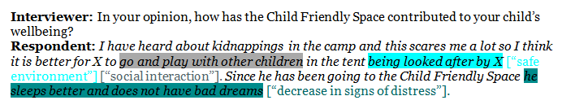
Example of qualitative coding

Slide 78
Quantitative data analysis
Quantitative data often results from surveys, record keeping and test results.
Even though the applications of quantitative data are vast, in M&E, quantitative data is mostly used to calculate totals, averages and percentages.
This is usually accompanied by graphical displays of calculations that make understating the results of the project or programme easier.
The descriptive statistics (totals, ratios, averages and percentages) that are commonly used in M&E can be calculated using Excel. Common graphical representations are bar graphs and scatter plots

Slide 79
Data collection tools and analysis
If the chosen data collection method is a survey and there is a stable internet or telephone connection in the place where the survey is conducted, it is possible to use freely available software such as Google Forms or SurveyMonkey to collect the data.
If the population is very large or there is a weak or no telephone or internet connection, it is possible to use softwares such as Koobo Toolbox, RAMP, or ODK. Although Koobo Toolbox has detailed instructions on its use, the other two software programmes require training.

Slide 80
Likert scales
Likert scales are commonly used in surveys to determine the level of agreement/disagreement to certain statements from participants. Common responses to Likert scale questions are:
Strongly agree
Agree
Neither agree nor disagree
Disagree
Strongly disagree

Slide 81
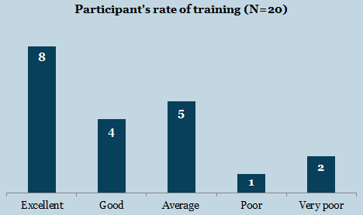
Example of likert scale presentation

Slide 82
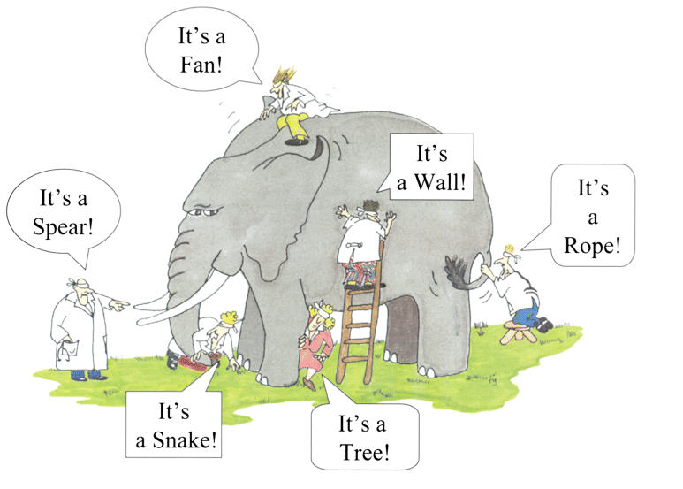

Slide 83
Evaluation of PS interventions

Slide 84
Evaluations
An evaluation is an objective measurement that aims to find out if the implemented activities or programme has succeeded in doing what it aimed to do, as well as what worked well and what did not work well.
It therefore looks at both outcome and outputs of a response.
Evaluations measure to what extent the goals or overall objectives of an intervention have been met, asking the question:
“What changes did the project bring about?”

Slide 85
Specific data templates for evaluation
Programme evaluation by direct beneficiaries
Programme evaluation tool
Monitoring and evaluation report guidance
Lessons learned feedback session report guidance

Slide 86
Evaluation questionnaire
Work through the evaluation questionnaire (programme evaluation tool) keeping a programme of yours in mind, answer the questions to the best of your knowledge

Slide 87
Lessons learned
What went well in implementing this programme (e.g., needs assessment, consultation with beneficiaries, engaging stakeholders, etc.)?
What were the challenges encountered in implementing the programme?
What factors in the context influenced how the programme was implemented, its quality, accessibility and reach?
What was the general impression of beneficiaries who participated in the programme?
What changes did the programme bring about in terms of PSS for beneficiaries?
What could we have done differently to improve design or implementation of the programme?
What did we learn in this programme that we will be sure to carry into other programmes/activities?
What did we learn in this programme that we should avoid doing in the future?
What were unexpected or unintended outcomes (positive or negative) of the programme?

Slide 88

Thank you!

