Slide 1
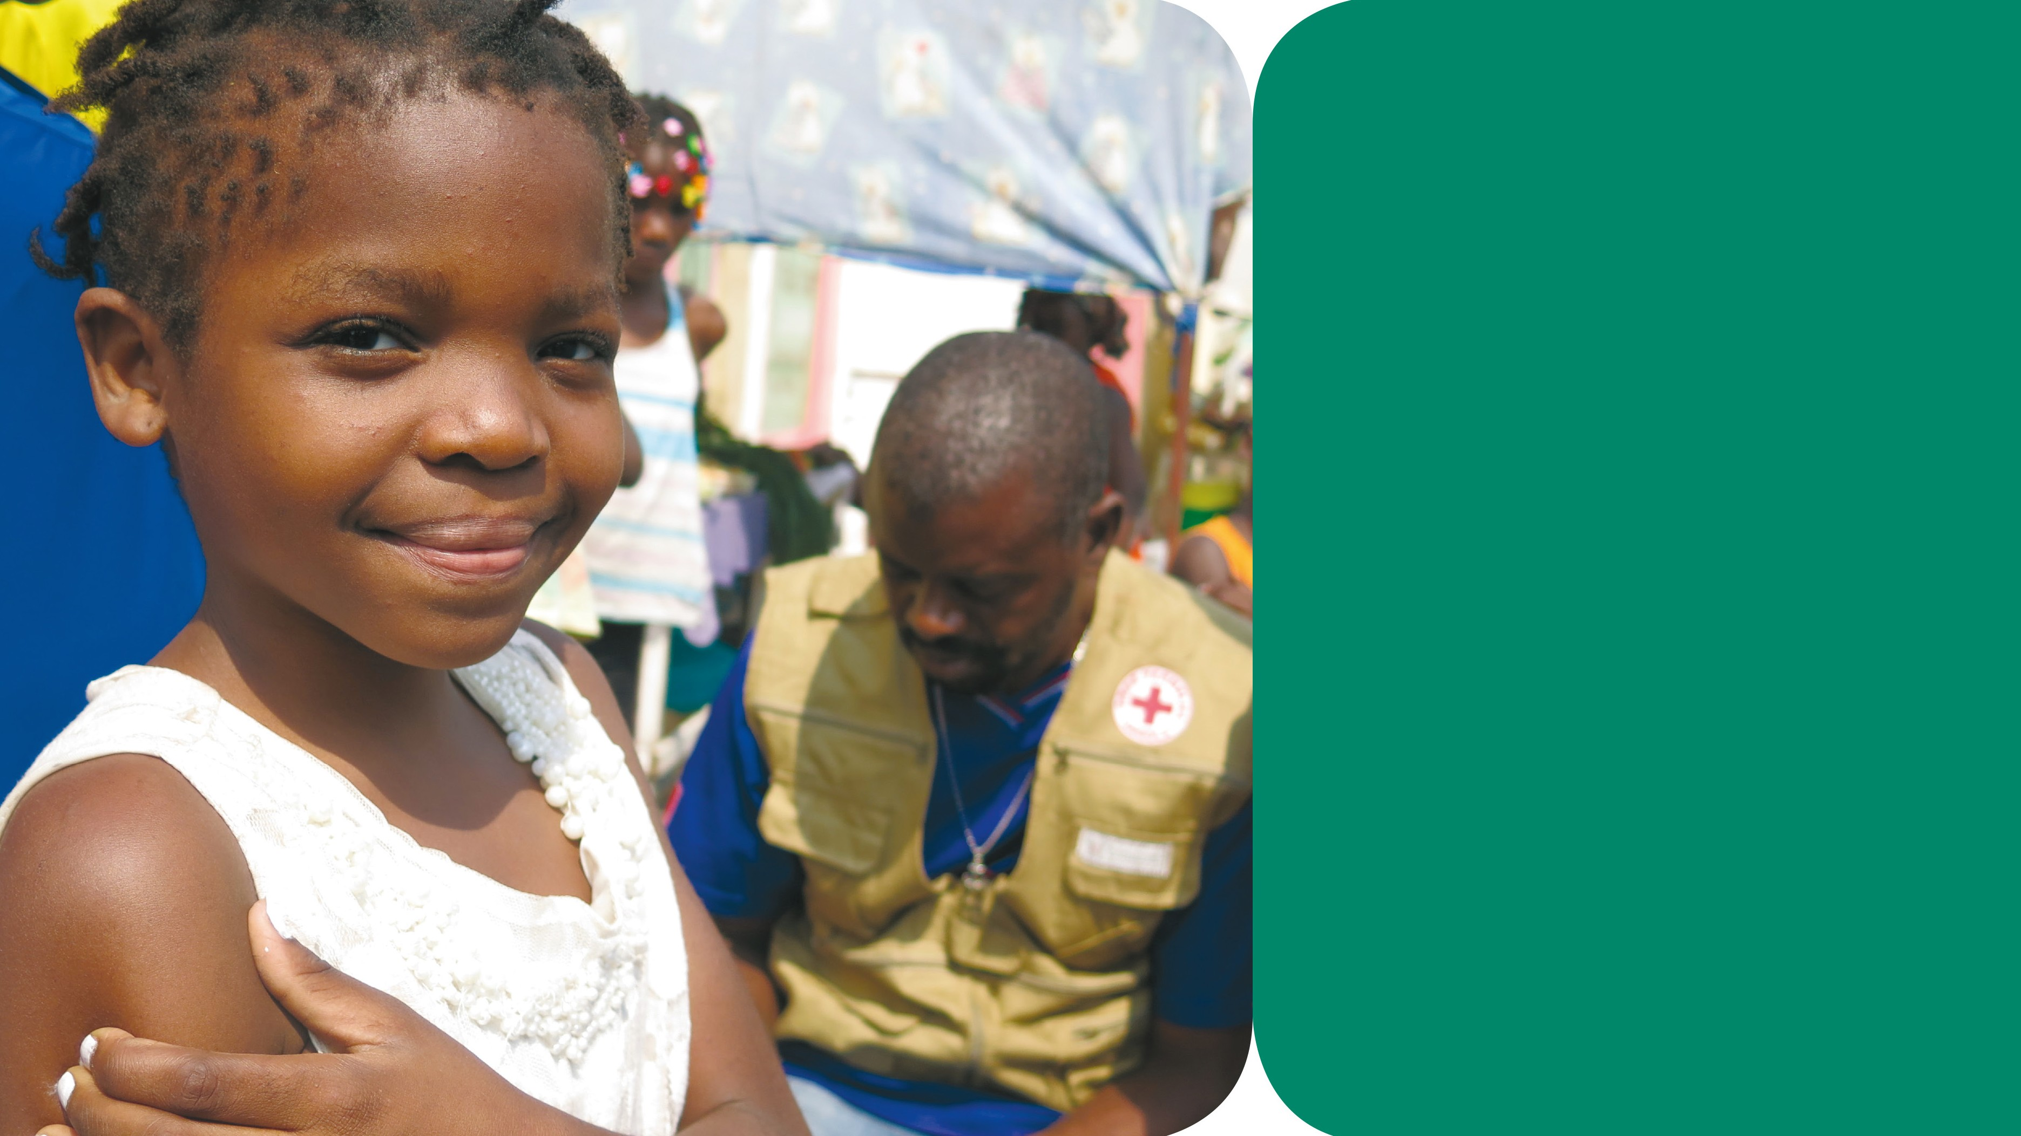


Training in Psychological First Aid for Red Cross and
Red Crescent Societies
Module 3
PFA for children
MARINE RONZI/MONACO RED CROSS

Slide 2

Psychological First Aid
Module 3 PFA for Children
TRAINING SCHEDULE
Time | Training programme
08:30 – 09:15 | 1. Introduction
09:15 – 09:35 | 2. What is PFA for children?
09:35 – 09:50 | 3. Distressing events
09:50 – 10:50 | 4. Children’s reactions to distressing events
10:50 – 11:05 | BREAK
11:05 – 11:35 | 5. Identifying children and caregivers that need PFA
11:35 – 11:55 | 6. ‘Look, Listen, Link’
11:55 – 12:55 | 7. Communicating with children
12:55 – 13:55 | LUNCH
13:55 – 14:25 | 8. Demonstrating ‘Look, Listen, Link’
14:25 – 14:40 | 9. Developing case studies
14:40 – 14:55 | BREAK
14:55 – 15:55 | 10. PFA role play
15:55 – 16:10 | BREAK
16:10 – 17:10 | 11. Complex reactions
17:10 – 17:55 | 12. Self-care
17:55 – 18:10 | 13. Workshop close
Notes:
PP 1
Adjust as necessary

Slide 3
PFA is…
Psychological First Aid
Module 3 PFA for Children
comforting children and caregivers in distress and helping them feel safe and calm
assessing needs and concerns
protecting children from harm
providing emotional support
helping to address immediate basic needs (e.g. food, water, a blanket or shelter)
listening to children and caregivers without pressuring them to talk
helping children and caregivers access information, services and social support.
Notes:
PP 2

Slide 4
PFA is not…
Psychological First Aid
Module 3 PFA for Children
something only professionals do
professional counselling or therapy
encouraging a detailed discussion of the distressing event
asking children or caregivers to analyse what has happened to them
pressing children or caregivers for details on what happened
pressuring children or caregivers to share their feelings and reactions.
Notes:
PP 3

Slide 5
Psychological First Aid
Module 3 PFA for Children
Safety
Avoid putting people at further risk as a result of your actions.
Make sure to the best of your ability that the people you help are safe and protect them from physical or psychological harm.
Dignity
Treat people with respect and in accordance with their cultural and social norms.
Rights
Make sure people can access help fairly and without discrimination.
Help people to claim their rights and access available support. Act only in the best interest of any person you encounter.
Notes:
PP 4

Slide 6
Questions on children’s reactions:
Psychological First Aid
Module 3 PFA for Children
How do you expect a child to react in this situation?
Describe both internal and external reactions.
Will the reactions be the same for boys and girls?
Notes:
PP 5

Slide 7
LOOK for
Psychological First Aid
Module 3 PFA for Children
information on what has happened and is happening
who needs help
safety and security risks
physical injuries
immediate basic and practical needs
emotional reactions.
Notes:
PP 6

Slide 8
LISTEN refers to how the helper
Psychological First Aid
Module 3 PFA for Children
approaches someone
introduces oneself
pays attention and listens actively
accepts others’ feelings
calms the person in distress
asks about needs and concerns
helps the person in distress find solutions to their immediate needs and problems.
Notes:
PP 7

Slide 9
LINK is helping people
Psychological First Aid
Module 3 PFA for Children
access information
connect with loved ones and social support
tackle practical problems
access services and other help.
Notes:
PP 8

Slide 10
Steps to creating a case study
Psychological First Aid
Module 3 PFA for Children
Choose a post-it note with a distressing event.
Decide who the child and caregiver in distress are.
Provide information on the context.
Brainstorm possible reactions. Choose two reactions for the child and two for the caregiver and add to form.
Check the details one more time.
Notes:
PP 9

Slide 11
Giving helpful feedback
Psychological First Aid
Module 3 PFA for Children
Step 1
The observer asks the PFA helper to reflect on:
What went well?
What would he or she do differently next time?
Step 2
The observer gives his or her feedback to the PFA helper:
Start with positive feedback and be specific in what went well.
Give specific feedback about areas to improve (if necessary).
End with an overall positive comment.
Step 2
The persons acting child and caregiver in distress give feedback to the PFA helper:
Start with positive feedback and be specific in what went well.
Give specific feedback about areas to improve (if necessary).
End with overall positive comments.
Notes:
PP 10

