Slide 1

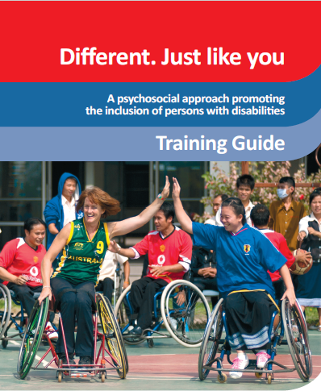




Wellcome !
Facilitator: [Insert name]
Date: [Insert]
Venue: [Insert]

Slide 2
The training programme
Time | Content
09:00-09:40 | Session 1: Welcome and introduction
09:40-10:15 | Session 2: Introduction to the bio-psychosocial approach
10:15-10:30 | Session 3: What is disability?
10:30-10:45 | Coffee/tea break
10:45-11:30 | Session 4: Barriers for persons with disabilities
11:30-12:00 | Session 5: Psychosocial well-being of persons with disabilities
12:00-12:30 | Session 6: Supportive communication
12:30-13:00 | Lunch
13:00-14:15 | Session 7: Inclusion through adapted physical activities
14:15-14:30 | Coffee/tea break
14:30-15:30 | Session 8: Adapting physical activities
15:30-16:00 | Session 9: Wrap-up and goodbye

Slide 3
The bio-psychosocial approach
Psychosocial: The dynamic relationship between the psychological and social dimensions of a person.
Bio-psychosocial: What affects the body often also affects the mind and vice versa.
Psychosocial well-being: The positive state of being when an individual thrives and is positively influenced by the interplay of biological, psychological and social factors.

Slide 4
Resilience
The ability to react or adapt positively to a difficult and challenging event or experience.
The ability to bounce back after something difficult has happened or to get through difficult experiences in a positive way.
Related to personality, experiences and magnitude of impairment/event.

Slide 5
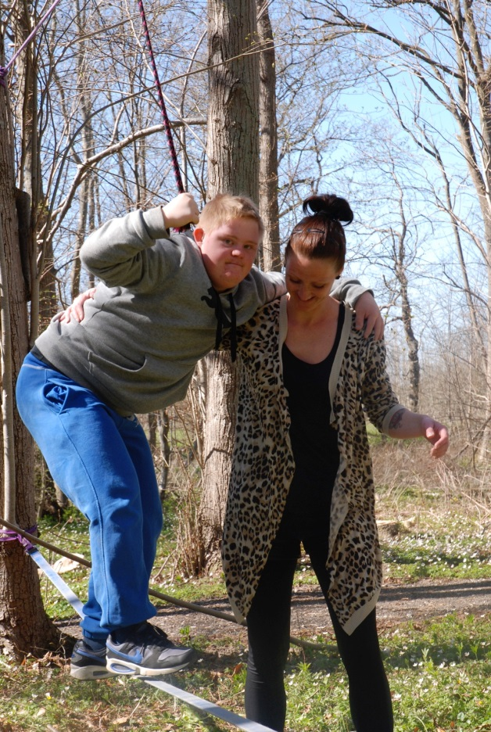
Resilience
Personal attributes related to resilience:
  ability to make realistic plans
  positive image of oneself
  ability to adapt easily to new situations
  ability to deal with strong emotions
  believing that change can happen.

Slide 6
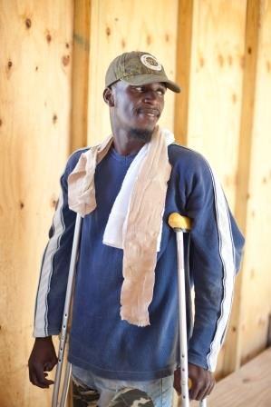
Empowerment
Supporting people to assert control over factors that influence their lives.

Slide 7
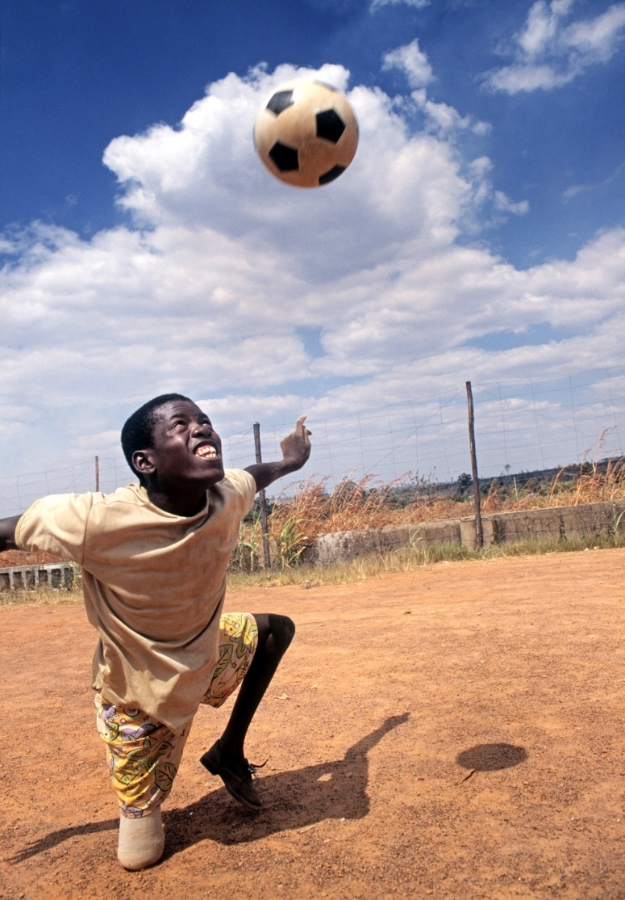
Psychosocial activities
Psychosocial activities may include:
  practical and emotional assistance
  helping people to make informed decisions
  helping to mobilize social support systems.
Psychosocial support aims at enabling people to draw on their own psychological and social resources.

Slide 8
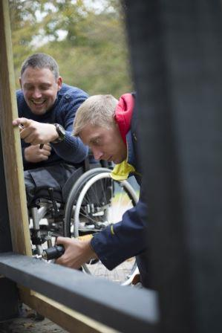
Psychosocial activities
Skills and knowledge (e.g. skills in sign language, walking on crutches, using a wheelchair, resolving conflicts, making good choices, communicating with peers).
Emotional well-being (e.g. hope for the future, improved sense of control and self-worth).
Social well-being (e.g. improved ability to interact with other or solve problems with others, a sense of belonging to the community or group).

Slide 9
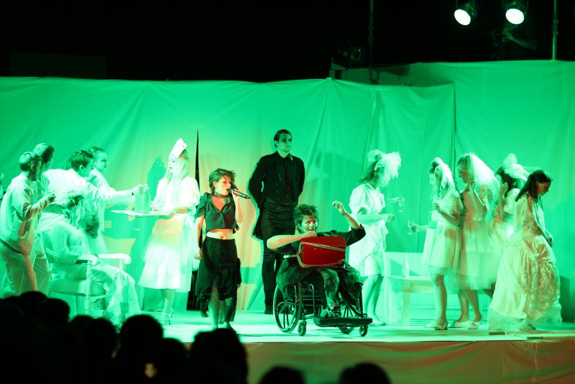
Principles in psychosocial activities
A sense of safety
Calming
A sense of self and collective efficacy
Connectedness
Hope

Slide 10
What is disability?
Disability is an umbrella term, defined in relation to:
  Impairment: problem in body function or structure.
  Activity limitation: difficulty encountered by an individual in executing a task or action.
  Participation restriction: problems experienced by an individual in involvement in life situations.

Slide 11
Barriers for persons with disabilities
Discuss in your groups the potential barriers for your target group in participating in society (physical, attitudinal and institutional barriers).
Consider gender issues related to your target group.
Discuss how volunteers and professionals can help break down these barriers (e.g. is there a need for advocacy? how should they communicate with persons with disabilities, etc.?)
Note your discussion points on a flipchart

Slide 12
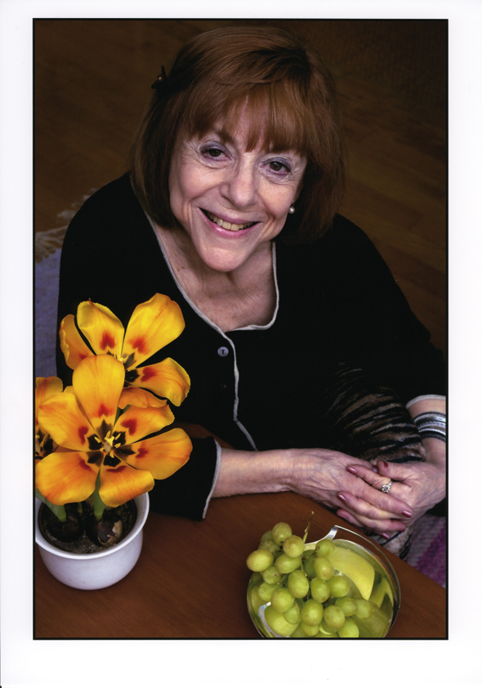
Psychosocial well-being of persons with disabilities
What factors promote Maria’s psychosocial well-being in terms of:
physical factors?
psychological factors?
social factors?

Slide 13
The grieving process
Recognition and understanding: Coming to terms with the fact that what is lost will not come back.
Managing negative emotions: Living through feelings of anger, sadness and frustration.
Skills: Gaining new skills in the changed life situation.
Hope and finding meaning in the future: Learning to live with the future.

Slide 14
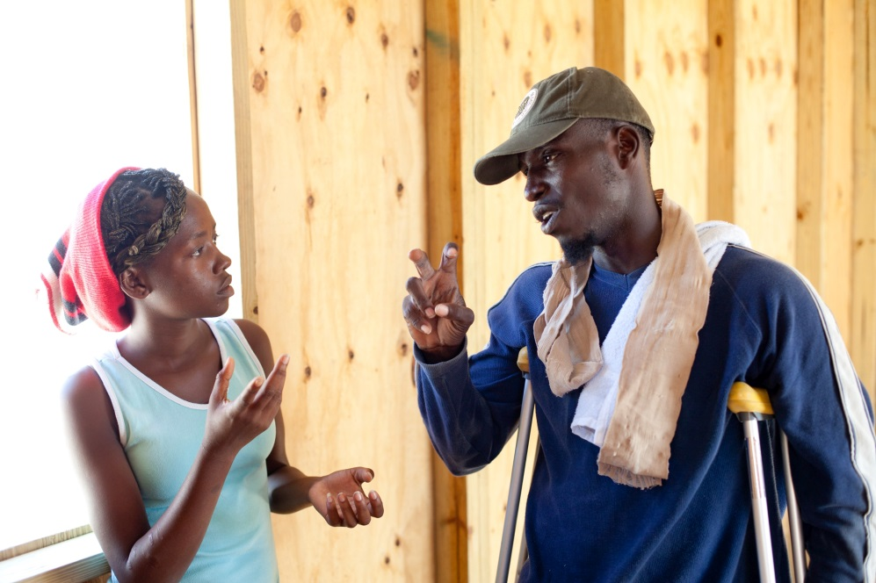
Basic elements of active listening
Maintain eye contact
Use clarifying statements and summarizing statements
Do not give opinions, argue or sympathize.
Use your own body language to convey your attention, and appropriate facial expression and words like ‘yes’, and ‘hmm,’ and ‘go on.’

Slide 15
What does inclusion mean in practice?
Including everyone, irrespective of race, gender, (dis)ability, health, socio-economic status, etc.
Making room for all to be part of society
Thinking “we” from the beginning; not “us” and “them.”
Using the inclusion spectrum model when implementing physical activities
Adapting activities responsive to the needs of all participants to ensure that everyone with different abilities has the opportunity to be part of the game or activity.

Slide 16
Inclusion through adapted physical activities
Sport offers a context for:
learning to play together
dealing with losing, winning and with competitiveness
building fitness and strength
facing challenges
overcoming barriers
boosting self-esteem
promoting empowerment
enhancing physical well-being.

Slide 17
Inclusion through adapted physical activities
Individual reflection:
Recall a time when you were participating in an activity and felt especially included, engaged or appreciated. What factors were helpful in promoting your inclusion?
OR
Recall a time when you felt especially excluded, alienated and unappreciated. What could have promoted your inclusion?

Slide 18
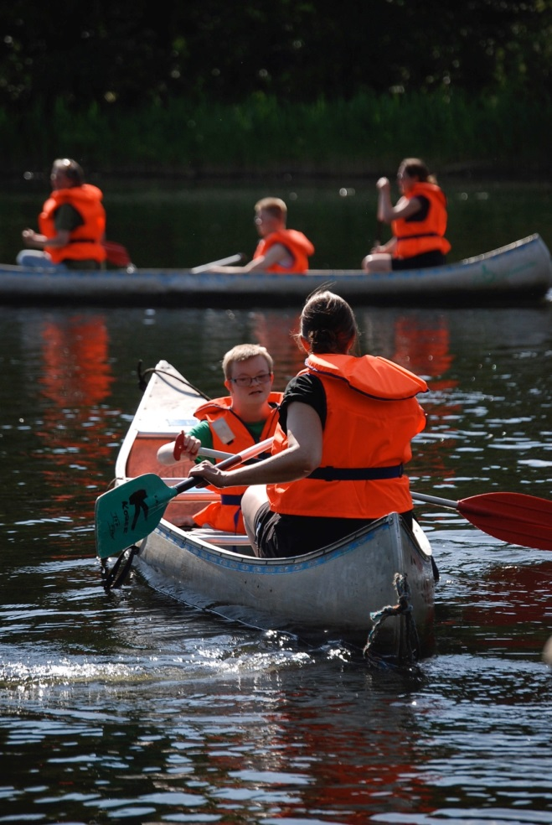
Inclusion through adapted physical activities
Discuss for 10 minutes:
How can facilitators promote inclusion for persons with disabilities when facilitating physical activities?
Note your suggestions on post-it notes (one suggestion per post-it note!)

Slide 19
Planning safe activities
You and your team decide to set up activities for a group. A priority is to keep everyone safe and healthy.
What types of risk do you need to consider?
What practical actions could be taken to prevent these risks?
What challenges related to gender and culture do you need to consider?

Slide 20
STEP adaptation model
Space
Increase/decrease size of the area
Vary the distances to be covered
Divide the field into different zones based on abilities
Task
Ensure equal participation
Break down complex skills
Give enough time to practise skills
Equipment
Increase/decrease size of the ball
Provide equipment that promotes participation
People
Match players of similar abilities in small teams
Balance team numbers according to the overall ability of the group

Slide 21
Adapting an activity using the STEP model
Group 1: Visual impairments + activity card 3
Group 2: Mobility impairments + activity card 10
Group 3: Cognitive impairments + activity card 11
Group 4: Hearing impairments + activity card 12

Slide 22
Adapting an activity using the STEP model
  Why should the activity be modified (e.g. do we want to make it easier, make it less competitive, make it more playful, foster more cooperation, etc.)?
  Could the activities activate unwanted feelings?
  How can facilitators make sure no one feels left out?
  How can all participants express their thoughts and ideas in the process?
  Should the game be competitive, focus strongly on teamwork, or perhaps empower individuals by learning new skills?
  Are there some moves or techniques that are not allowed or should be discouraged?
  How can participants support each other?
  What should the facilitator be aware of when communicating with the participants?
Write your notes on a flipchart and prepare a three-minute presentation on the modified activity.

Slide 23
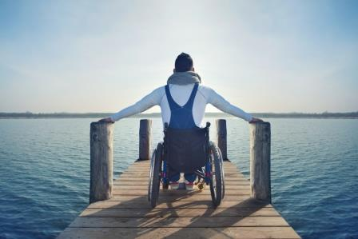
Wrap up and goodbye

