Slide 1


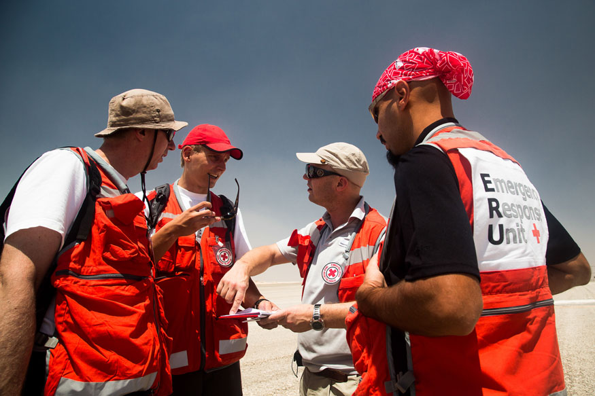
Caring for Volunteers: Training of Trainers
(NAME OF FACILITATORS)
(DATE)
(VENUE)

Slide 2
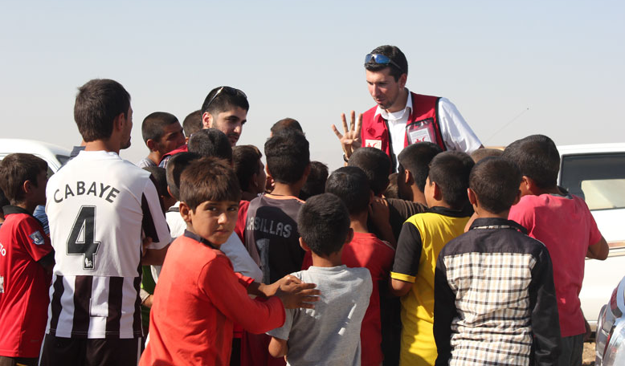
Welcome
An icebreaker to get to know one another
The training programme
Ground rules for the training

Slide 3
The training programme – day 1
09:00-10:00 | Welcome, introduction to the training programme and ground rules
10:00-10:30 | Organising a training workshop
10:30-11:00 | Creating a safe and inclusive learning environment
11:00-11:15 | COFFEE/TEA BREAK
11:15-11:45 | What makes a good facilitator?
11:45-12:15 | Different learning styles
12:15-13:00 | Training methods
13:00-14:00 | LUNCH
14:00-16:45 | Preparing a training session
16:45-17:00 | Wrap up

Slide 4
The training programme – day 2
09:00-09:45 | Opening the day, explaining the programme, structured feedback
09:45-10:15 | Group 1. Understanding psychosocial support
10:15-10:30 | Feedback session
10:30-10:45 | COFFEE/TEA BREAK
10:45-11:30 | Group 2. Risks, resilience and protective factors
11:30:11:45 | Feedback session
11:45-12:45 | Group 3. Self-care
12:45-13:00 | Feedback session
13:00-14:00 | LUNCH
14:00-14:45 | Group 4. Peer support
14:45-15:00 | Feedback session
15:00-15:15 | COFFEE/TEA BREAK
15:15-16:30 | Group 5. Psychological first aid
16:30-16:45 | Feedback session
16:45-17:00 | Wrap up

Slide 5
The training programme – day 3
09:00-09:15 | Opening the day, explaining the programme for the day
09:15-10:00 | Group 6. Setting up psychosocial support systems for volunteers
10:00-10:15 | Feedback session
10:15-10:30 | COFFEE/TEA BREAK
10:30-11:30 | Group 7. Setting up psychosocial support systems for volunteers
11:30-11:45 | Feedback session
11:45-12:45 | Group 8. Monitoring and evaluation
12:45-13:00 | Feedback session
13:00-14:00 | COFFEE/TEA BREAK
14:00-15:00 | Group 9. Communicating the message
15:00-15:15 | Feedback session
15:15-15:30 | COFFEE/TEA BREAK
15:30-15:45 | Developing an action plan
15:45-16:30 | Closing the ToT

Slide 6
Ground rules
Work in pairs:
Ask each other what helps to establish a good learning environment
Decide on one thing that you both think is important.
Write it on a post-it note.
Discuss your responses in plenary.

Slide 7
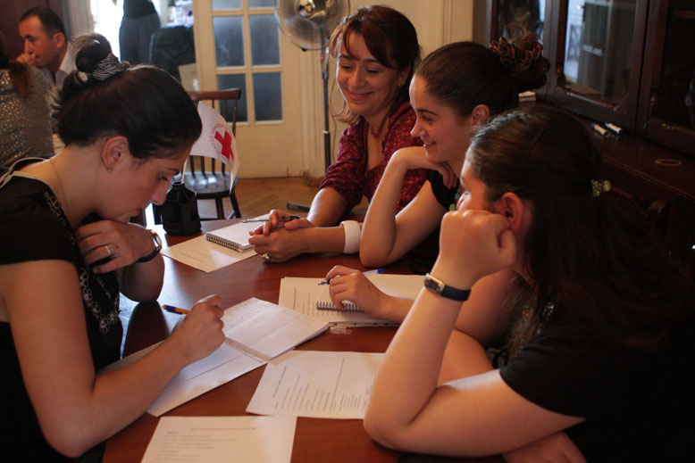
Organising a training workshop

Slide 8
The learning environment
What kind of learning experience have you most enjoyed ?
What needs to be in place for you to feel safe in a learning environment?
What do you enjoy most about being a trainer?
What situations would you like to be better at tackling as a trainer?

Slide 9
Creating a safe and inclusive environment
Set ground rules
Facilitate energizers and icebreakers
Use a buddy system
Do not probe participants’ experiences
Be aware of strong reactions:
  Give participants the necessary space to react and listen to what they say.
  Link the person up with another participant.
  If someone gets distressed, talk to all the participants about it, right after it has happened.

Slide 10
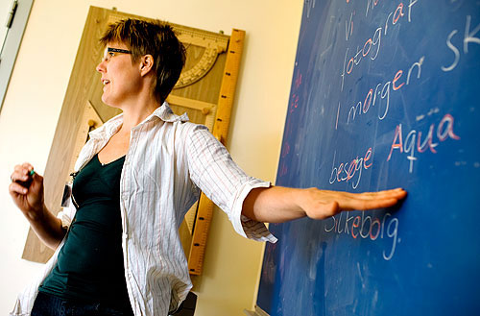
What makes a good facilitator?
In groups of three:
Think about what makes a good facilitator.
Now list all the functions they fulfil and the skills and qualities they may have.
Record your points
on post-it notes
(one point per
post-it).
Insert photo

Slide 11
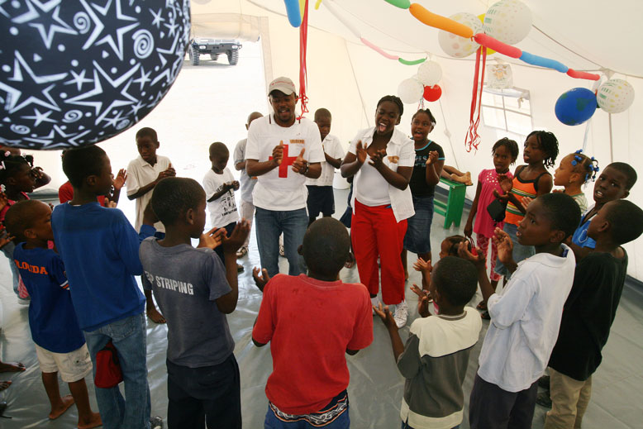
Learning styles
The three most common learning styles are:
Auditory
Visual
Kinesthetic
Insert photo

Slide 12
Training methods
Adults learn best in the following circumstances:
When the learning builds on their experiences
When the learning achieves identified goals
When the learning is relevant to their daily life or is meaningful for their future
When the learning can be put into effect immediately.

Slide 13
Different training methods
Spend 15 minutes brainstorming the different methods that would best suit each learning style:
  Group 1: Auditory methods
  Group 2: Visual methods
  Group 3: Kinesthetic methods

Slide 14
Preparing a training session
Group 1: Section 1: Understanding psychosocial support
Group 2: Section 2: Risks, resilience and protective factors
Group 3: Section 3: Self-care
Group 4: Section 4: Peer support
Group 5: Section 5: Psychological first aid
Group 6: Section 6.1: Support strategies at each phase
Group 7: Section 6.3: Developing support systems
Group 8: Section 7: Monitoring and evaluation
Group 9: Section 8: Communicating the message

Slide 15
Giving feedback
Keep these things in mind when giving feedback:
Let the person know what went well. For instance by saying: “It was really good when you did…”, “Doing … was a really good way of getting the groups’ attention”, “The way you did … was excellent!”
Let the person know what to do more of. For instance by saying: “Continue doing…”, “The way you … seems to work well. Keep doing that.”
Be specific and clear. Avoid general comments such as: “That was great.” Be specific: “It was great when you … because it showed you had prepared well.”

Slide 16
Receiving feedback
Keep these things in mind when receiving feedback:
Practise active listening: Keep your body language open and maintain eye contact. Don’t think about how you are going to reply, just listen.
Don’t argue - ask for clarification, if necessary: You may want to ask clarifying questions, but you should never start arguing with the person giving you feedback. You can say, for example, “Have I understood correctly that when I did …, you experienced that ...?”

Slide 17
Developing an action plan
Section 9 in the Caring for Volunteers Training Manual helps participants to:
define their goals for the next six months
identify the actions needed to achieve those goals
decide the deadline for each action
identify who is responsible for following up on each action.

Slide 18
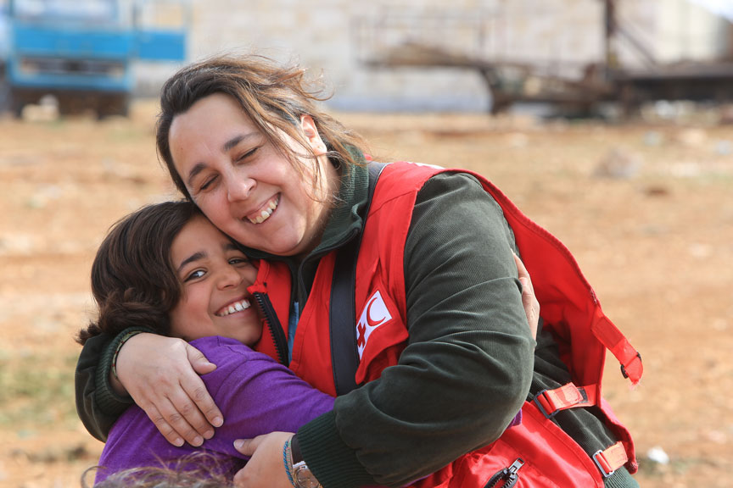
Wrap up and goodbye

