Slide 1


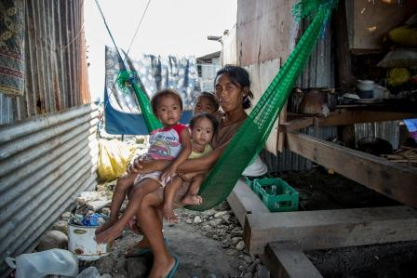
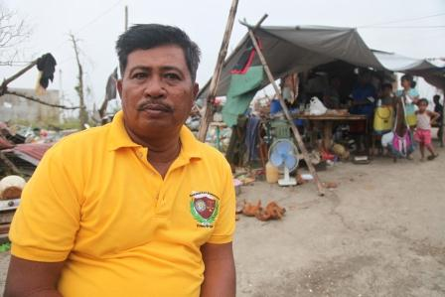
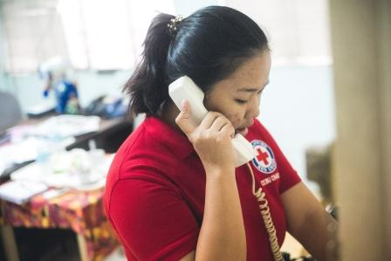
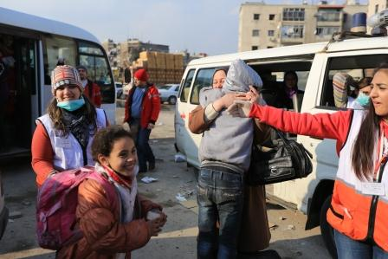
Welcome!
Broken Links: Psychosocial support for people separated from family members - Training module
Notes:
Upper left photo: Olav A/Danish Red Cross
Upper right photo: Patrick Fuller, IFRC
Bottom left photo: Jarkko Mikkonen/Finnish Red Cros
Bottom right photo: Ibrahim malla

Slide 2
Programme
09.00 - 09.30 Welcome and introduction
09.30 - 10.00 Session 1: Causes of separation
10.00 - 10.20 BREAK
10.20 - 11.00 Session 2: Consequences of separation
11.00 - 12.00 Session 3: Psychosocial impact of being separated
12.00 - 13.00 LUNCH BREAK
13.00 - 14.30 Session 4: How to support
14.30 - 15.00 BREAK
15.00 - 16.00 Session 5: Self-Care
16.00 - 16.30 Winding up the day

Slide 3
Learning objectives
The training will enable you to:
• understand psychological and social reactions to separation
recognize and support people who have been separated from family members with sensitivity and in line with local customs
take care of yourself in your work.

Slide 4
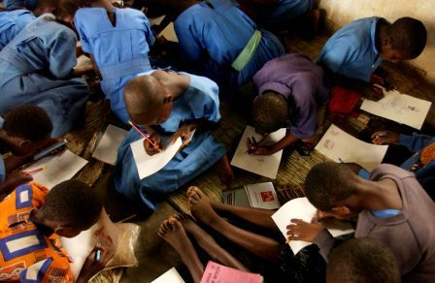
Ground rules
Notes:
Photo: Jacob Dall

Slide 5
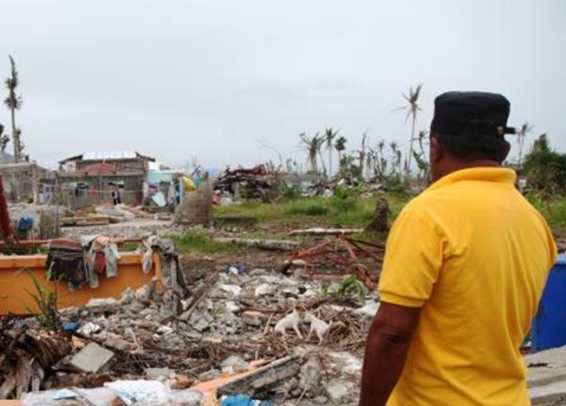
Session 1: Causes of separation from family members
Notes:
Photo: Patrick Fuller / IFRC

Slide 6
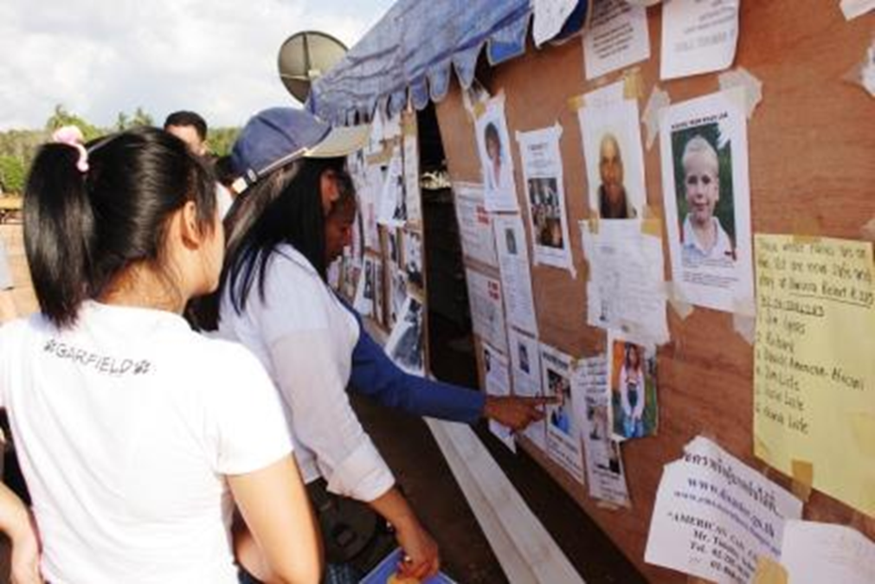
Possible causes for family members becoming separated (group work)
Spend ten minutes with the person next to you identifying the following:
Situations that can cause families and individuals to become separated
Notes:
Photo: IFRC

Slide 7
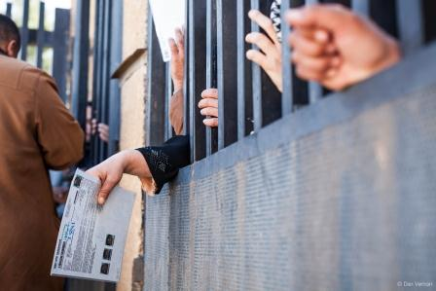
Causes of separation
Migration
Disasters – natural or man-made
Pandemics and epidemics
Armed conflict and other situations of violence
Imprisonment and detention
The death of a parent or close relative
Seeking refuge
Human trafficking.
Notes:
Photo: IFRC

Slide 8
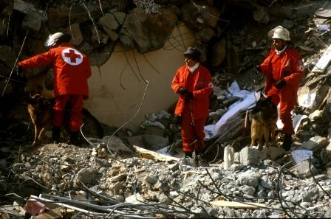
Survivors found after Turkish earthquake
(group work).
Identify in the article the following themes arising
from the disaster and sketch them on paper:
persons affected by the disaster
basic needs (health, food, shelter, etc.)
psychosocial consequences of the disaster
psychosocial support activities for affected persons
psychosocial support activities for aid and rescue workers.
Notes:
Photo: IFRC

Slide 9
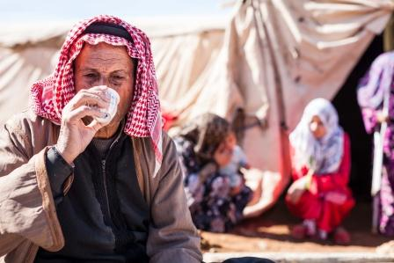
Break
Notes:
Photo: IFRC

Slide 10
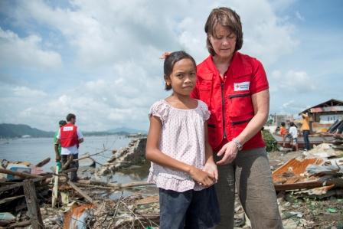
Session 2: Consequences of separation from family members
Notes:
Photo: IFRC

Slide 11
Consequences of separation for different groups (group work)
Spend fifteen minutes with your group discussing the following:
What might be some of the reasons behind the separation from family
members for your group (i.e. children, women or men)?
What is particular about the consequences of separation for this group?
Write down your answers on the post-it notes, one reason per post-it.

Slide 12
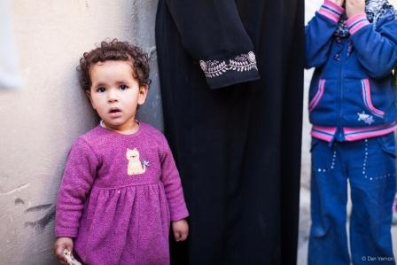
Consequences of separation for children
Separation from parents can cause:
loss of sense of self
loss of sense of security
loss of protection
complicated reactions and feelings
insecurity due to not knowing if one’s parents are alive or dead.
Notes:
Photo: IFRC

Slide 13
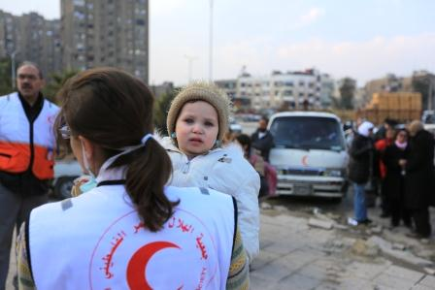
Unaccompanied minors
Unaccompanied minors without adult or parental protection are:
dependent on external assistance with regard to their human rights
at risk for sexual violence, abuse, exploitation or recruitment into armed forces.
Notes:
Photo: Ibrahim Malla / IFRC

Slide 14
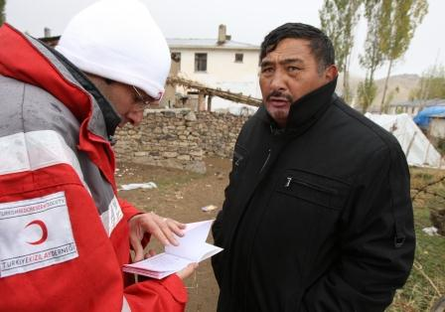
Consequences of separation for men
Men report a range of reactions and feelings such as:
Frustration
Powerlessness
Anger
Desperation
Denial, loneliness
Sadness
Isolation
Shock.
Men are often left alone with the responsibility for housekeeping and child-rearing, which may contribute to these feelings.
Notes:
IFRC

Slide 15
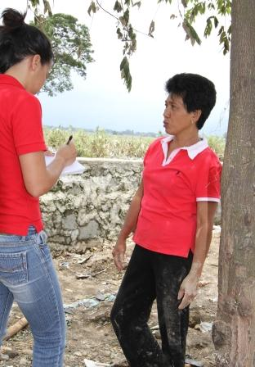
Consequences of separation for women
Women left alone are:
more at risk for and vulnerable to violence
more at risk for sex trafficking
often disconnected from their community
stigmatized, haunted by guilt and shame
often feeling that the situation is their own fault.
Notes:
Photo: Edison Enriquez / PRC

Slide 16
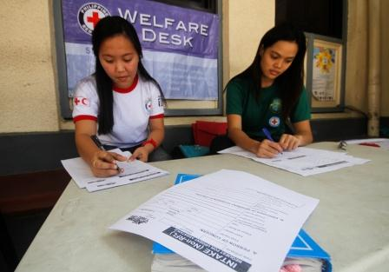
Secondary separation
Occasionally, medical evacuations and transfers
in emergencies lead to ‘secondary
Separations,’ which occur when people cannot
be traced in the system of being transferred
between health and/or other services in
emergencies.
Have any of you experienced this problem?
How did you deal with it?

Slide 17
Secondary separation
Accurate records are crucial to avoid secondary separation.
Inform health staff of the risks of secondary separation.
Take accurate records of all patients on arrival, as far as the situation allows.
Record all transfers, including departure and arrival points, as well as the details on individuals transferred and the team performing the transfer.
Record all deaths, including unidentified persons who have died in medical facilities, including their place of burial.
Notes:
Photo: IFRC

Slide 18
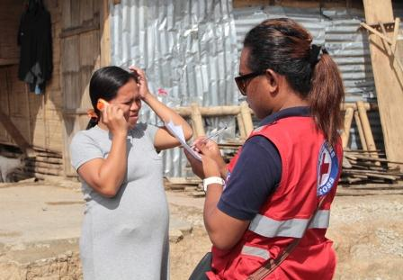
Summary
Staff and volunteers
Children
Parents
Unaccompanied minors
Men
Families
Women
Women seeking jobs as domestic workers or as factory workers
Notes:
Photo: Nichola Jones/IFRC

Slide 19
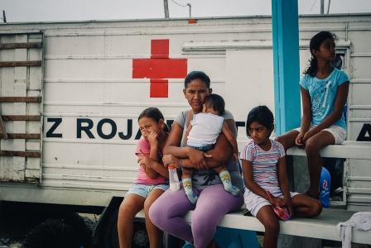
Session 3: The psychosocial impact of separation from family members
Notes:
Photo: IFRC

Slide 20
Psychosocial support
The term ‘psychosocial’ refers to the interconnection between psychological and social aspects of human life.

Slide 21
The psychosocial support pyramid

Slide 22
The psychosocial impact of separation
Reactions to loss and separation vary for individuals, families and communities,
depending on personal resilience, social support and cultural values.
Some of the impacts that can be felt are:

Slide 23
The psychosocial impact of separation

Slide 24
The psychosocial impact of separation
Avoidance / Withdrawal
Lack of interest in social activities
Emotional isolation / Inability to engage emotionally
Distress / Uncertainty / Anxiety
Undefined social status
Difficulties in communicating with the rest of the family
Place the words below in the circles where they belong
Refusal to accept loss
Stigma
Guilt / Self-accusation / Anger
Disagreements over the fate of the missing person
Absence of rituals
Gaps in personal / family story
Swinging between hope and despair
Challenges with changed roles

Slide 25
Psychosocial impact of separation
The psychosocial impact of separation

Slide 26
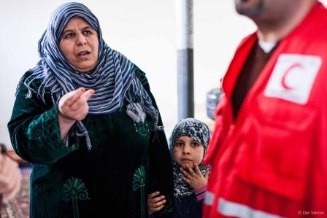
Ambiguous loss
Ambiguous loss:
is defined as the absence of a loved one, where the individual’s situation, location and condition are unknown.
generally refers to situations where people have gone missing and are therefore physically absent, but psychologically present, meaning that their families still actively seek and/or think about them.
Notes:
Photo: IFRC

Slide 27
Death and Disappearance (group work)
In groups of three sort the following into the two categories: death and disappearance
Evidence
Rituals (e.g. funeral, witnesses of loss)
Possibility of social stigmatization, isolation and vulnerability to violence
New social role
Clear outcome / ending of a relationship
Clear start to grieving process
No stigma – death is natural part of life
Uncertainty of outcome
Only open question with no answers
No evidence of death or life
No rituals
Ambiguous situation (search, wait or move on?)
Unclear social role (i.e. wife or widow?)
No social or religious norms
Notes:
Photo: Patrick Fuller/IFRC

Slide 28
Grief
Grief
is a normal psychological reaction to loss of any kind
is a natural but painful process that allows the affected person to release the pain associated with what has been lost
involves a process of acceptance and adjustment, leading to a stabilization of emotion and routine, and a turning to the future and moving on.
It is important to keep in mind that the objective of the grieving process is not to forget the missing or deceased person, but to remember him or her in a way that causes less pain.
Notes:
Photo: Patrick Fuller/IFRC

Slide 29
Supporting people in their grief
Supporting people in their grief needs to be adapted to each individual situation and
to the specific cultural frame of reference. It is crucial to allow people to react in their own
way to what they have lost.
Their reactions will be influenced by a number of factors:
their relationship to the lost person
the circumstances of the loss
their own character traits
the social and cultural environment.
Notes:
Photo: Patrick Fuller/IFRC

Slide 30
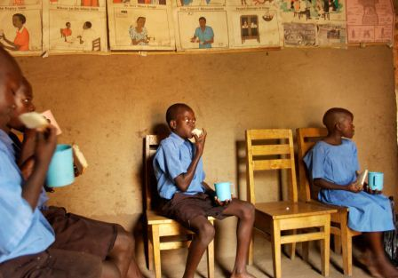
Lunch break
Notes:
Photo: Jacob Dall

Slide 31
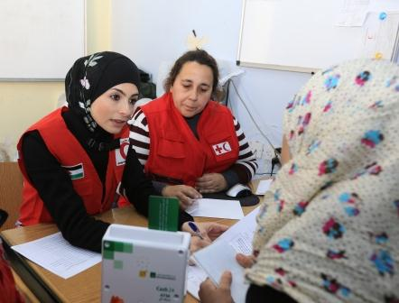
Session 4: Supporting people who have been separated
Notes:
Ibrahim Malla / IFRC
ATM cards distribution to families in need at the Jordan Red Crescent vocational center in Amman. volunteer of Jordanian Red Crscent with an International Federation Delegate are talking to a syrian refugee woman with her child.

Slide 32
Basic helping skills
keeping questions focused on what needs to be known
reassuring families that their reactions are normal and understandable, given the circumstances
providing options for participating in activities that can distract them from disturbing thoughts and feelings for a while.
using supportive communication
providing a consistent member of staff or volunteer for contact with a family, if at all possible
giving clear explanations of the process and possible outcomes
keeping information confidential where appropriate
treating people with respect and dignity

Slide 33
Basic helping skills
Staff and volunteers can support families by:
Recognizing and naming the situation as ambiguous loss
normalising stress levels, confusion and sense of hopelessness
creating opportunities for families to talk about the missing person
looking for ways of rebuilding roles in the family and creating rituals to commemorate the missing person.
Notes:
Photo: Jarkko Mikkonen/Finnish Red Cross
Philippines, November 2013. Typhoon Haiyan struck Philippines 8th November, 2013. PRC Cebu chapter staff April Erames answering calls from people who are trying to reach their missing family members.

Slide 34
Practising support (group work)
In this activity you will be doing a role play in groups of three people.
Read the scenario and divide the following roles between you:
a helper
a person who is separated from a loved one
an observer.
Use basic helping skills and the pointers given in the previous slide to help support the person in their uncertainty.
Spend 10 minutes doing the role play
Spend 10 minutes answering the questions for feedback

Slide 35
Questions for feedback
What basic helping skills were used?
What examples were there of supporting the person in their uncertainty? (naming, normalising, creating opportunities, rebuilding roles, commemorating)
What was done well?
What could have been done better?

Slide 36
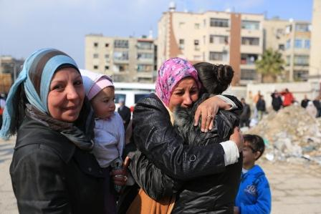
Reunification
Re-establishment of contact
Identity and kinship
Mutual consent
Assessment of best interests
Primacy of safety
Logistical support
Authorization of the authorities.
Notes:
Photo: Ibrahim Malla/IFRC
Joint mission of the first aid squads of the Syrian Arab Red Crescent from Damascus branch and the Palestinian Red Crescent to evacuate 261 persons, children, women, old and sick people from the Palestinian Camp of Yarmouk in Damascus, which is under siege. The operation is the 6th evacuation of the camp, the evacuated persons are 870 in total and they were accompanied to the hospital or to their relatives houses in Damascus. Members of a family, who were separated for a long time, are happy to meet again after the evacuation.

Slide 37
Break
Notes:
Photo: IFRC

Slide 38
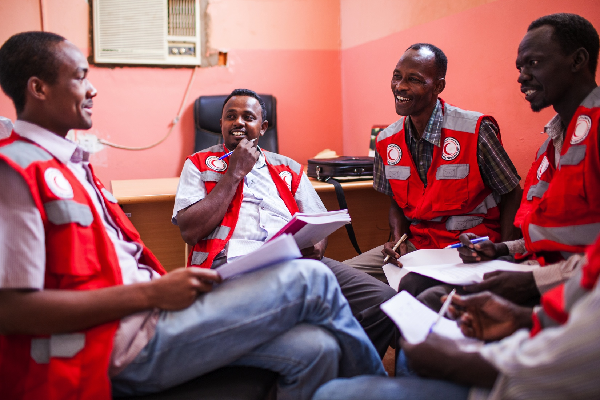
Session 5: Self-care
Notes:
Photo: SARC

Slide 39
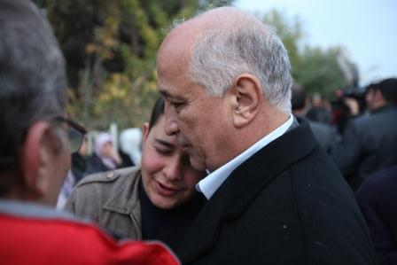
Delivering news (individual work)
Imagine you are in a situation where you have to tell someone that a person close to them has died.
Think about how to deliver the news and write down the actual sentences you would use when delivering distressing news.
Notes:
Photo: Turkish Red Crescent

Slide 40
Do
• Mention the person who has died and acknowledge an awareness of the loss.
• Remember that grieving is a process and that the person or family will need support long after the event has passed.
• Listen to the grieving person.
Validate feelings: “This is clearly a shock to you,” “I understand that this is very upsetting news for you.”
• Keep eye contact, show warmth and compassion.
• Speak calmly and slowly.
• Allow the families time to react; do not be afraid of silence.

Slide 41
Don’t
• Don’t suggest replacing the person that is lost, by saying, for example, “You can have another baby.”
• Don’t use clichés such as, “Time heals all wounds,” “It will soon pass,” etc.
• Don’t compare the way one person grieves with another.
Don’t encourage the grieving person to make any big life changes.
• Don’t give advice or lecture the grieving person.
• Don’t try to change the subject when the person is crying or wants to talk about the person who has died.

Slide 42
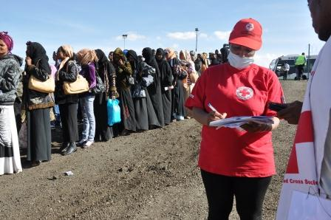
Stress on staff and volunteers (group work)
Look at the case study and discuss the
following questions in groups of three or four:
• What sources of stress for the staff member or volunteer do you see in this situation?
• If you wish, share examples of stress that you have experienced.
Notes:
Photo: Berhanu Gezahegn/Ethiopia Red Cross Society

Slide 43
Causes of stress reactions in staff and volunteers
• non-existent job descriptions
• poor preparation and briefing
• lack of boundaries in work
• lack of support or acknowledgement from management
harsh working conditions related to the nature of the crisis event
• ethical dilemmas arising at work
• long assignments / missions (causing staff or volunteers to be away from home for long periods of time).

Slide 44
Support for staff and volunteers
Each person’s response to stress is influenced by many different factors, including:
the nature and severity of the crisis event
personality and personal history
available support systems.
Emotional stress among volunteers and staff should never be an individual
responsibility. National Societies can create conditions that foster resilience in
individuals and teams.

Slide 45
Support for staff and volunteers
National societies can create conditions that foster resilience by:
encouraging reasonable working conditions through policies and strategies
providing accessible guidance and support from managers and peers
normalizing responses
providing psycho-education regarding emotionally stressful work
creating an organizational culture where people can talk openly and share problems respecting the principle of confidentiality, and where getting together after a critical event is the norm
arranging regular meetings which bring all staff and/or volunteers together and foster a feeling of belonging to a team.

Slide 46
Self-care reminders
Focus on routine tasks
If you feel overwhelmed by the situation or your duties, try focusing on simple tasks and routines.
Communicate with others
Let peers and supervisors know how you feel and be patient with yourself.
Talk about your experiences and feelings (even those that seem frightening or strange) with colleagues or a trusted person.
Talking with someone about your thoughts and feelings may help you to process the event and come to terms with any unpleasant experiences.
Listen to what others say about how the event has affected them and how they cope; they may share useful insights.
Keep in touch with loved ones.

Slide 47
Self-care reminders
Take care of your own body and mind
Get enough rest and sleep. If you have sleep difficulties or feel anxious, avoid caffeine, especially before bedtime.
Consciously try to relax by doing things you enjoy, like meditation or yoga.
Limit your intake of alcohol and tobacco.
Exercise to relieve tension, eat healthy foods and keep regular meal times.
Play and take time for fun
Express your feelings through creative activities, like drawing, painting, writing or music.

Slide 48
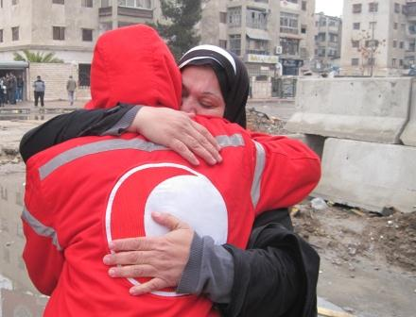
Winding up the day
Notes:
Photo: Mahmoud Qwder / SARC

